Slide 2
The Good, The Bad, and The Ugly Title
Is Good Title Marketable?
Greg Nibert
Melinda Branin
Hinkle Shanor LLP
Roswell, New Mexico

Slide 3
Risk
Resource risk
Access risk
Market risk
Political risk
Domestic
International
Title risk

Slide 4
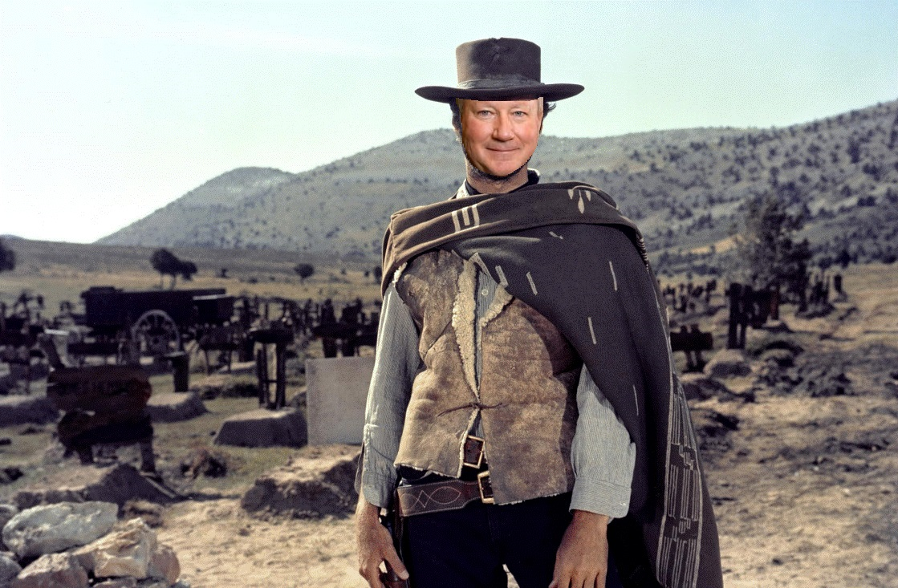
Marketable Title
Definitions Marketable title
Merchantable title
Good title
Defensible title
Unmarketable title
Bad title
Ugly title
Perfect title?

Slide 5
Does it Matter?
Receive the bargained for interest from the Seller
Are you really concerned with the legal status of title or something else?
Risk
Risk Tolerance
Due Diligence Review

Slide 6
Acquisition
Fee Minerals
Leasehold
Other Interests
Overriding Royalty Interests
Contractual

Slide 7
Drilling
Trespass
Spacing
Surface Issues and Agreements

Slide 8
Division Order
Who owns production
More concern for title defects
Size of Interest
Amount involved

Slide 9
Purchase and Sale Agreements
Quality of Title to be delivered at closing should be spelled out
Care should be taken in drafting – should not rely on the definition
Marketable Title
Defensible Title

Slide 10
Dormant Mineral Acts
Model Dormant Mineral Interests Act
Connecticut and Washington (1987)
Dormant Mineral Interests Acts
California, Georgia, Illinois, Indiana, Iowa, Kansas, Kentucky, Louisiana, Maryland, Michigan, Minnesota, Nebraska, New York, North Carolina, North Dakota, Ohio, Oregon, South Dakota, Tennessee, Virginia, West Virginia, Wisconsin

Slide 11
Marketable Title Acts
Marketable Title Acts
California, Connecticut, Florida, Illinois, Indiana, Iowa, Kansas, Michigan, Minnesota, Nebraska, North Carolina, North Dakota, Ohio, Oklahoma, Rhode Island, South Dakota, Utah, Vermont, Wisconsin, Wyoming
Title Standards
Texas, Oklahoma, North Dakota, Michigan, Louisiana, Arkansas, Colorado…

Slide 12
Title Failures
Curative Instruments
Stipulations
Disclaimers
Correction Instruments
Affidavits
Letter or Memoranda
Lawsuit
Probate
Quiet Title

Slide 13
Sleeping Dogs

Slide 14
Meeting Expectations
Understand the goal
Understand the risk tolerance
Clearly articulate expectations
Have mechanisms to deal with title that does not meet the standard set forth
Time -- Costs -- Procedures
Terminate the agreement

Slide 15
THE END

Slide 16
