Slide 2

Intrepid Financial Partners – Leading Energy-Focused Merchant Bank
Intrepid was founded by Skip McGee and Chris Winchenbaugh in May 2015
  ~50 professionals with a presence in both Houston and New York
  Solely focused on the energy sector – across traditional energy & energy transition
Energy-Focused Merchant Bank
Intrepid Partners, LLC
Advisory
Intrepid Investment Management, LLC
Investing
Best-in-Class Energy Advisory Platform
Highly Experienced Investment Team
Expertise across all major sub-sectors and products:
  Upstream, Midstream, Downstream, Oilfield Services, Energy Transition / Sustainability
  M&A, A&D, Restructuring / Liability Management, Capital Markets
Advised on over $200 billion worth of transactions since inception
Deep institutional knowledge and relationships
Joint Ventures with Rothschild & Co (Restructuring) and Cowen & Company (Capital Markets)
Seasoned investment team with over 100 years of experience
Expertise across all energy sub-sectors (Upstream, Midstream, Downstream, Oilfield Services), Infrastructure and Energy Transition / Sustainability
Experience investing through multiple cycles
1

Slide 3





































Demonstrated Success in Complex Transactions
Since inception in mid-2015, Intrepid has advised on over $200 billion worth of transactions
M&A / Advisory
Capital Raising
Restructuring
$2.1 Billion
Undisclosed ⁽¹⁾
$1.29 Billion
$52 Million
Undisclosed
$300 Million
~$526 million
Business Combination with
Acquisition of
Acquisition of
Growth Equity Capital Raise in
Convertible Term Loan with
Financial Advisor to the Special Committee of the Board of Directors of Crescent Energy
Financial Advisor to Revenir on sale of Northern Midland, Twin City, Delaware and East Texas Assets
Chapter 11 Restructuring
Financial Advisor to Sable Offshore Corp.,
Joint Placement Agent on Private Placement
Financial Advisor to Talos Energy Inc.
Exclusive Financial Advisor to the Company
Financial Advisor to Ecotec
Financial Advisor to Calumet Specialty Products Partners
Financial Advisor to the Ad Hoc Group of Unsecured Noteholders
2024
2024
2023/2024
2024
2024
2022
2021
2023
$7.1 Billion
$500 Million⁽²⁾
$1.5 Billion
$1.1 Billion
$2.05 Billion
$750 Million
$22 Million
$1.8 Billion
Repurchase of Class B Units from
Acquisition of
Sale of
Sale of the Company to
Private Unsecured Term Loan Agreement with
Financial Advisor to the Conflicts Committee of the Board of Directors of the General Partner of HESM
to
Issuance of Senior Secured Notes
Private Investment in Public Entity
Chapter 11 Restructuring
Lead Financial Advisor to Crestwood
Financial Advisor to The Conflicts Committee of the Board of Directors of HEP’s General Partner
Financial Advisor to Buckeye Partners
Financial Advisor to
NGL Energy Partners LP
Financial Advisor to
NuStar Energy
Placement Agent
Financial Advisor to the First Lien Term Loan Lenders
2023
2023/2024
2023
2023
2021
2020
2019
2021
$1.96 Billion
The Hamm Family
$1.1 Billion
$579 Million
$53 Million
$56 Million
$35 Million
$10.8 Billion
Acquisition of All Outstanding Publicly-Owned Unaffiliated Common Units of
Acquisition of the
Unaffiliated Shares of Common Stock of
Sale of Company to
Acquisition of All Outstanding Publicly-Owned Unaffiliated Common Units of
Private Investment in Public Entity
Preferred and Common Stock
Common Equity Offering
Chapter 11 Restructuring
Financial Advisor to
SHLX Conflicts Committee
Exclusive Financial Advisor to
The Hamm Family
Intrepid served as Exclusive Financial Advisor to EnVen Energy Corporation
Financial Advisor to
PBFX Conflicts Committee
Placement Agent
Joint Book-Running Manager
Joint Book-Running Manager
Financial Advisor to
Chesapeake Energy
2022
2022
2022
2022
2019
2019
2018
2021
Four separate transactions.
Five separate, $100mm transactions.
2

Slide 4
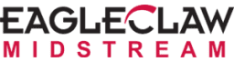



We Have Done Some of the Most Important Recent Energy Transactions
Selected M&A / Advisory Transactions
$7.1 Billion
$1.1 Billion
The Hamm Family
Acquisition of the
Unaffiliated Shares of Common Stock of
Sale of the Company to
Lead Financial Advisor to Crestwood
Intrepid served as Exclusive Financial Advisor to EnVen Energy Corporation
Exclusive Financial Advisor to
The Hamm Family
2023
2023
2022
Largest G&P transaction in 2023
Largest GOM M&A transaction since 2019
Largest Upstream take-private in U.S. History
$9 Billion
$10.8 Billion
$10.3 Billion
Acquisition of
All-Stock Merger with
Sale of the Company to
Financial Advisor to EagleClaw Midstream
Chapter 11 Restructuring
Financial Advisor to Chesapeake
2021
2020
Co-Financial Advisor to Buckeye Partners
2019
Formation of the largest integrated Midstream in the Delaware Basin
Largest oil & gas bankruptcy
in 20 years
Largest Midstream take-private since 2007
3

Slide 5
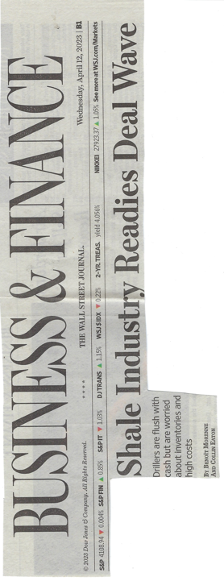
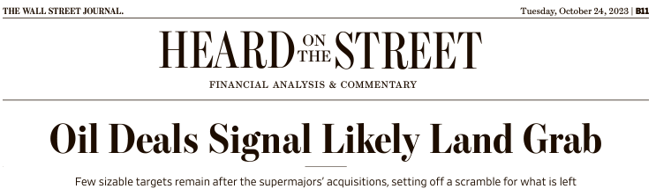




Current State of Upstream Energy
“The Oil And Gas Industry Is Undergoing Its Biggest-ever Consolidation”
(January 23, 2024)
“Oil & Gas Deals Are Powering the Global M&A Engine”
(February 12, 2024)
“After Record Year, Permian Basin Set for Even More M&A in 2024”
(December 28, 2023)
“Big Oil Enters 2024 Strengthened By U.S. Industry Consolidation”
(December 26, 2023)
4

Slide 6
Thoughts on U.S. Oil and Natural Gas Demand
Drivers / Questions
EIA World Energy Consumption Forecast⁽¹⁾
(quadrillion British thermal units)
Global GDP Growth
Oil and Natural Gas Demand Projected to Grow Through 2050
Pace of “Energy Transition”
Russia / Ukraine
Middle East Turmoil
OPEC Production Cuts
Data Centers
And About 45 Other Things…
Fears of Oil and Natural Gas Demand Going Away in the Near-Term Have Subsided
Reflects data from U.S. Energy Information Administration (“EIA”) October 2023 International Energy Outlook.
5

Slide 7
Consolidation Waves in the Upstream Sector Since the Mid ‘90’s
M&A Over $5bn in Value
1
2
Resource scarcity and increased competition from the ‘shale boom’ drive dealmaking
Focus on ‘sustainable’ return of capital to investors
3
“Formation of the supermajors”
Total Transaction Value ($bn)
WTI ($/Bbl)
Note: Market data as of June 7, 2024.
Source: FactSet, Enverus.
6

Slide 8
The Third Wave is Underway – Key Themes
Resource replacement needed
  Majors have limited “growth” assets left in portfolio
  Independents need to extend duration of asset base
Scale is preferred by public investors
  Lower cost of capital
  Trading liquidity gives ability to get in / out of stocks
Shareholder returns / free cash flow
  Synergies drive real value
  Accretion to dividend and buyback programs
Shale increasingly a ‘big boy game’
  Large companies have the engineering discipline, purchasing power and long-term focus to excel at the “manufacturing” of reserves required in the shale plays
Energy Transition investor headwinds
  Concerns over demand rollover and “green energy” replacement of fossil fuels abated for now but still relevant
  Is natural gas eventually acknowledged as a ‘bridge fuel’?
1
2
On the Menu?
3
4
5
7

Slide 9





























Changing Landscape of U.S. Upstream Companies
75% of the top 20 companies have done a significant transaction since 2021
Market Value ($bn) (1/1/2021)
(9)
Combined Mkt. Cap.: $531bn
Merged / Acquired / Taken-Private
Current Market Value ($bn) (Pro Forma for Recent Acquisitions)
Combined Mkt. Cap.: $1,379bn
Stock Price Increase % :
(1)
174% | 85% | 180% | 141% | 244% | 293% | 196% | 219% | n.a. | 69% | 232% | 923% | 356% | 103% | 524% | 442% | 381% | 250% | 228% | 668%
Notable Merger Counterparties & Companies Acquired Since 2021
(Permian)
Note: Market data as of June 7, 2024.
Chesapeake shares were delisted in June 2020 during CHK’s Chapter 11 proceedings; resumed trading in February of 2021.
8

Slide 10
Larger Upstream Companies Trade at Significant Premium
Enterprise Value / 2024E EBITDA (x)
(CVX, XOM)
(COP, EOG, OXY)
>$10bn
$3-10bn
<$3bn
2024E Free Cash Flow Yield (%)
(CVX, XOM)
(COP, EOG, OXY)
>$10bn
$3-10bn
<$3bn
Note: Market data as of June 7, 2024. Values represent the median of each group. Gas-Focused E&Ps include: AR, CHK, CNX, CRK, EQT, GPOR and RRC. Large-Cap Independents include public E&Ps with a market capitalization greater than $10bn. Mid-Cap Independents include public E&Ps with a market capitalization between $3bn – $10bn. Small-Cap Independents include public E&Ps with a market capitalization less than $3.0bn and greater than $500mm.
Source: FactSet, public disclosures, Wall Street research.
9

Slide 11


Permian Continues to Attract the Most Attention, Because It Has The Best Resource
Key Basin Commentary
M&A Since 1/1/2023 By Basin
“From 4Q17 to 4Q23 the Permian has grown from ~45% to ~65% of total US shale oil production. We view the Permian as the last growth basin in L48 and has accounted for ~80% of oil growth in the past two years.”
April 5, 2024
Permian
Multi Region
Bakken / DJ
“By gaining scale in the Permian, acquiring companies are positioning themselves for many years of highly efficient and highly profitable production in one of the world’s most attractive hydrocarbon plays.”
January 10, 2024
93% Oil Deals;
Total Value: $269bn
Eagle Ford
Haynesville
Gulf of Mexico
Mineral
About 80% of the remaining Tier 1 drilling locations throughout the entire basin, including all benches of the Midland and Delaware basins, are held by a small number of companies with a market cap of over $30 billion... That inventory scarcity is driving up prices for acreage and production in the Permian."
December 28, 2023
Other
SCOOP/STACK/Mid-Con
Note: Market data as of June 7, 2024. Analysis includes only U.S. transactions with a value greater than $100mm.
Source: FactSet, public disclosure, Wall Street research.
10

Slide 12









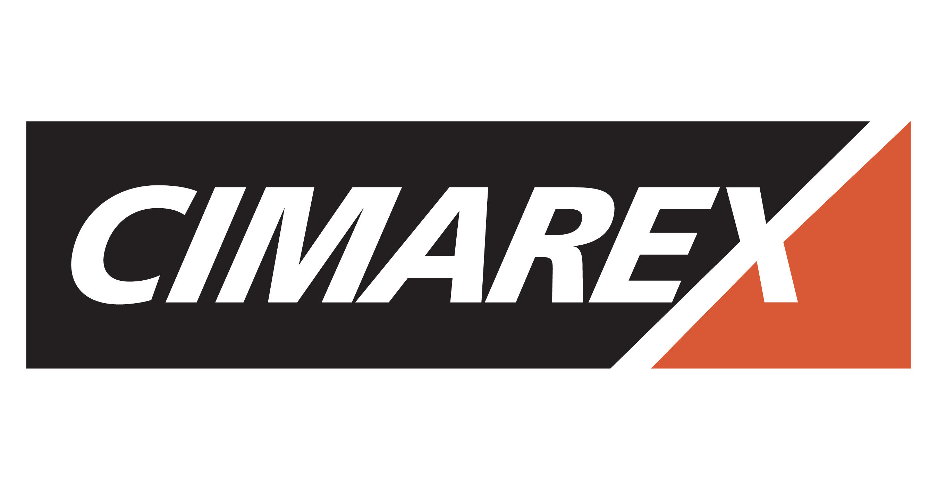







Equity Investors Have Been Supportive of Low Premium Consolidation
Recent Transactions
Average 1-Day Premium Paid: 10.2%
(2)
(1)
Premium Paid to
Unaffected Price
1-Week Price Performance Buyer vs. XOP
Buyer:
Seller:
Transaction
(3)
Note: Market data as of June 7, 2024. Analysis reflects select corporate transactions since 2021 with U.S. targets.
Unaffected represents SWN and CHK closing prices on October 16, 2023 prior to Bloomberg article on October 17, 2023.
Based on 3/12/2024 unaffected date of Kimmeridge’s offer to acquire SilverBow.
Note: Market data as of June 7, 2024. Analysis reflects select corporate transactions since 2021 with U.S. targets.
Unaffected represents ERF closing price on February 9, 2024 prior to articles surrounding DVN / ERF acquisition rumors.
Based on 3/12/2024 unaffected date of Kimmeridge’s offer to acquire SilverBow.
SBOW shareholders have the option to receive a cash portion up to total cash consideration of $400mm.
Source: FactSet, public disclosure, Wall Street research.
11

Slide 13
What’s Next?
Upstream consolidation will continue
Majors will be active
Independents need to be bigger to compete
Companies will divest non-core assets post-transactions
“Smart” private money will continue to seek opportunities to invest in growth areas where they can be more nimble than the larger public companies
Private Equity
Hedge Funds
Family offices
Commodity Traders and others
12

Slide 14
Disclaimer
This document has been prepared by Intrepid Partners, L.L.C. (“Intrepid”), member FINRA and SIPC, for informational purposes only. You should not rely upon or use it to form the definitive basis for any decision or action whatsoever, with respect to any proposed transaction or otherwise. This document and any oral information provided in connection with this document, as well as any information derived by you from the information contained herein, is confidential and is for the intended recipient and cannot be redistributed, reproduced, disclosed or transmitted without prior written permission from Intrepid. If you are not the intended recipient of this document, please delete and destroy all copies immediately.
Prices shown in this document are indicative only and Intrepid is not offering to buy or sell, or soliciting offers to buy or sell any financial instrument. This document is “as is”. Unless otherwise specified, the source for all graphs, charts, and other information is Intrepid. Intrepid’s databases are derived from various internal and external sources. Intrepid’s use of any information from external sources does not imply that it has independently verified or necessarily agrees with any of such information, and Intrepid has assumed and relied upon the accuracy and completeness of such information for purposes of this document. Neither Intrepid nor any of its affiliates or agents represents or warrants, expressly or impliedly, that the information provided herein, or any oral information provided in connection herewith, or any data it generates, is accurate or complete, and it should not be relied upon as such. Intrepid and its affiliates and agents expressly disclaim any and all liability (whether direct or indirect, in contract, tort or otherwise) in relation to any of such information or any errors or omissions therein. Any data on past performance, modeling or back-testing or any other information contained herein is no indication as to future performance. No representation is made as to the reasonableness of the assumptions made within or the accuracy or completeness of any modeling or back-testing or any other information contained herein. All levels, prices and spreads are historical and do not represent current market levels, prices or spreads, some or all of which may have changed since the issuance of this document. All opinions, terms and estimates contained herein are preliminary and are based on financial, economic, market and other conditions prevailing as of the date hereof and are subject to change. Intrepid assumes no obligation or responsibility to update any of the information contained in this document to reflect any such changes. The value of any investment may fluctuate as a result of market changes. The information herein is not intended to predict actual results and no assurances are given with respect thereto. Nothing herein shall be deemed to constitute investment, legal, tax, financial, accounting or other advice.
Intrepid and/or its affiliated companies may make a market or deal as principal in the securities mentioned in this document or in options or other derivatives based thereon. Intrepid may be on the opposite side of any orders executed for securities or financial instruments that are related to or the subject of this material. In addition, Intrepid, its affiliated companies, shareholders, directors, officers, and/or employees, including persons involved in preparation or issuance of this material, may from time to time have long or short positions in such securities or financial instruments, or in options, futures, or other derivative instruments based thereon. Intrepid and its affiliates and their respective officers, directors, partners and employees, including persons involved in the preparation or issuance of this document, may from time to time act as manager, co-manager, arranger or underwriter of an offering or otherwise, in the capacity of principal or agent, transact in, hold or act as market-maker or advisor, broker or commercial and/or investment banker in relation to the securities, instruments or related derivatives which are the subject of this document.
This document does not constitute nor does it form part of an offer to sell or purchase, or the solicitation of an offer to sell or purchase, any securities or instruments or an offer or recommendation to enter into any transaction described herein nor does this document constitute an offer or commitment to provide, syndicate, arrange or underwrite any financing, underwrite or purchase or act as an agent or advisor or in any other capacity with respect to any transaction, or commit capital, or to participate in any trading strategies, and does not constitute legal, regulatory, accounting or tax advice to the recipient. This document does not constitute and should not be considered as any form of financial opinion or recommendation by Intrepid or any of its affiliates. This document is not a research report nor should it be construed as such.
IRS Circular 230 Disclosure: Intrepid and its affiliates do not provide tax advice. Please note that (i) any discussion of U.S. tax matters contained in this communication (including any attachments) cannot be used by you for the purpose of avoiding tax penalties; (ii) this communication was written to support the promotion or marketing of the matters addressed herein; and (iii) you should seek advice based on your particular circumstances from an independent tax advisor.
No action has been made or will be taken that would permit a public offering of the securities described herein in any jurisdiction in which action for that purpose is required. No offers, sales, resales, or delivery of the securities described herein or distribution of any offering material relating to such securities may be made in or from any jurisdiction except in circumstances which will result in compliance with any applicable laws and regulations and which will not impose any obligation on Intrepid or any of its affiliates.
This document does not disclose all the risks and other significant issues related to an investment in the securities described herein. Prior to transacting, potential investors should ensure that they fully understand the terms of the relevant securities and any applicable risks.
The information contained herein is not intended to be distributed to any prospective or actual investors and, accordingly, may not be shown or given to any person other than the recipient, and is not to be forwarded to any other person (including any retail investor or customer), copied or otherwise reproduced or distributed to any such person in any manner whatsoever. Failure to comply with this directive can result in a violation of the Securities Act of 1933, as amended.

