Slide 2
The Technologies of Transition
Tom Seng, Ed.D.
Assistant Professor of Energy Finance
Ralph Lowe Energy Institute - Texas Christian University

Slide 3
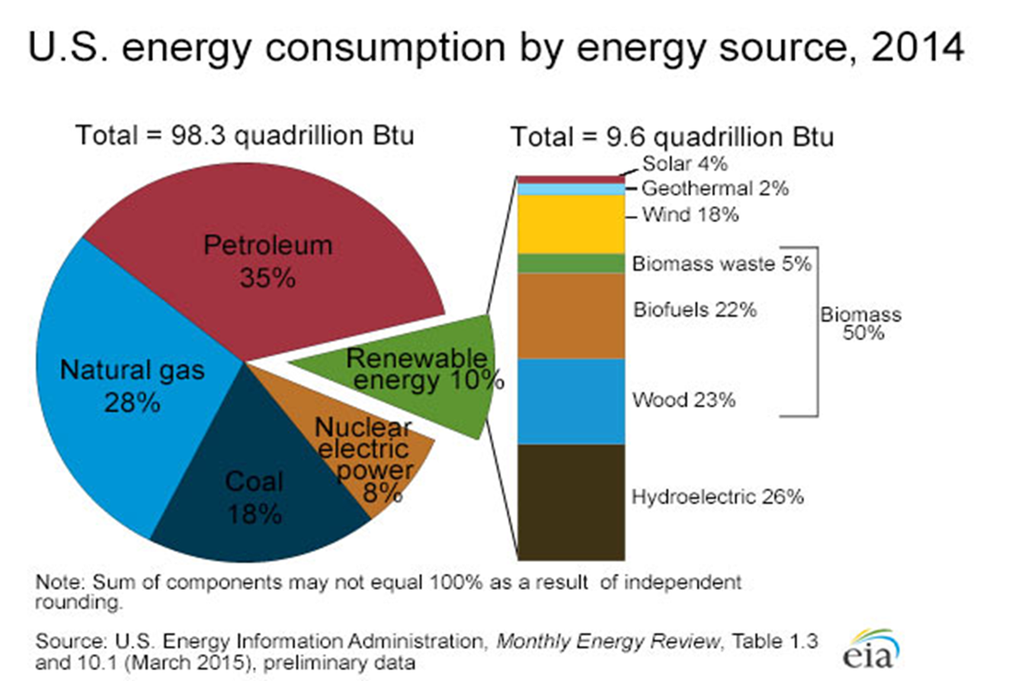

Slide 4
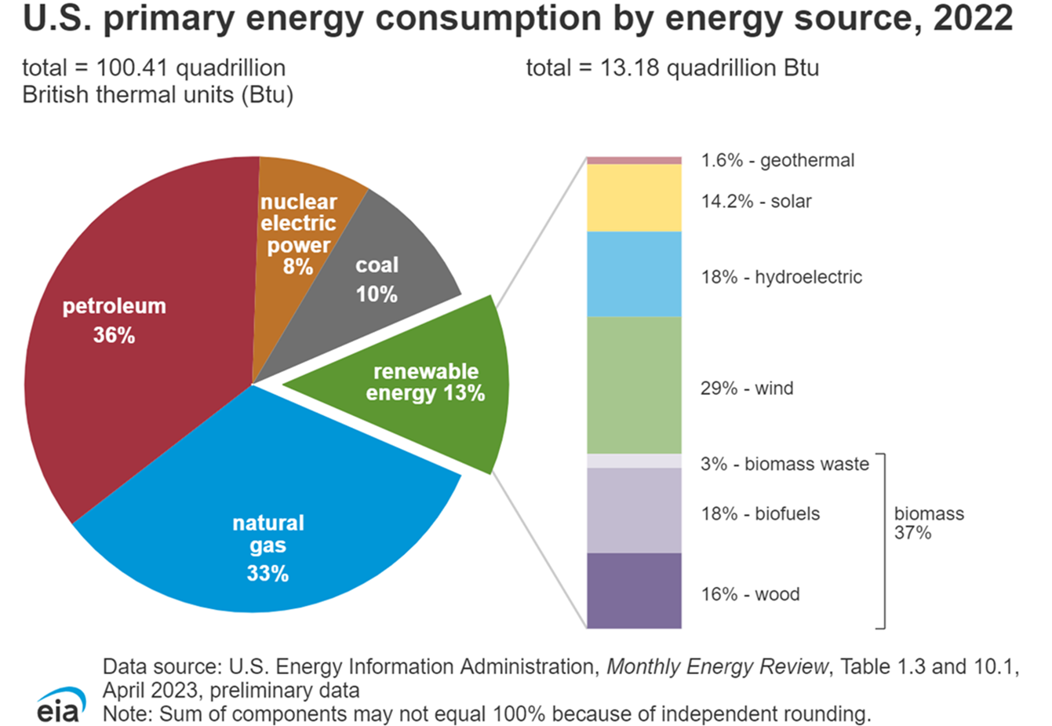

Slide 5
What “Transition”?
Coal-fired to natural gas-fired generation has been occurring for years, now.
Emissions standards
Cleaner burning natural gas
More abundant supplies thanks to shale revolution
Mostly cheaper
Solar PV and Wind generation growth has been consistent
New nuclear plants – Vogtle #3 & #4
Despite cost overruns

Slide 6
Why a transition? (from fossil fuels)
United Nations Council on Climate Change
Paris Accord – December 2015
196 signatory countries
Limit global warming to less than +2.0⁰ C annually
Legislated without guidance
ESG investing
“activist” investors – e.g., “Engine No. 1” vs. Exxon
Anti-fossil fuel investing
Higher education endowments shifting from fossil fuels

Slide 7
A transition delayed…?
Mother Nature Intervenes
Winter Storm Uri – February 2021
Brought reality of energy infrastructure issues to the forefront
Wind turbine blade freezes
No solar on cloudy/snowy days
Natural gas freeze-offs on a huge scale
Power outages impacted field operations
Stability of nuclear power
TX – South Texas Plant; Comanche Peak

Slide 8
A transition delayed…?
Summer of 2021 – Global Record Heat
UK – Failure of North Sea Wind Generators
Heavy reliance on imported LNG and gasoil
China/Asia/India
Increased coal usage
Reliance on LNG imports
California
Low hydropower availability – “snowpack” issue
Import fossil-fueled power

Slide 9
A transition delayed…?
February 2022 – Russian Invasion of Ukraine
Boycott/interruption of Ural exports? (3.0 million Bbld.)
Skyrocketing global oil prices/gasoline prices
EU/UK attempting to wean off Russian energy
Global LNG prices spike
France rethinks nuclear energy
Plans (12) new plants in the coming decades
Energy security becomes paramount

Slide 10
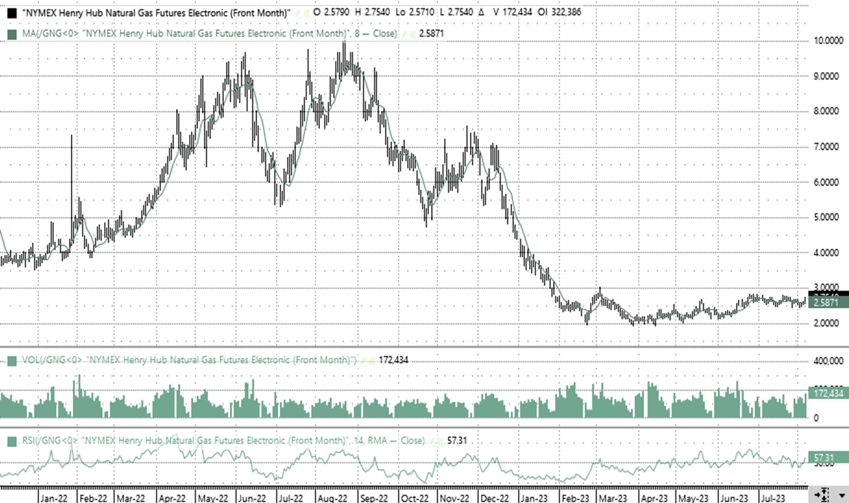
Natural Gas Futures Prices - Russia/Ukraine

Slide 11
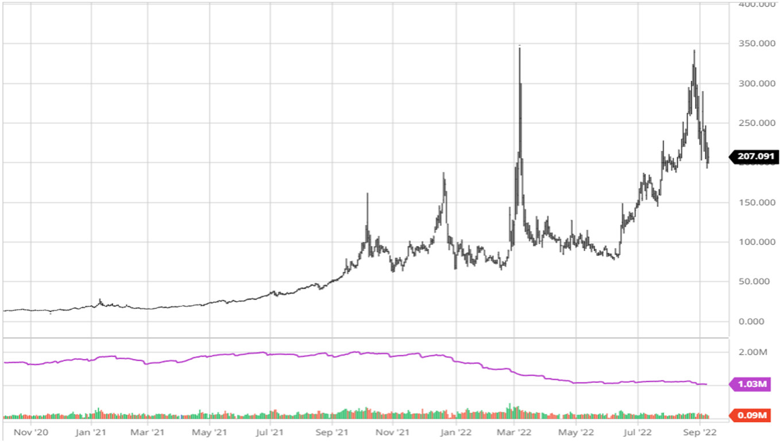
Dutch Title Transfer Facility (TTF)

Slide 12
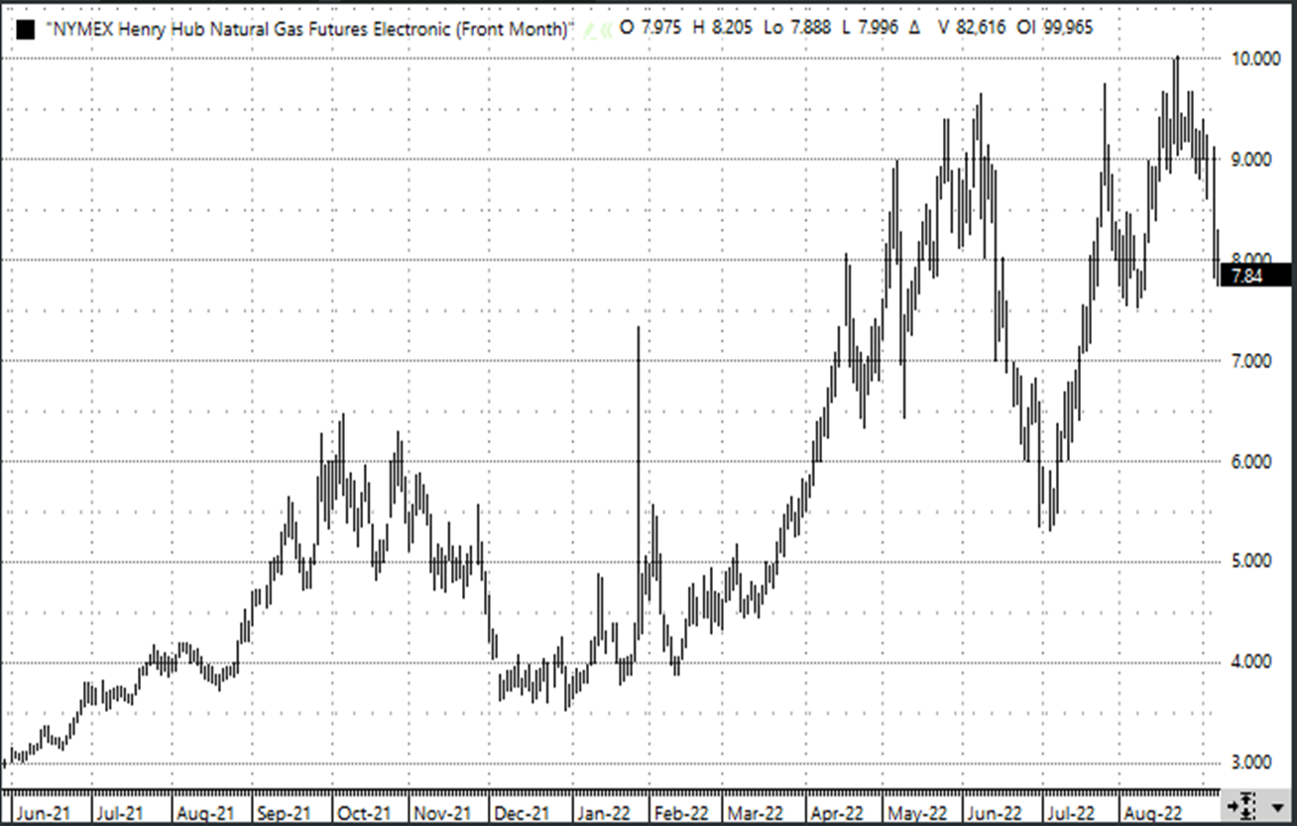
Henry Hub Natural Gas

Slide 13
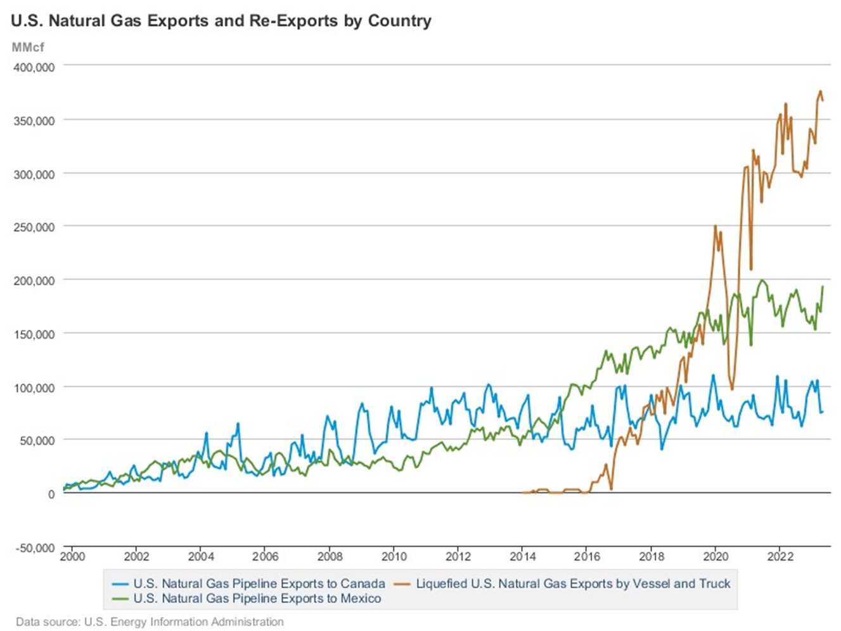

Slide 17
A transition delayed…?
Summer of 2022 Deja vu – Global Record Heat
UK/EU
Heavy reliance on imported LNG and gasoil
China/Asia/India
Increased coal usage
Reliance on LNG imports
Record-high natural gas prices
US “tapped-out” on LNG exports
Record send-out
Scramble for long-term purchase agreements
More greenfield and expansion projects receive “FID”

Slide 18
A transition delayed…?
Summer of 2022 Deja vu – Global Record Heat
California/SW US
Low hydropower availability – drought & “snowpack” issue
Import fossil-fueled power
Rethink Diablo Canyon Nuclear Plant shut-down
Delay closure of (3) gas-fired plants in SoCal
Residential solar fees
Halt new construction using natural gas
Outlaw sale of gasoline-powered vehicles

Slide 19
A transition including fossil fuels…..?
Carbon Capture & Sequestration (CCS)
Opportunity to change the O&G industry image
Capture global warming emissions – CO2
Operational & Atmospheric (DAC)
Sequester
Geologic formations
Evaluate on case-by-case basis
Abandoned oil & gas reservoirs
Known characteristics
“orphan” wells
Enhanced Oil Recovery – inject CO2, drive hydrocarbons, sequester CO2

Slide 20
A transition including fossil fuels…..?
Financial incentives – Tax Credits (US Code § 45Q)
Energy Improvement & Extension Act of 2008
Differing credits for permanent storage vs. EOR
CCUS Tax Credit Act – 2021
Extended the credits
BKV – Barnett CCS: November 2023
Receives CO2 from EnLink Plant, stores supercritical CO2
DOE – Research Funding for CCS

Slide 21
A transition including fossil fuels…..?
Carbon Capture & Utilization (CCU)
CO2 as a needed industrial/commercial gas
Beverage carbonation (beer, wine, soft drinks, carbonated H₂O)
Concrete building materials (carbonates & curing)
Synthetic fuels
Chemicals & Plastics
Methanol
Urea (fertilizer)
Dry Ice
Refrigerant
Aerosol propellant

Slide 22
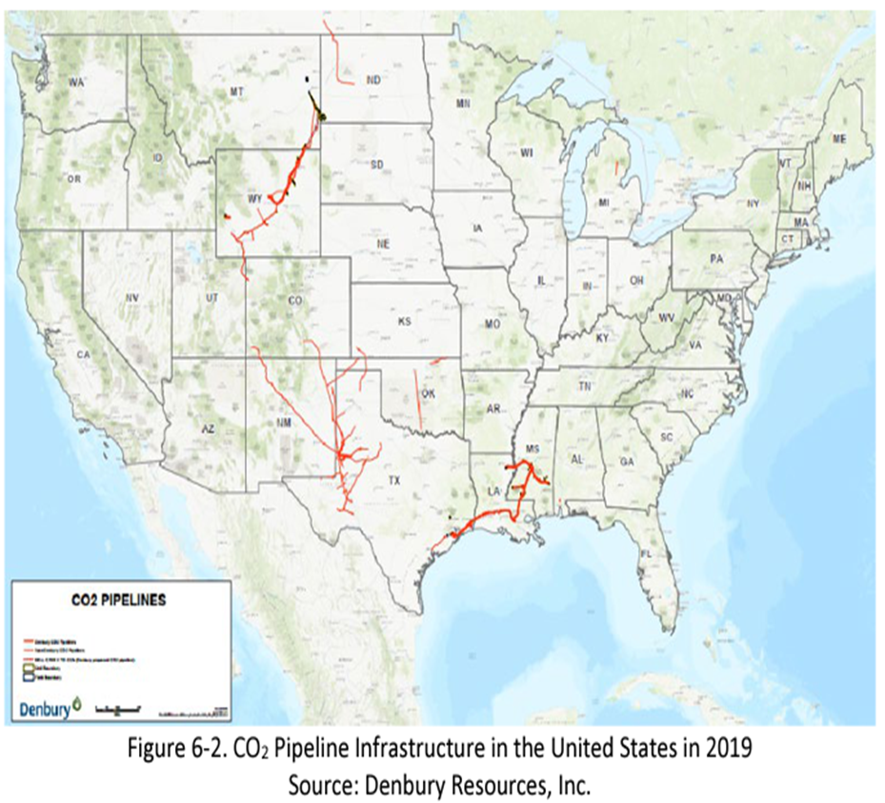
A transition including fossil fuels…..?
Carbon Capture & Utilization (CCU)
CO2 for Enhance Oil Recovery (EOR)

Slide 23
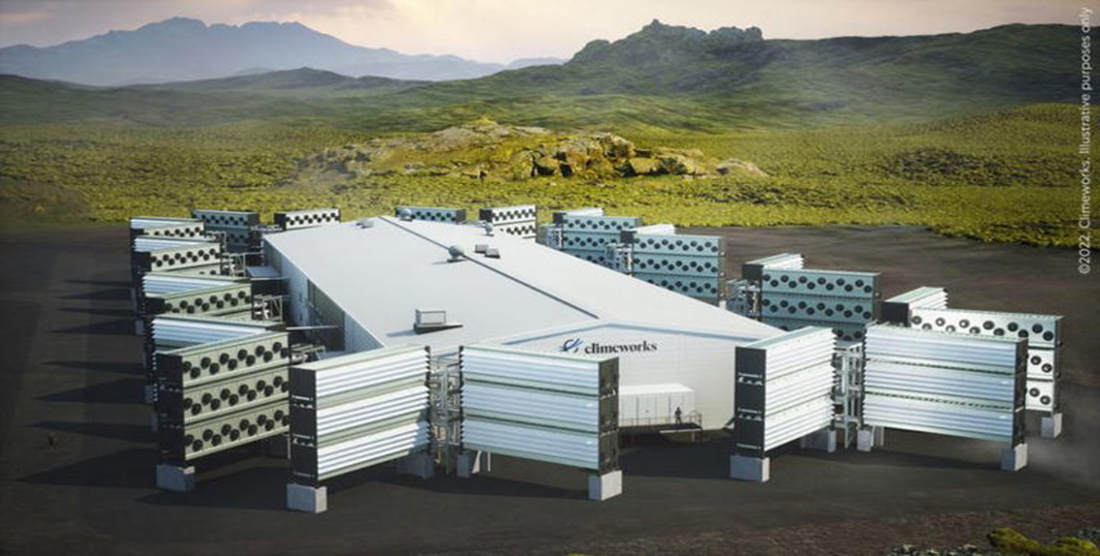
Direct Atmospheric Capture – CO2
Climeworks - Orca (Norway): 09/08/21
DOE awards $1.2 billion to Project Cypress in Louisiana – Oxy, et al.

Slide 24
Carbon Capture & Sequestration (CCS)
“Land Grab”
While mostly secret, may O&G companies are acquiring leases for pore space for CCS/CCUS.
Oxy – 287k acres in TX & LA
Chevron – 100k acres in TX
Issues
Class 6 certification
100 permits under review by EPA
States seeking “primacy” (Louisiana has been granted primacy)
Pore space ownership
Opposition to sequestration and pipelines

Slide 25
Alternative & Renewable Energy
Energy Information Administration (DOE)
+3% growth in electricity demand this year
Economic growth – positive GDP
Artificial Intelligence
Bitcoin mining
Data center growth
Google
Amazon Web Services
Microsoft Cloud
Microchip manufacturing
EV battery manufacturing
Electrolyzers for H2
Direct Air Capture “vacuums”

Slide 26
Alternative & Renewable Energy
Energy Information Administration (DOE)
Solar, Wind, Hydropower = 22% of US generation in 2024
Solar = +41% over 2023
Exceeds hydro in 2025
Wind = +5% over 2023
Hydropower = +6% over 2023

Slide 27
Energy transition or addition….?
Additional sources
Increasing Solar PV – Utility-scale & Residential/Commercial
Battery storage dependent
Land use issues
Increasing “concentrated” Solar
High temperature processes – steam for EOR/Power generation
“molten” salt storage
Increasing Wind generation – onshore/offshore
Battery storage dependent
Land use issues
Blade disposal/recycling

Slide 28
Solar & Wind to Supply 33% of Global Power by 2030 - RMI
RMI – independent, non-partisan, nonprofit promoting clean energy
Currently at 12%
12,000 to 14,000 TW by 2030
Solar & battery costs -80% from 2012
Offshore wind costs -73%; Onshore – 57%
Cost of power to decline from $40/kWh to $20/kWh by 2030
IEA: “Russia-Ukraine war accelerated momentum in clean energy
technologies”. (1)
(1) Solar and Wind Power to Supply a Third of Global Power by 2030: RMI | Rigzone

Slide 29
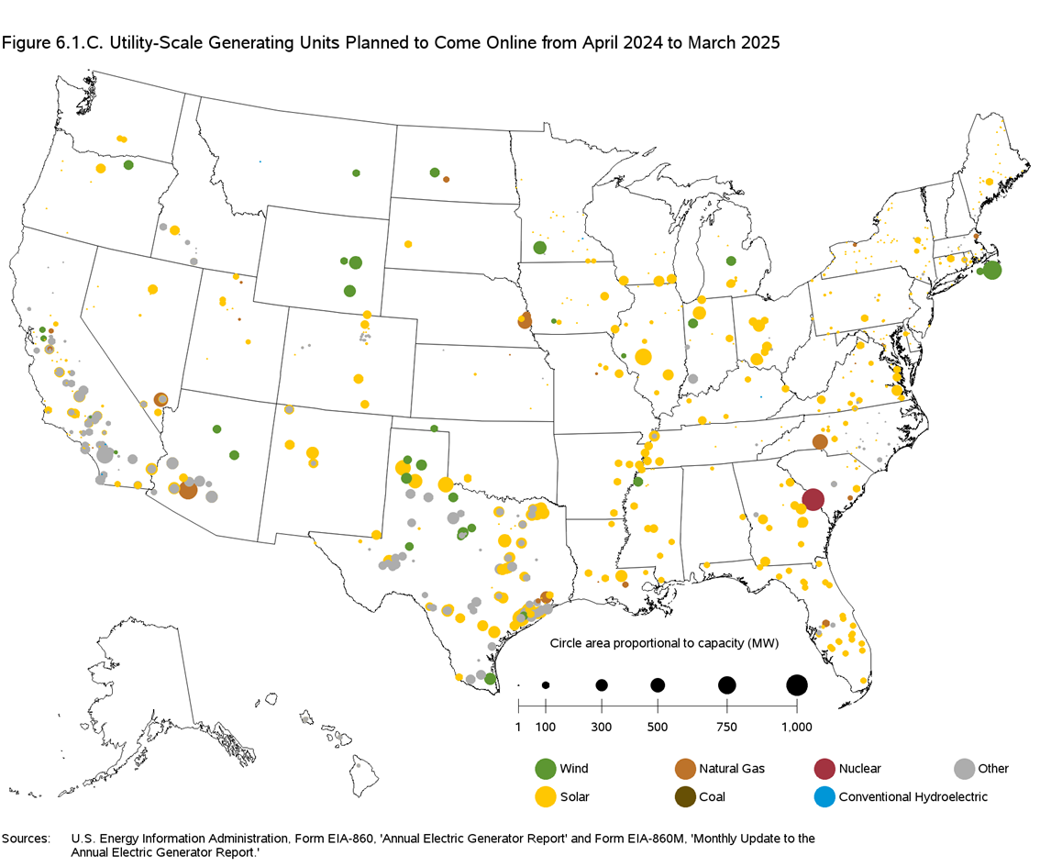
Planned Utility-Scale Generation

Slide 30
Energy transition or addition….?
Additional sources
Renewable Natural Gas (RNG) – Already commercialized
Large-scale bio-digesters
Renewable Fuels – Already commercialized
Biomass derived (food sources, waste oil, soybean oil)
Geothermal Expansion
Steam for power generation
Steam for industrial usage
Directional/Horizontal Drilling increasing output

Slide 31
Energy transition or addition….?
Additional sources
Landfill methane
(100) new slated projects
Utility-scale battery storage
Distributed power “grid”
Residential solar PV with battery back-up (PG&E)
Small-scale nuclear power plants
TerraPower – Natrium® modular plants
Sodium cooling and molten salt storage
Hydrogen fuel cells

Slide 32
A transition accelerated?
The Inflation Reduction Act of 2022 (IRA)
$369 billion – energy security & climate change investment
$3.0 billion to reduce air pollution & carbon emissions at nation’s ports
Extends tax credits for energy efficiency buildings, homes, EVs and charging stations
Expanded clean energy tax credits for wind, solar, nuclear, battery storage, clean hydrogen, clean fuels, carbon capture.
Grants & loans to help companies reduce emissions of methane from oil & gas.
Fees for excess methane emissions.

Slide 33
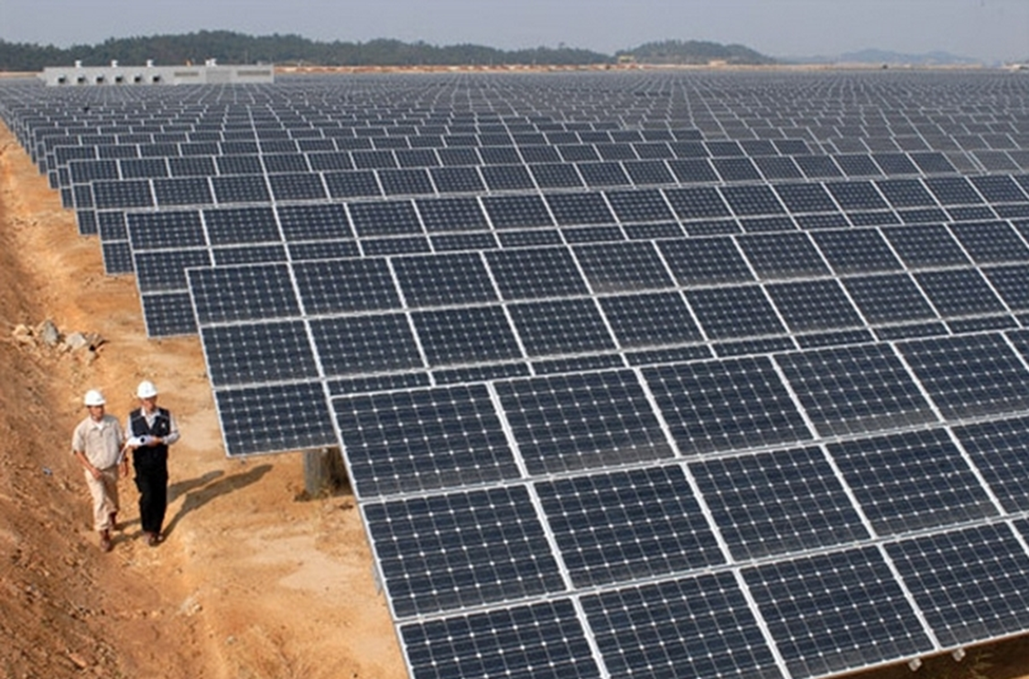
Solar Power Generation

Slide 34
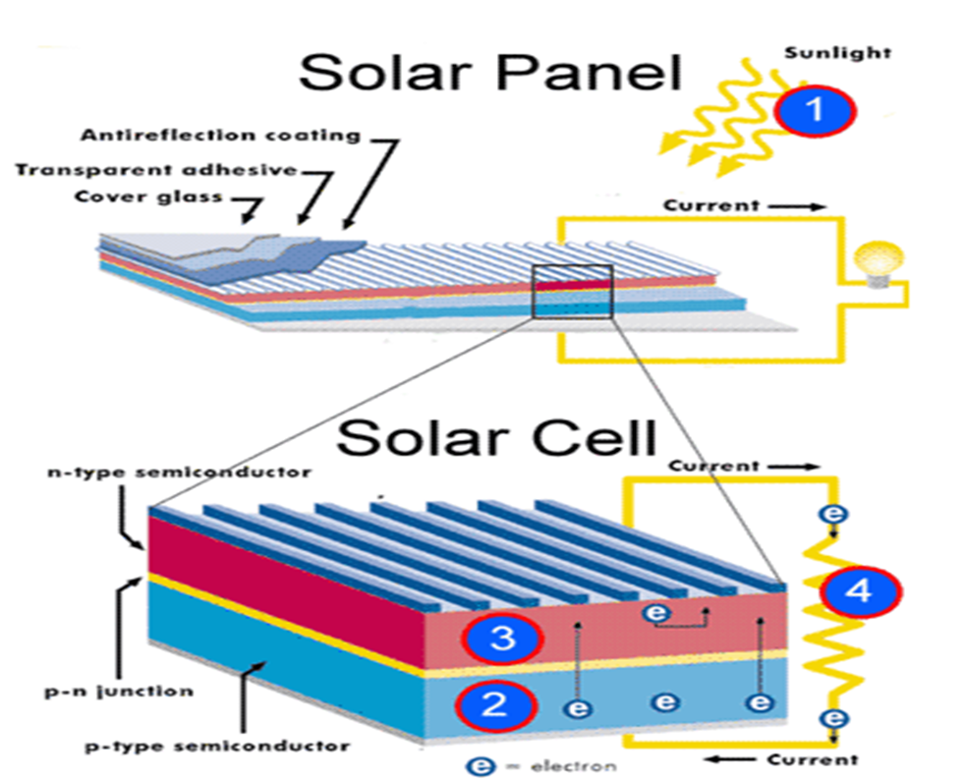
Solar Power Photo-voltaic generation (PV)

Slide 35
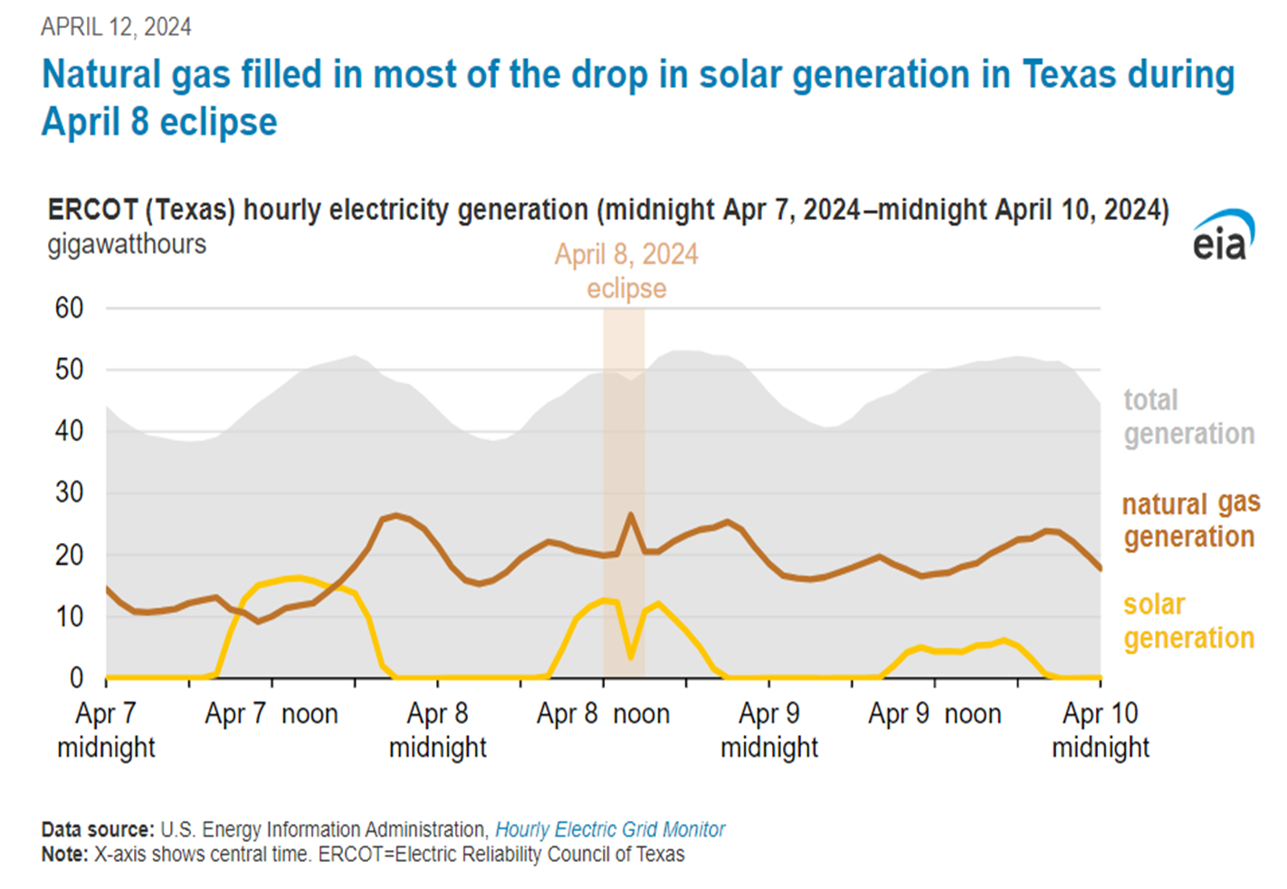
Solar Power in Texas - 2024 Solar Eclipse

Slide 36
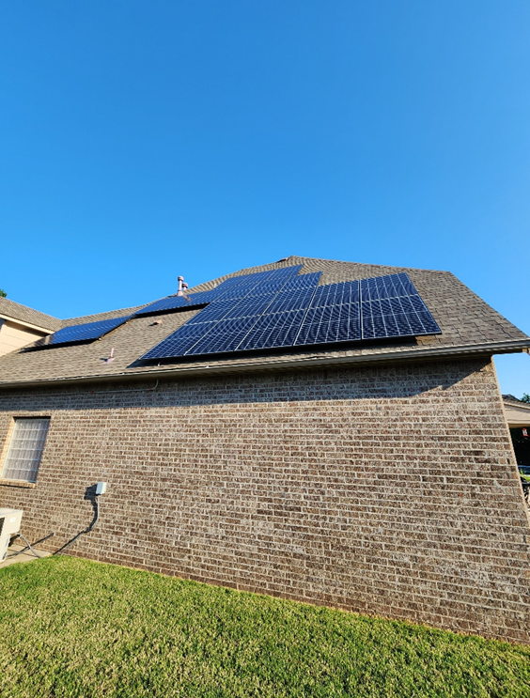
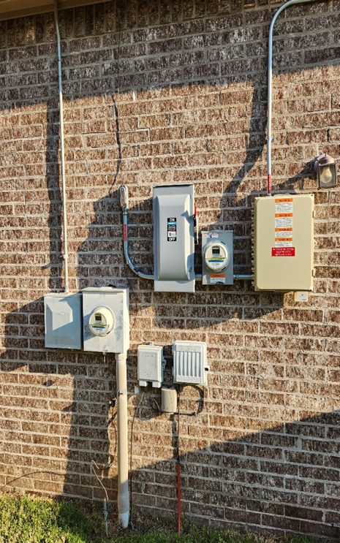
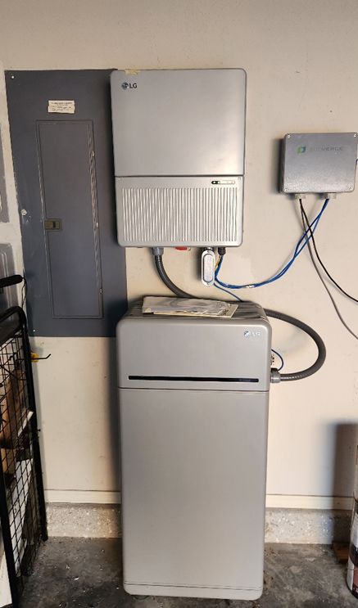
Residential Solar PV - Distributed Generation

Slide 37
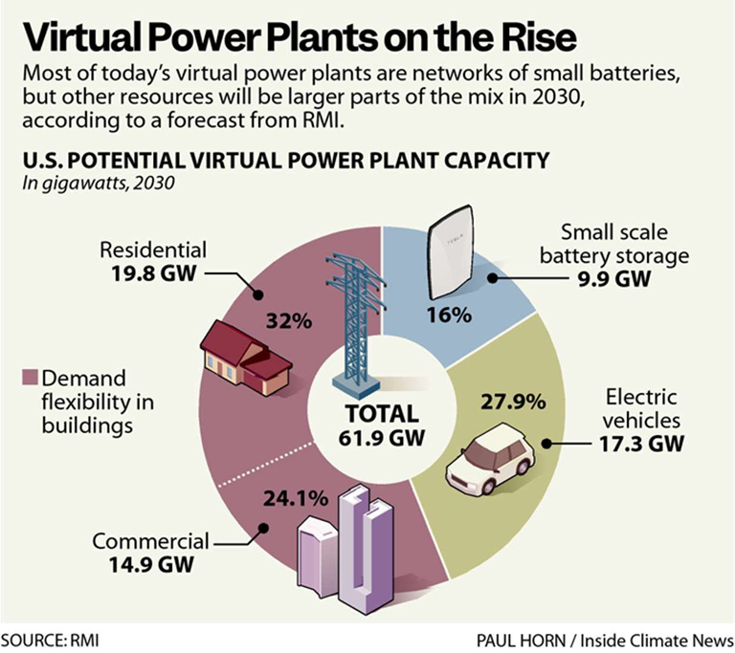
“Virtual” Power Plants (VPPs)
Utilities establishing pilot battery storage projects
Provide peaking power/load curtailment
Largest source = residential solar
“Micro-grids” – distributed generation & storage

Slide 38
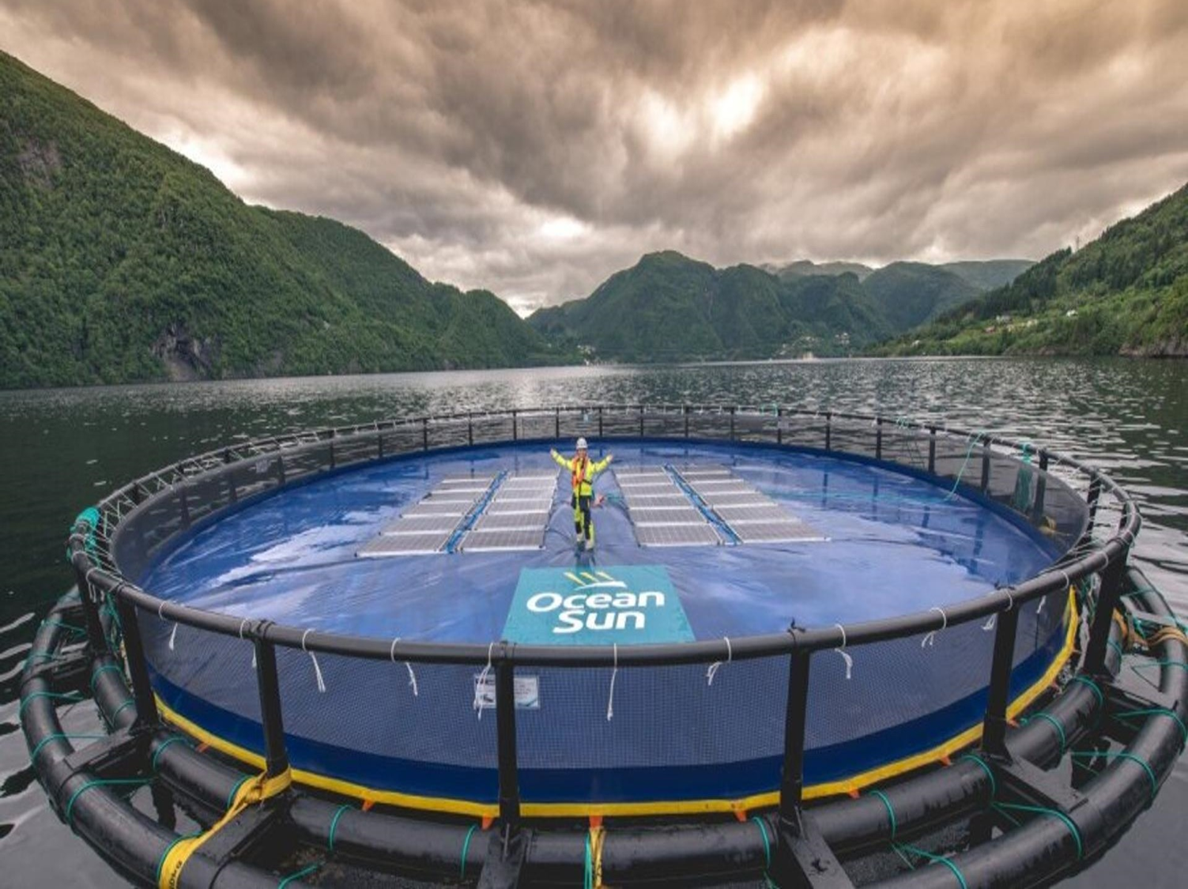
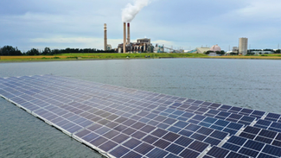
Floating Solar PV

Slide 39
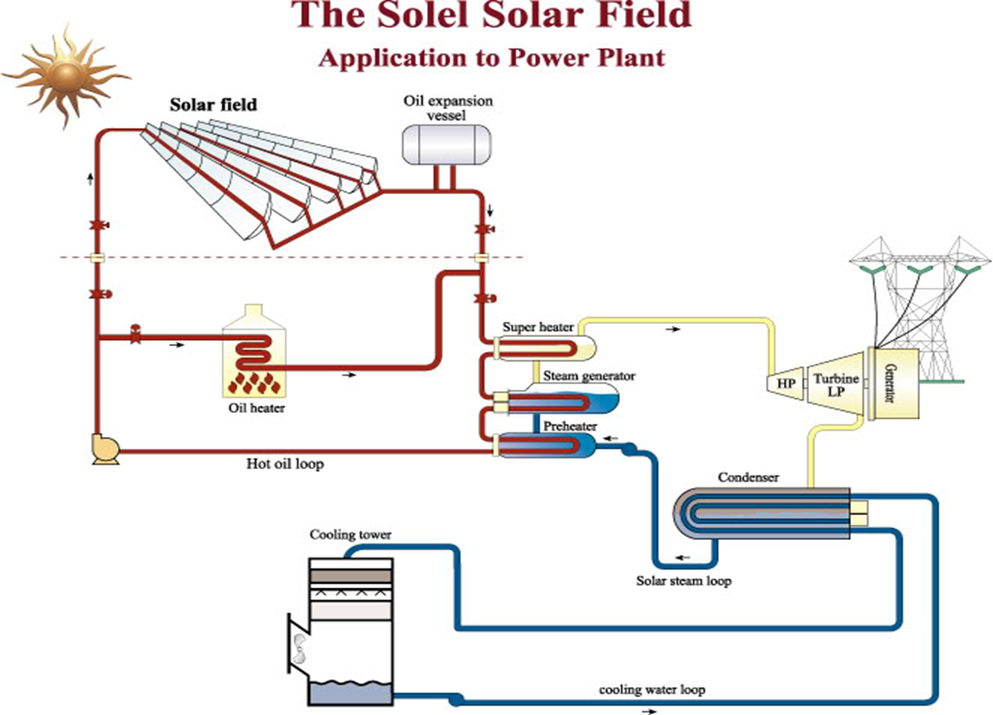
Solar Power - Steam generation

Slide 40
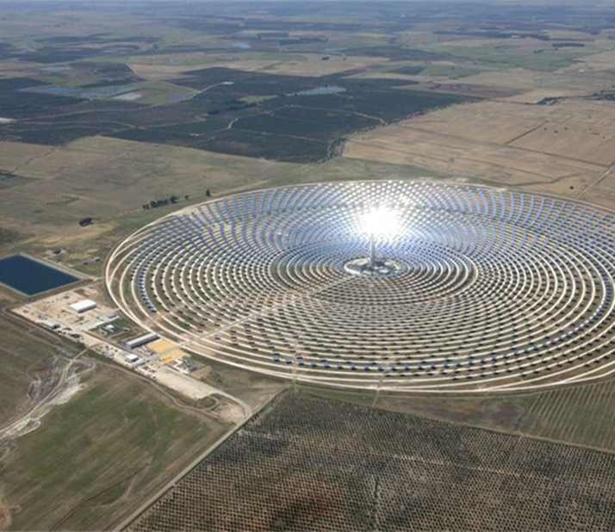
Concentrated Solar

Slide 41
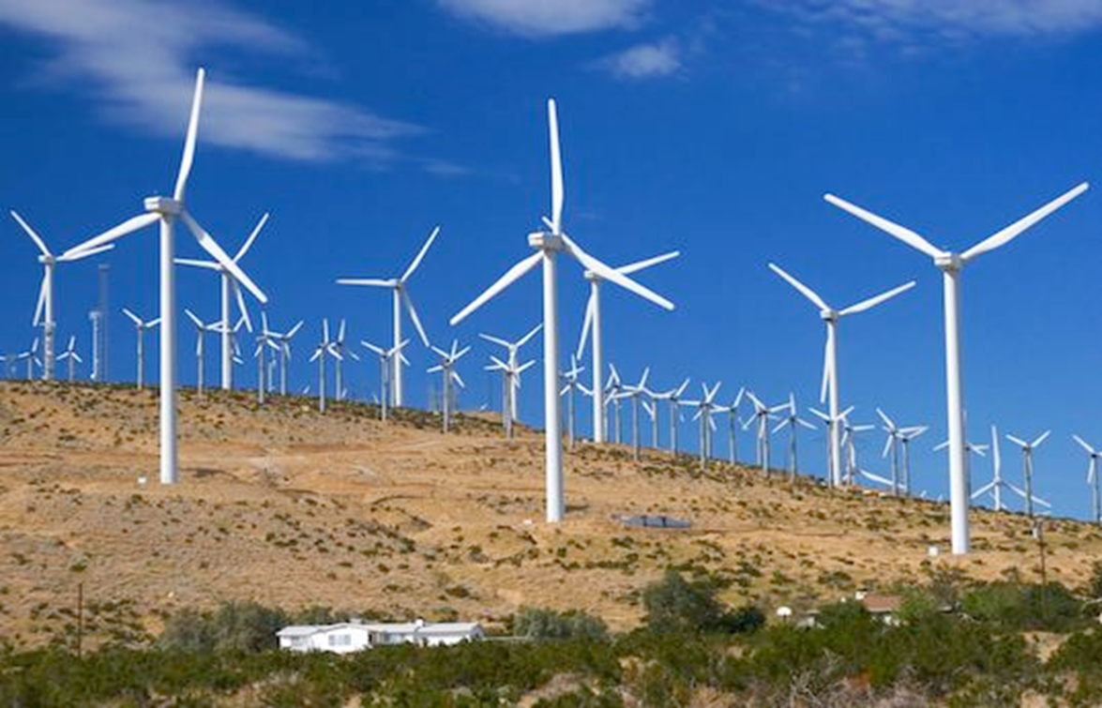
Wind Power

Slide 42
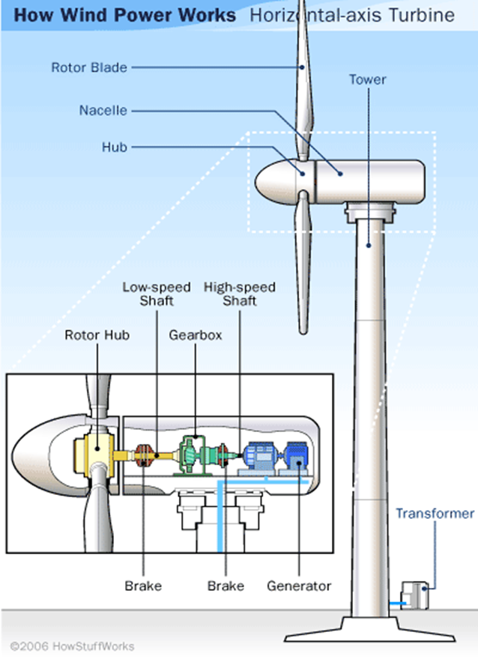
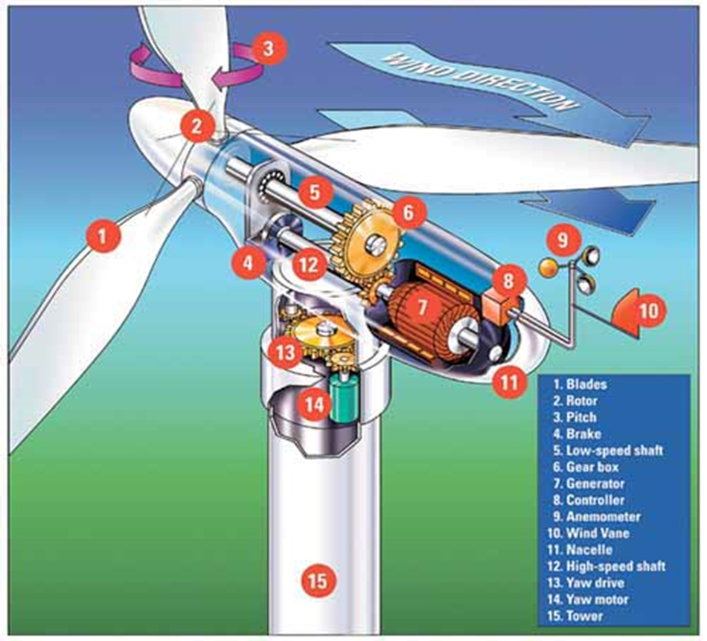
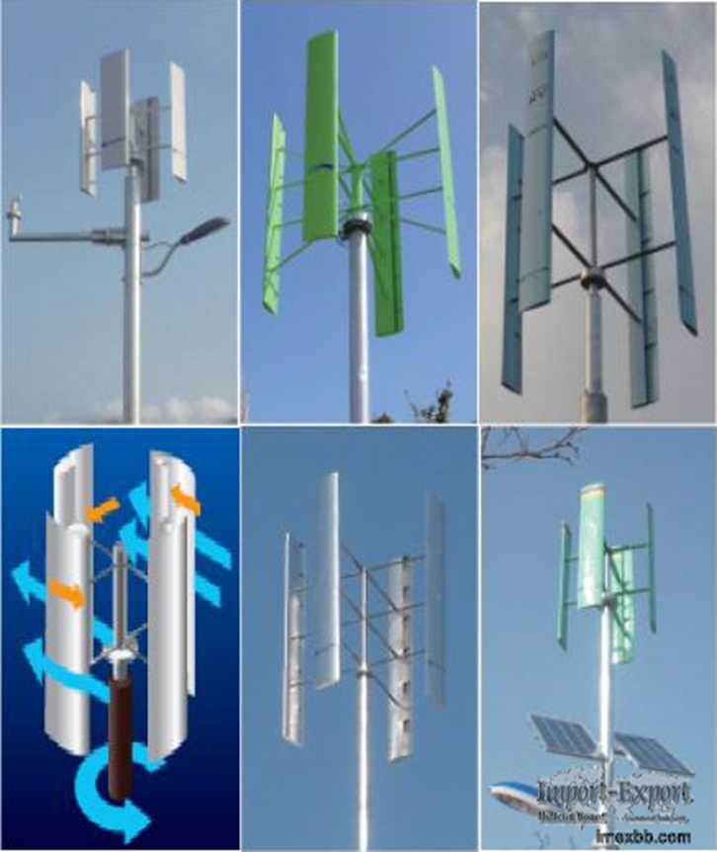
Wind Turbine Generation

Slide 43
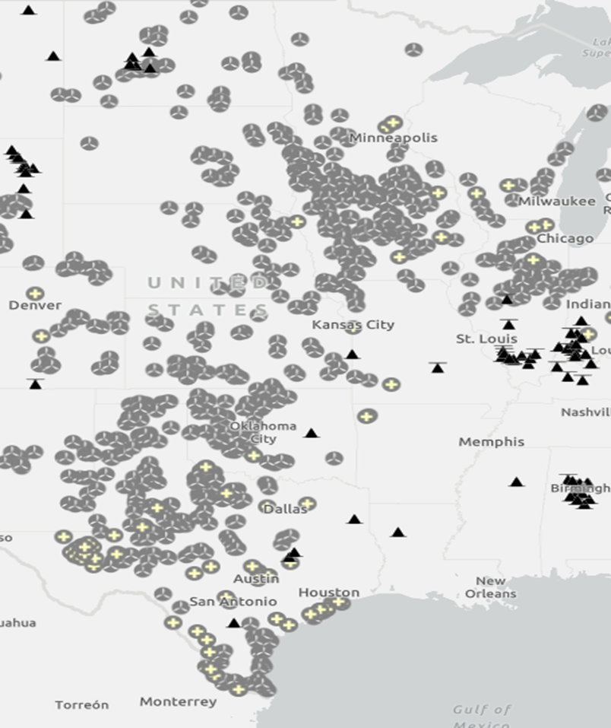
“Tornado Alley”
Texas, Iowa, Oklahoma – Top 3 in Wind Generation Capacity

Slide 44
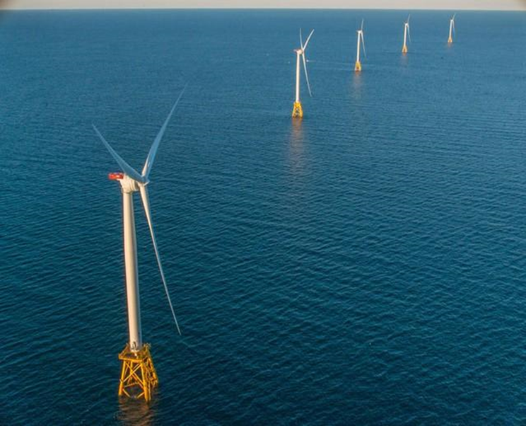
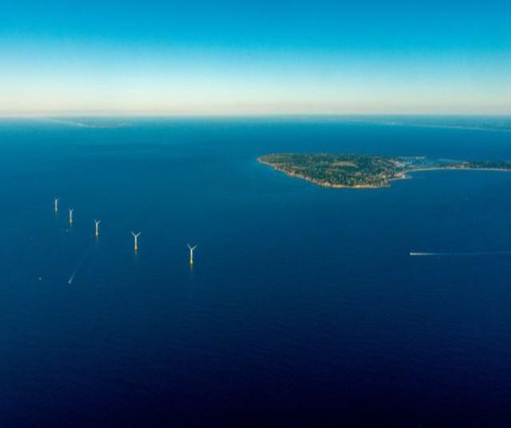
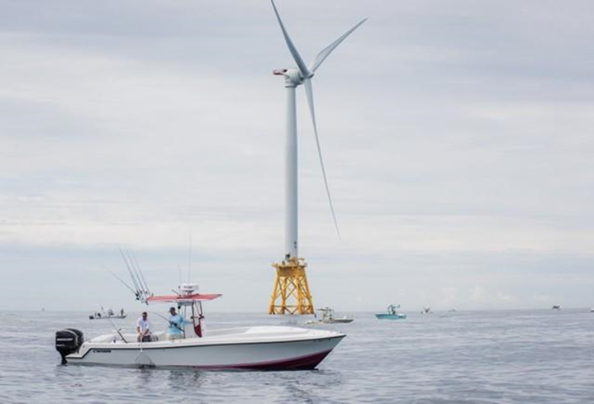
US Offshore Wind Block Island, RI

Slide 45
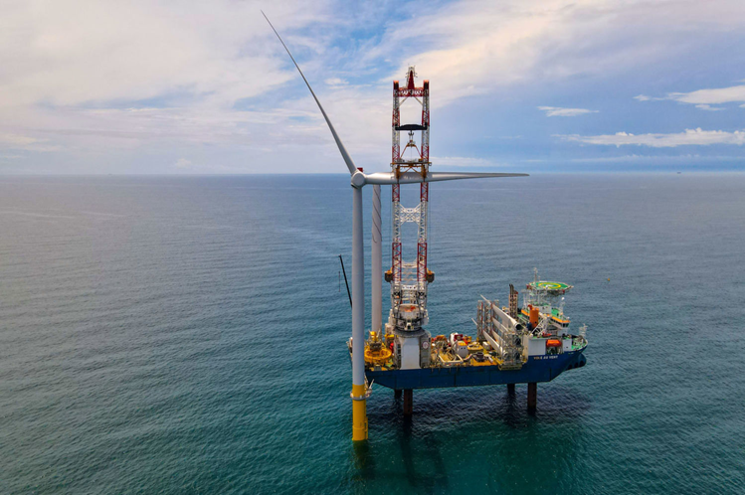
Ocean Wind 1 Project
Offshore-New Jersey 13 nautical miles SE of Atlantic City
1.1 MW
Bureau of Ocean Management (BOEM) approved
Local protestors got it canceled

Slide 46
New York State Offshore Wind Projects
South Fork Wind - Operational
130 MW - 35 miles East of Long Island, NY
Empire Wind
No. 1 = 816 MW planned
No. 2 = 1,260 MW planned
Sunrise Wind
924 MW planned
Beacon Wind
1, 230 MW planned

Slide 47
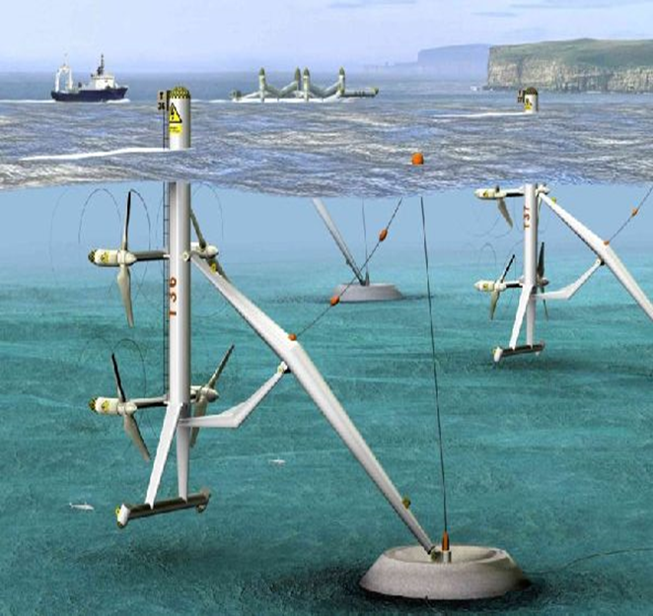
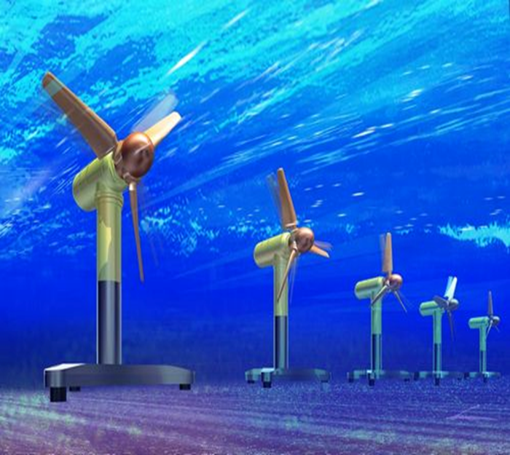
Tidal/Current Power

Slide 48
Tidal Power
https://www.ecowavepower.com/

Slide 49
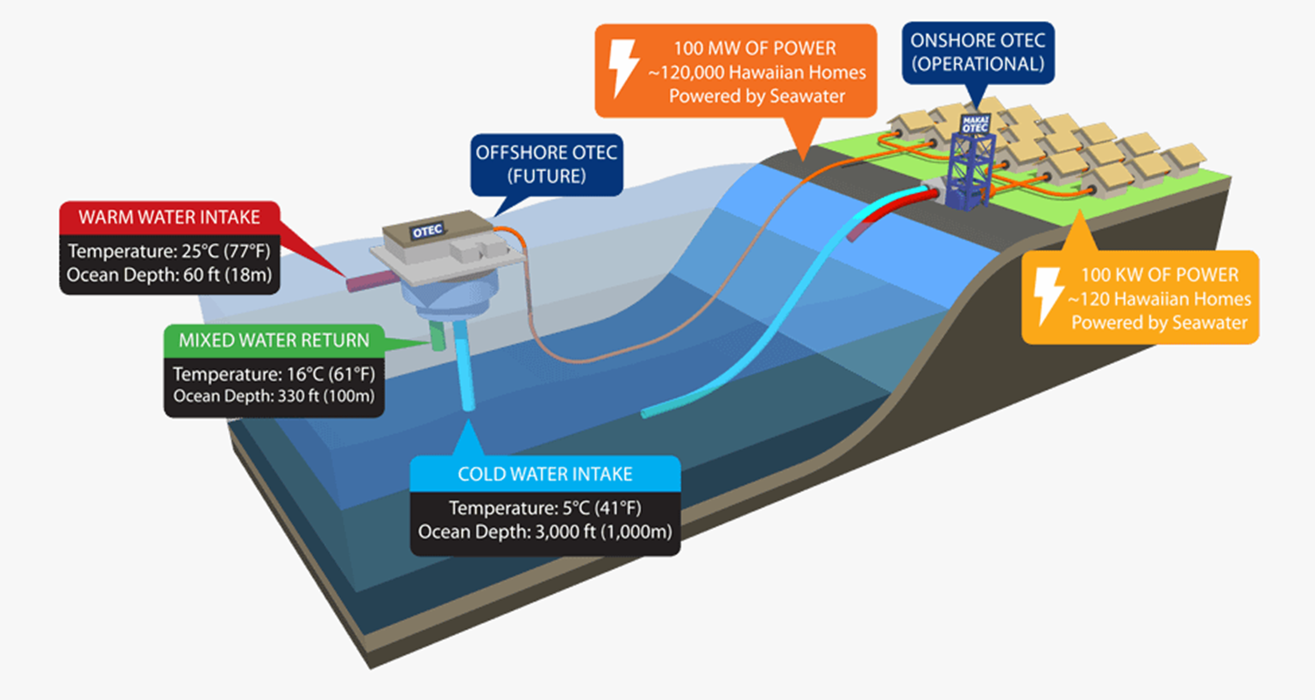
Ocean Thermal Energy Conversion (OTEC)

Slide 50
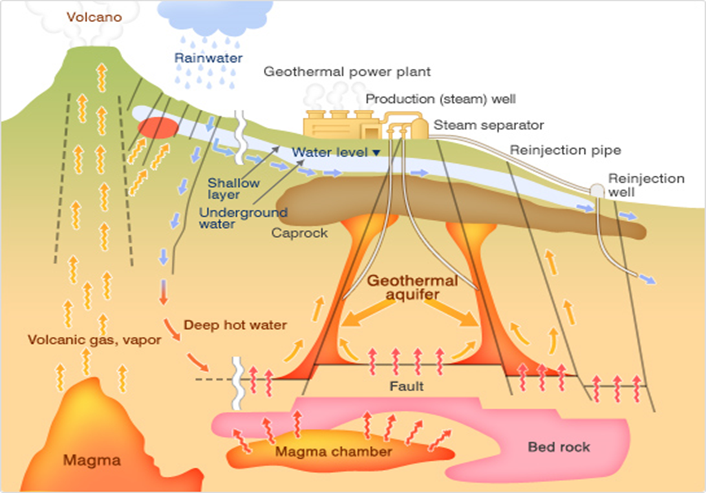
Geothermal Energy

Slide 51
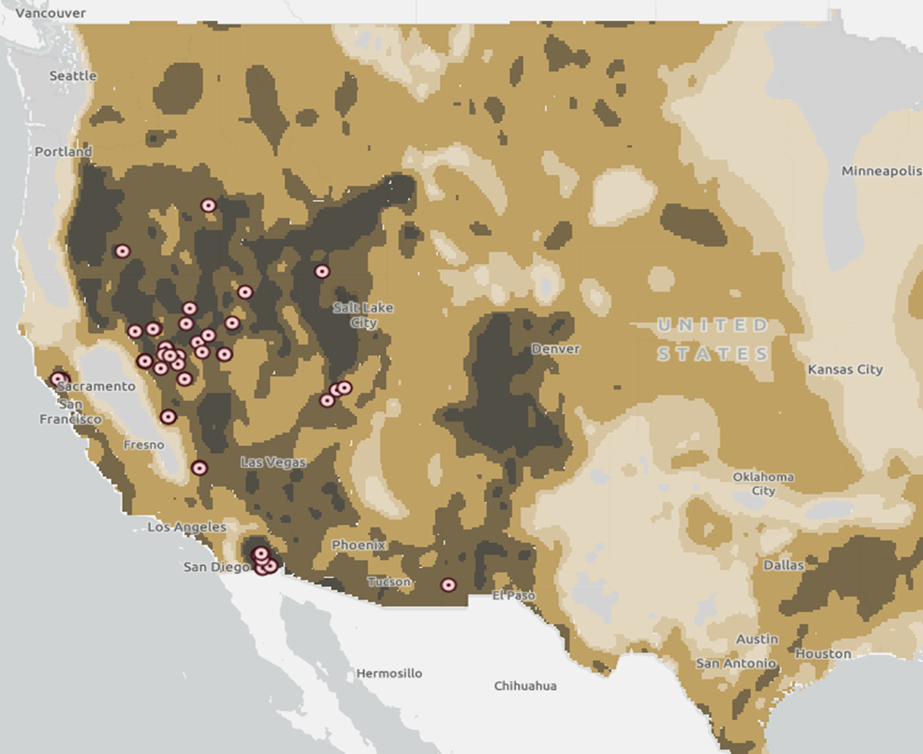
Geothermal Resources

Slide 52
Geothermal Power Generation

Slide 53
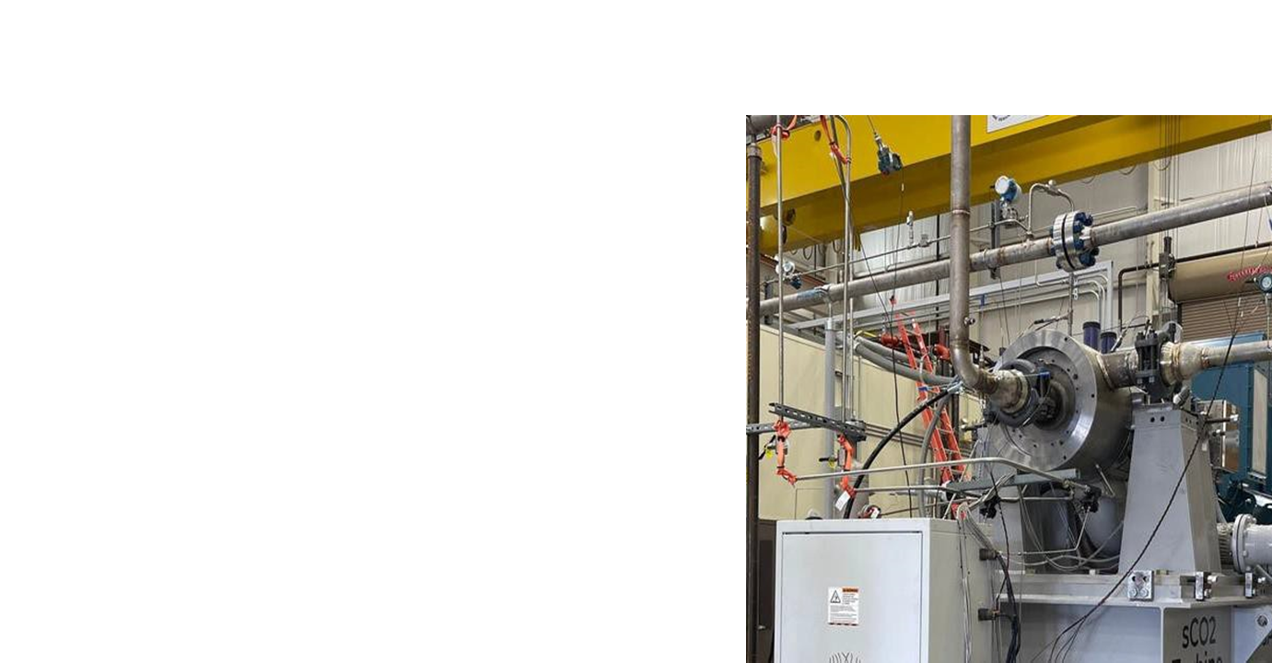
Geothermal in South Texas’ Eagle Ford
Sage Geosystems - Eagle Ford
Sage deploys an enhanced geothermal system using a combination of off-the-shelf oilfield equipment and proprietary technology to capture geothermal power from any underground formation where the required heat level exists. The beauty of this approach is that the oil and gas industry has been drilling into many suitable formations for decades now, and that project execution requires the same basic fields of expertise used in the oil and gas business since its inception.
“It's contained in formations that the oil and gas industry has drilled to these depths for many, many years,” Taff says. “For example, the Starr County test well that we have was drilled in 2008 to a depth of 19,000 feet and almost 500 degrees F. That's plenty of heat right there to have a commercial installation.”
Cindy Taff – CEO Sage Geosystems

Slide 54
Geothermal in Oklahoma
Baker Hughes - Oklahoma
Drill down for geothermal hot zones
Existing and old well sites
Utilize existing oil & gas technology
Supply heat for residential heat pumps
Heat for steam for power generation
24/7 supply

Slide 55
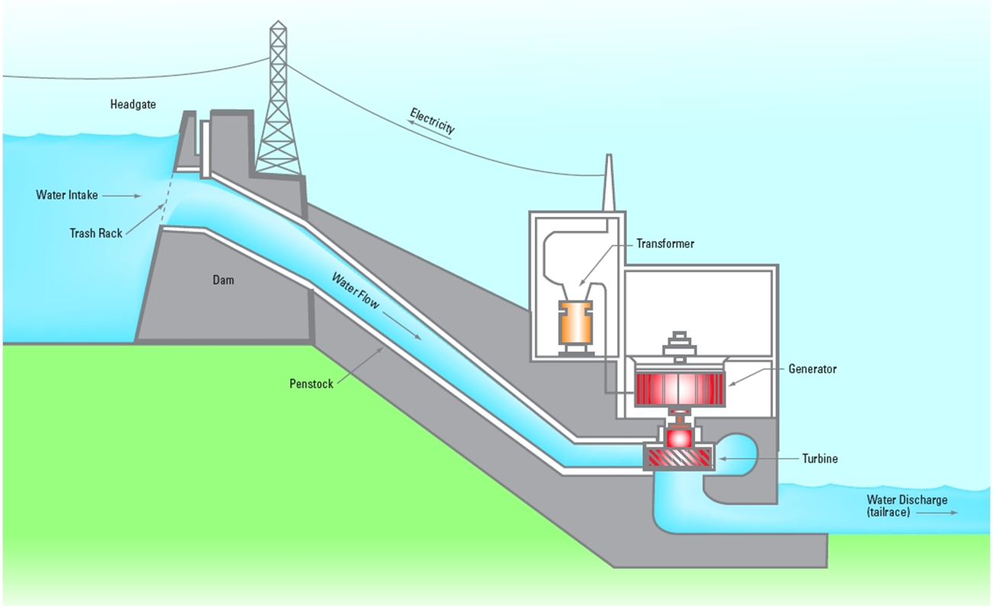
Hydro Power

Slide 56
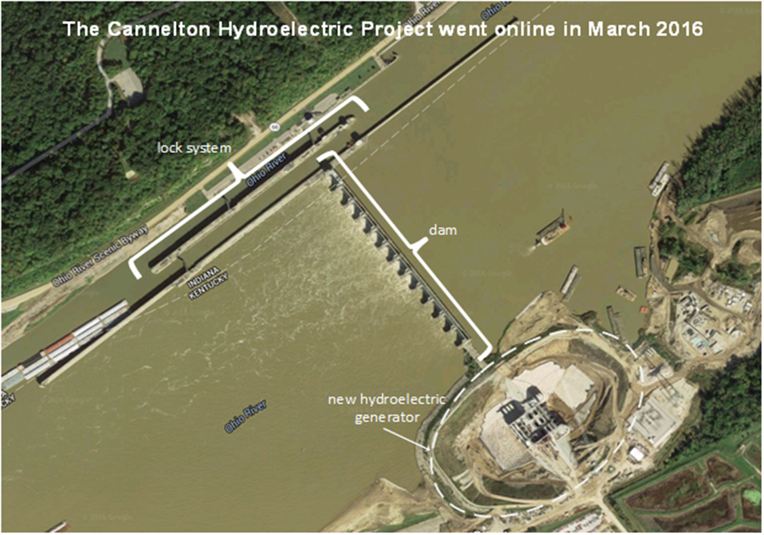
“Non-Powered” Dams (NPDs)

Slide 57
Pumped Storage
Pumped hydro storage operates by using electrically powered turbines to force water uphill at night to fill a reservoir while power prices are lower. During times of the day when electricity demand is high, the water is released to flow downhill through turbines to generate electricity, shifting the availability of power from overnight generation to serve daytime load adds significant value.
The original water “battery”

Slide 58
Oklahoma Pumped Storage Facility
Grand River Dam Authority
Salina, OK Pumped-Storage Project

Slide 59
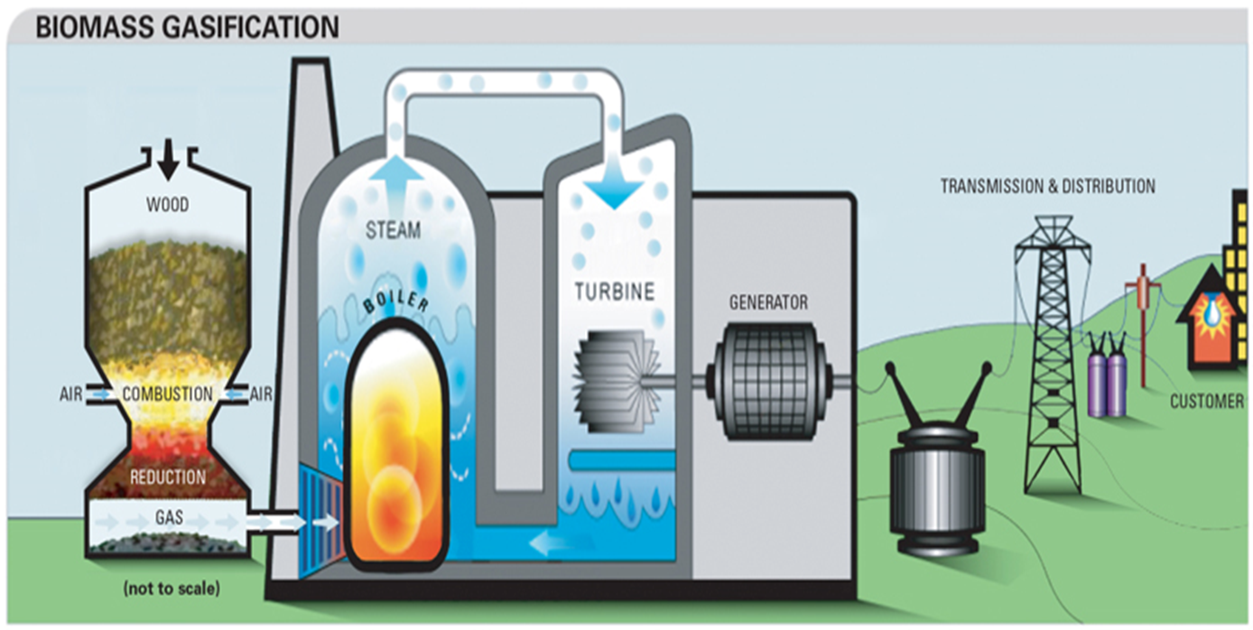
Biomass Heat Energy

Slide 60
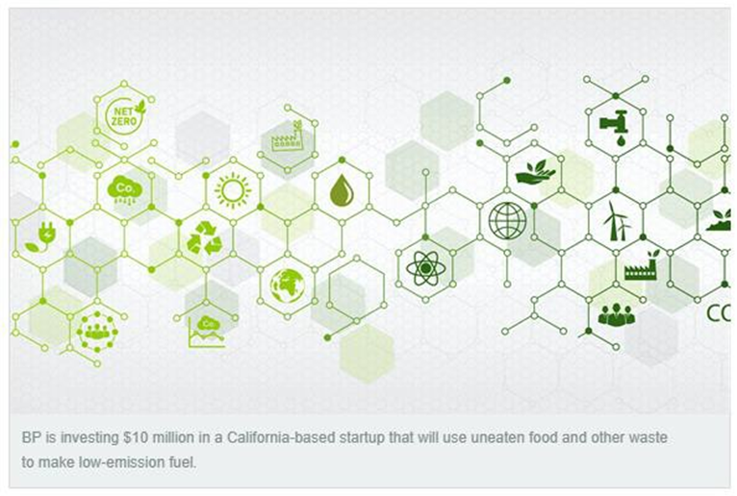
BP Invests in Waste-to-Fuel Company
WasteFuel – convert municipal and agricultural wasted into biomethanol for shipping industry
Replace high-sulfur
“bunker” fuel
First plant - Dubai

Slide 61
Hydrogen (H₂)
Sources & “colors”
Methane
“blue”: electrolysis separation w/CCS
“grey”: electrolysis w/o CCS
Water – “green”: electrolysis separation using renewable power
Ammonia – “turquoise” – thermal separation from methane
Issues as combustible fuel
Initial blending into natural gas infrastructure
Burner-tip change outs
Leakage - CH₄ vs. H₂
Increased electricity demand for electrolyzers
Expanding use in fuel cells

Slide 62
Hydrogen Hubs
Infrastructure Investment & Jobs Act – 2021
$8.0 billion for regional clean hydrogen hubs.
Target – at least (4) US regional hubs
Feedstock diversity
Clean hydrogen from fossil fuels
Hydrogen from renewable energy
Hydrogen from nuclear energy
Proximity to natural gas resources
CCS/CCUS to play a key role in the hydrogen production

Slide 63
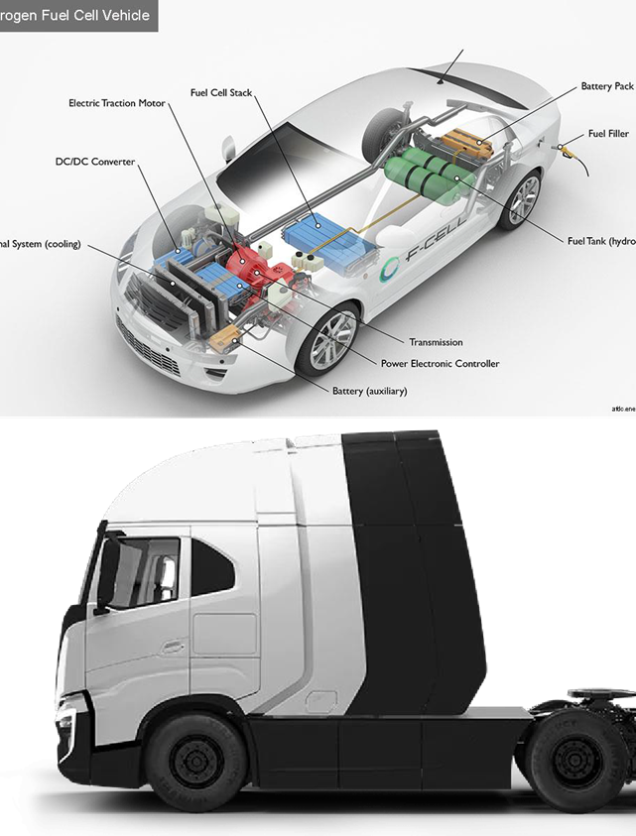
Fuel Cell Cars & Trucks
Hyundai
Toyota
Honda
Nikola

Slide 64
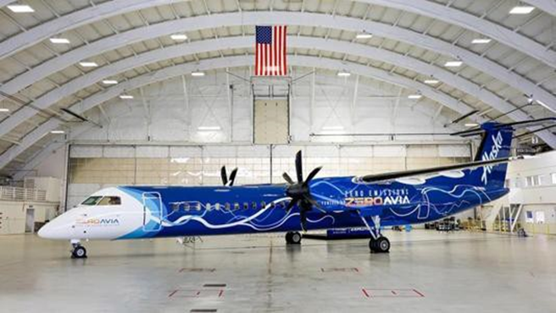
Hydrogen Planes & Trains
Alaska Airlines
prototype
Airbus
Commercial planes by 2035
Canada
Prototype train

Slide 65
Supply & Demand for EV Battery Materials
EVs = 56% of US passenger vehicles by 2030
= 5,000,000 tons of battery packs (+500% increase)
= 200,000 tons of lithium; 100,000 tons of cobalt
Growing utility-scale battery storage
IRA impact - $65 billion flowing into EV supply chain
Lithium supply
China is the No. 1 source of lithium
US – Salton Sea Project
Berkshire Hathaway – geothermal brine project SE CA
Exxon buys lithium drilling rights in Arkansas
Brine from oil production wastewater?

Slide 66
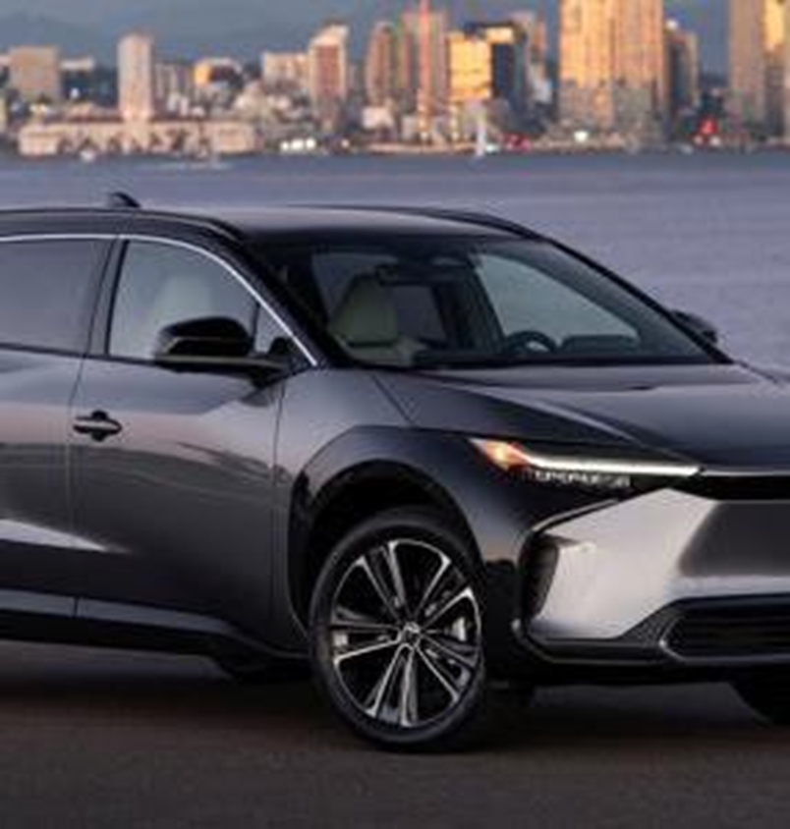
Toyota Develops 745- mile range solid state battery
10-minute charging time
“solid state” = solid electrolyte
Larger storage capacity than conventional batteries

Slide 67
Graphene Batteries
Graphene batteries are a new form of energy storage technology that hold the potential to revolutionize the way we power our devices and vehicles. Graphene is an extremely thin, light and strong form of carbon that can be used to create ultra-thin electrodes, which can store and release energy more efficiently than traditional battery technologies. Graphene batteries can be used in a variety of applications, ranging from consumer electronics and electric vehicles to medical and military applications. Current batteries cannot handle more than 500 charge cycles, unlike graphene batteries which can manage up to 1500 charge cycles. Moreover, graphene batteries respond to fast charging better.

Slide 68
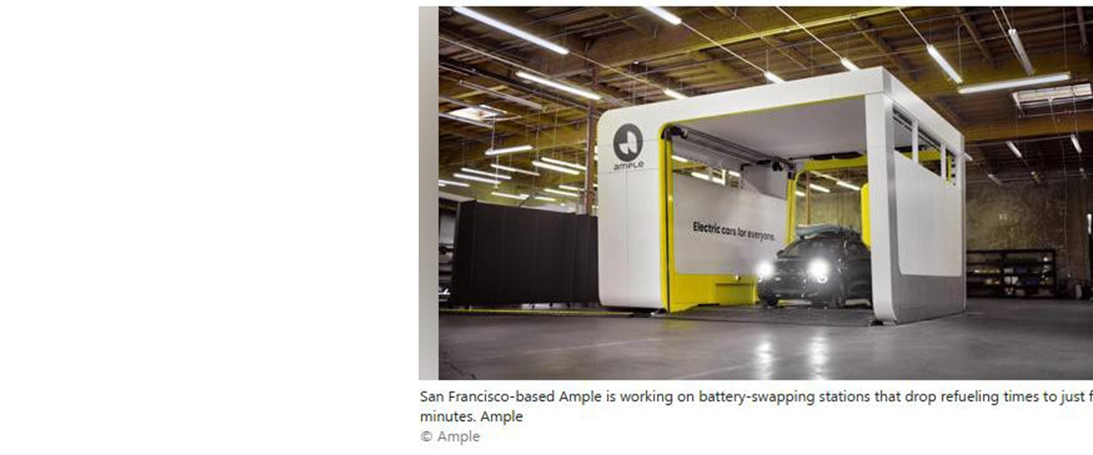
EV Batteries – Advances in Charging
Battery “Swap out”

Slide 69
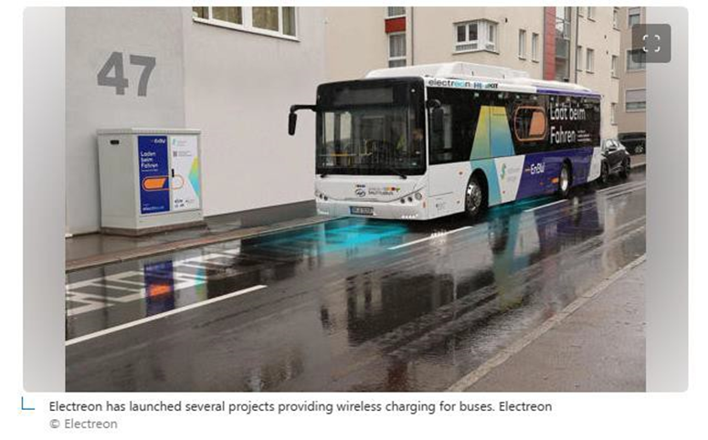
EV Batteries – Advances in Charging
Charging roadways

Slide 70
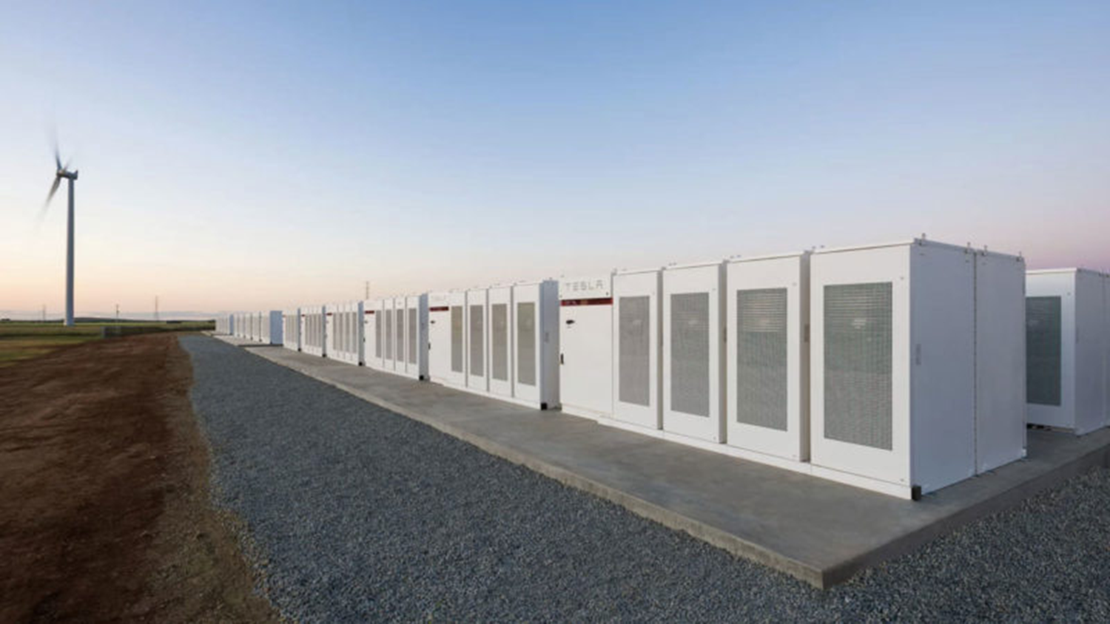
Utility-Scale Battery Storage

Slide 71
Small Modular Nuclear Reactors (SMR)
SMR = 0.5 MW to 300 MW
Westinghouse announced the launch of a small version of its flagship AP1000 nuclear reactor on Thursday.
The new reactor, called the AP300, aims to be available in 2027, and will generate about a third of the power as the flagship AP1000 reactor, enough to power about 300,000 homes (300MW)
It’s expected to cost about $1 billion to set up each plant, a small fraction of the expense of the full AP1000.

Slide 72
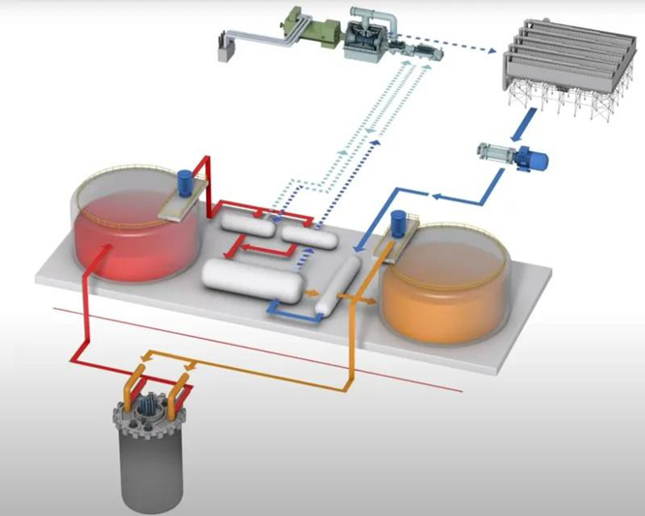
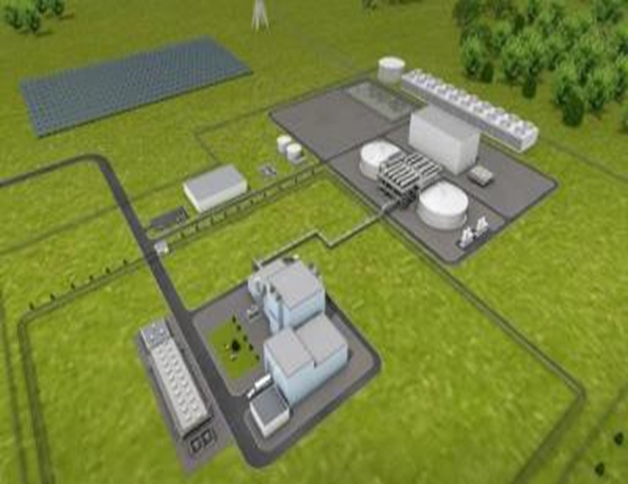
Small Modular Nuclear Reactors (SMR)
Terra Power’s Natrium Plant
Wyoming prototype
Sits atop a salt dome used for cooling
Stores heat as molten salt
Create additional steam from stored heat

Slide 73
Key Issues Remain
Transition to hydrogen as main source of heat energy will be decades long.
Increased power demand for electrolyzers
CCS/CCUS will rapidly expand over the next decade.
“Class 6” wells and “primacy”
Opposition to CO₂ & H₂ pipelines
NIMBY/NOPE/BANANA
Critical minerals for batteries
Cobalt, lithium, nickel
China – No. 1 global lithium miner
Need “liquid” & “solid state” battery construction

Slide 74
Thank you!

