Slide 2
Asset Allocation and Investment Strategy for 2025 and Beyond
David M. Darst
Chief Investment Officer | Americana Partners

Slide 3
Disclosures
Americana Partners, LLC is registered as an investment adviser with the SEC. The firm only transacts business in states where it is properly registered, or is excluded or exempted from registration requirements. Registration as an investment adviser does not constitute an endorsement of the firm by securities regulators nor does it indicate that the adviser has attained a particular level of skill or ability. A copy of Americana Partners’ current written disclosure brochure filed with the SEC which discusses among other things, Americana Partners’ business practices, services and fees, is available through the SEC’s website at: www.adviserinfo.sec.gov.
This presentation does not constitute advice or a recommendation or offer to sell or a solicitation to deal in any security or financial product. It is provided for information purposes only. To the extent that the reader has any questions regarding the applicability of any specific issue discussed herein to their specific portfolio or situation, you are encouraged to consult with a professional adviser of your choosing.
Except where otherwise indicated, the information contained in this presentation is based on matters as they exist as of the date of preparation of such material and not as of the date of distribution or any future date. Recipients should not rely on this material in making any future investment decision.
There is no guarantee that the investment objectives will be achieved. Moreover, past performance is not a guarantee or indicator of future results.
The tax and legal information contained in this presentation is general in nature. It should not be construed as legal or tax advice. Always consult an attorney or tax professional regarding your specific legal or tax situation.
Certain information contained herein has been obtained from third party sources and such information has not been independently verified by Americana Partners. No representation, warranty, or undertaking, express or implied, is given to the accuracy or completeness of such information by Americana Partners or any other person. While such sources are believed to be reliable, Americana Partners does not assume any responsibility for the accuracy or completeness of such information. Americana Partners does not undertake any obligation to update the information contained herein as of any future date.
Any indices and other financial benchmarks shown are provided for illustrative purposes only, are unmanaged, reflect reinvestment of income and dividends and do not reflect the impact of advisory fees. Investors cannot invest directly in an index. Comparisons to indexes have limitations because indexes have volatility and other material characteristics that may differ.

Slide 4
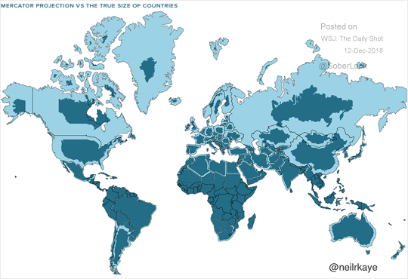
Source: Neil Kaye, United Kingdom National Weather Service; Dated: December 12, 2018

Slide 5
The Big Stories
I. Of the Past Four Centuries; Abolitions of:
1700s: Absolute Monarchies
1800s: Slavery and Serfdom
1900s: Fascism and Totalitarianism
2000s: Oppression, Abuse, and Mistreatment
II. Of the First 24 Years of this Century:
The Rise of China
Middle Eastern Relations
The Redefinition of Europe
The Positioning of the Americas
III. Of Recent Times:
Cryptocurrencies + Cybersecurity
Covid and Stimulus
Polarization
Armed Conflict
IV. Of the Investment Realm:
Derivatives
Central Banks, Debt, and Deficits
Alternative Investments
Deglobalization

Slide 6
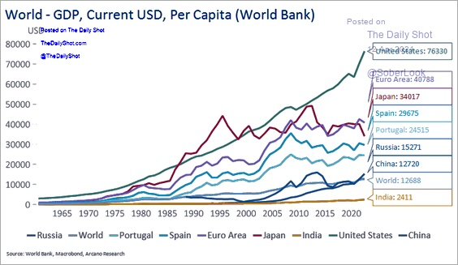
Source: World Bank, Macrobond, Arcano Research; Dated: April 12, 2024

Slide 7
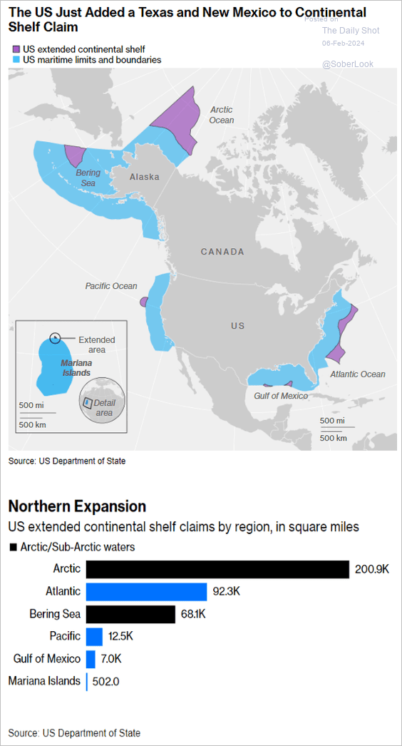
Source: U.S. Department of State; Dated: February 6, 2024
Source: U.S. Department of State; Dated: February 6, 2024

Slide 8
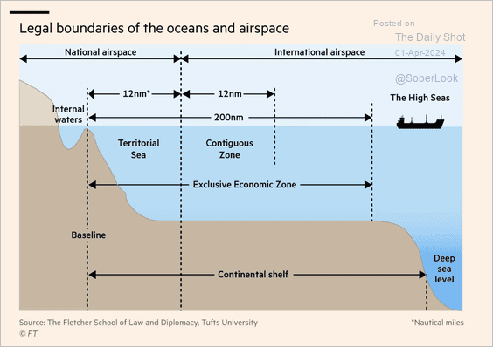
Source: The Fletcher School of Law and Diplomacy, Tufts University; Dated: April 1, 2024

Slide 9
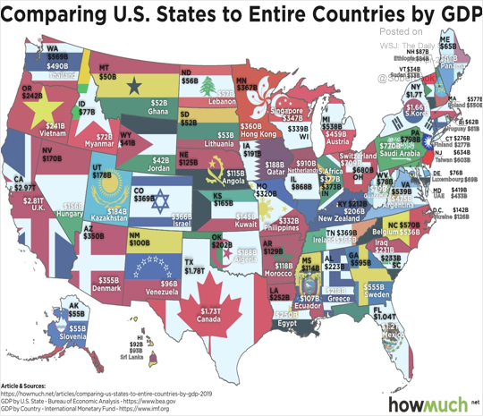
Source: U.S. Bureau of Economic Analysis, International Monetary Fund; Dated: April 1, 2019

Slide 10
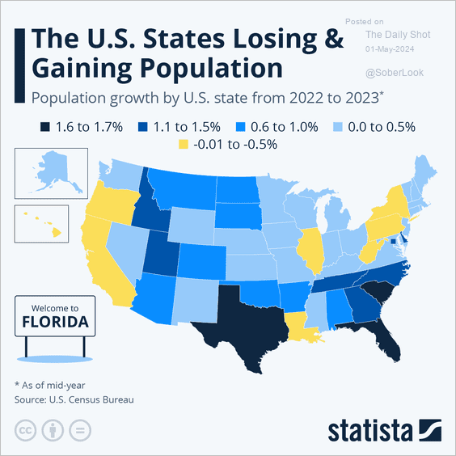
Source: U.S. Census Bureau; Dated: May 1, 2024

Slide 11
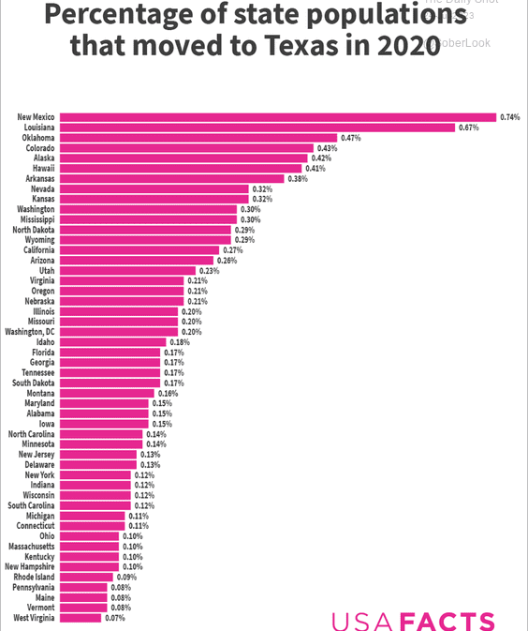
Source: US Census Bureau, U.S. Internal Revenue Service; Dated: July 24, 2023

Slide 12
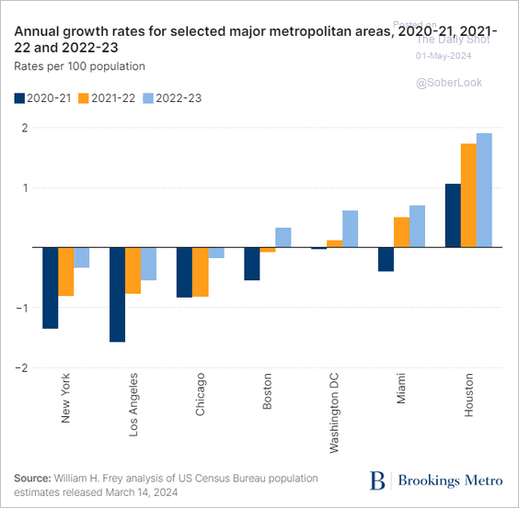
Source: W. H. Frey, U.S. Census Bureau; Dated: May 1, 2024

Slide 13
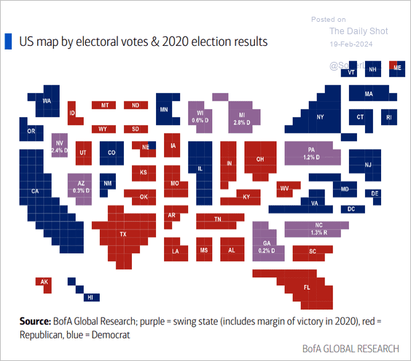
Source: BofA Global Research; Dated: February 19, 2024

Slide 14
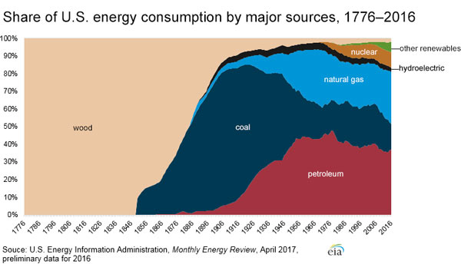
Source: U.S. Energy Information Administration; Dated: February 12, 2018

Slide 15
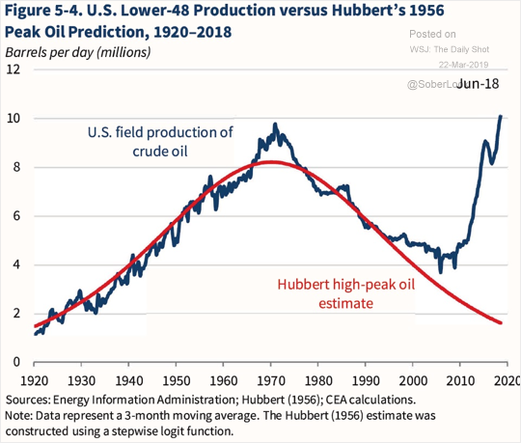
Source: Energy Information Administration; Hubbert (1956); CEA Calculations; Dated: March 22, 2019

Slide 16
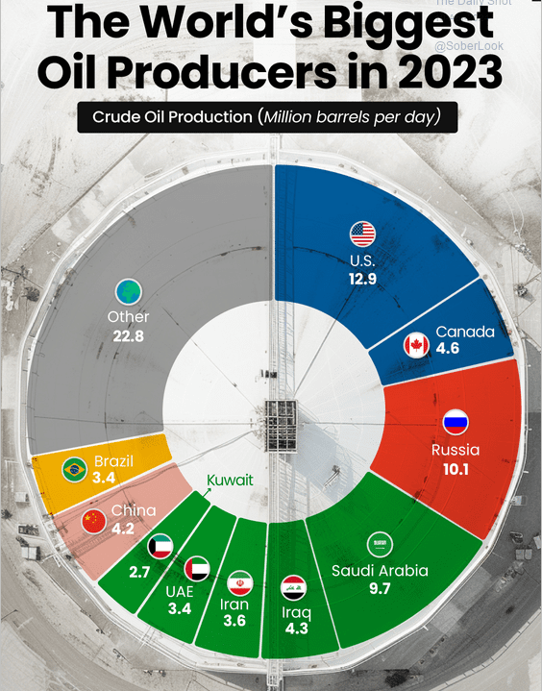
Source: U.S. Energy Information Administration, International Energy Statistics; Dated: April 10, 2024

Slide 17
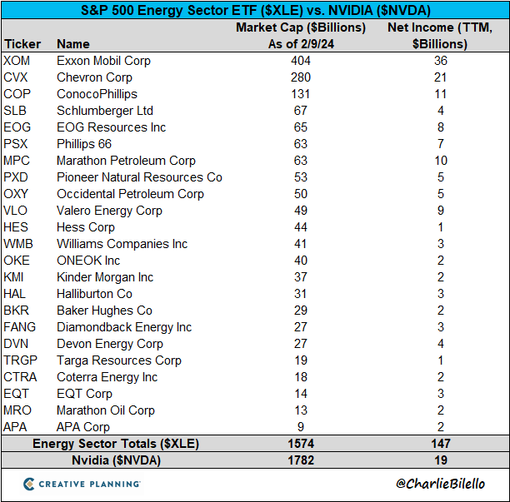
Source: Charlie Bilello; Dated: February 13, 2024

Slide 18
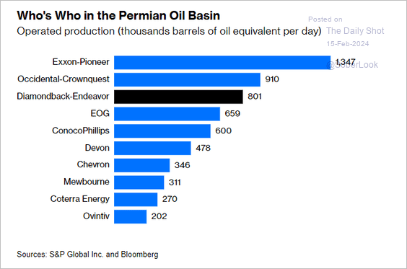
Source: S&P Global Inc.and Bloomberg; Dated: February 15, 2024

Slide 19
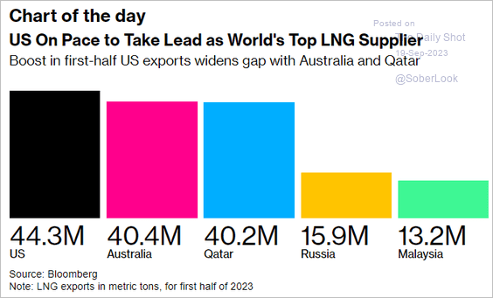
Source: Bloomberg; Dated: September 19, 2023

Slide 20
Source: Wood Mackenzie; Dated: August 17, 2023
Source: Wood Mackenzie; Dated: August 17, 2023

Slide 21
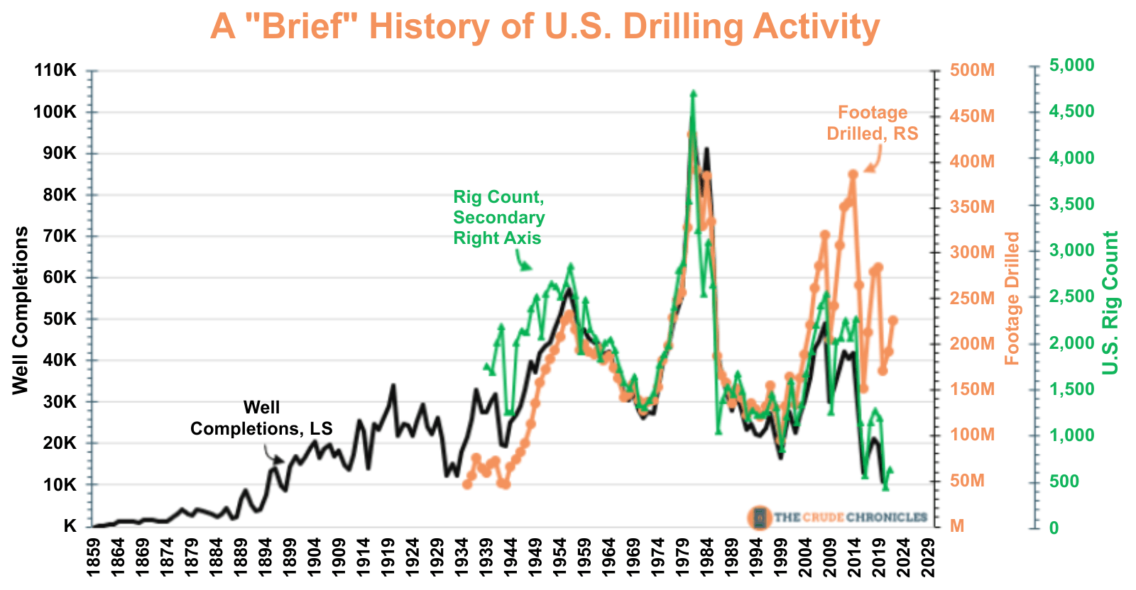
Source: The Crude Chronicles; Dated: January 30, 2023

Slide 22
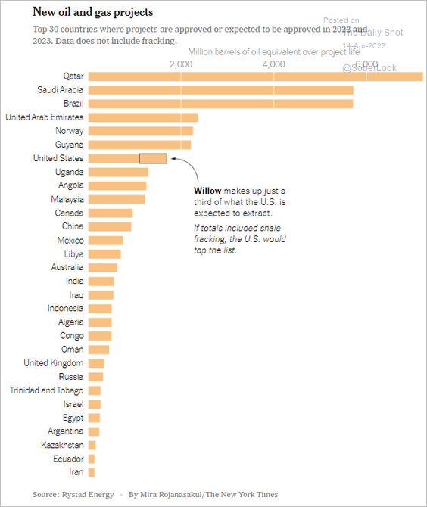
Source: Rystad Energy; Dated: April 14, 2023

Slide 23
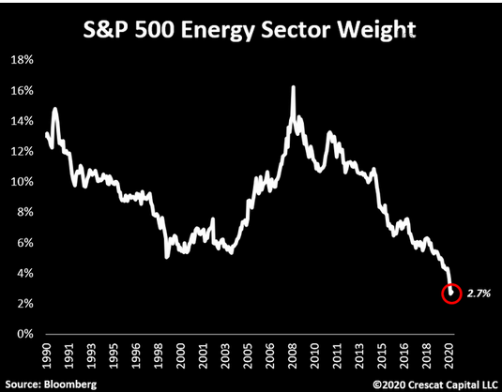
Source: Bloomberg; Crescat Capital LLC; Dated: April 7, 2020

Slide 24
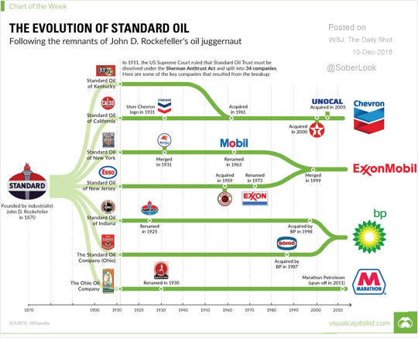
Source: Visualcapitalist.com and Wikipedia; Dated: December 10, 2018

Slide 25
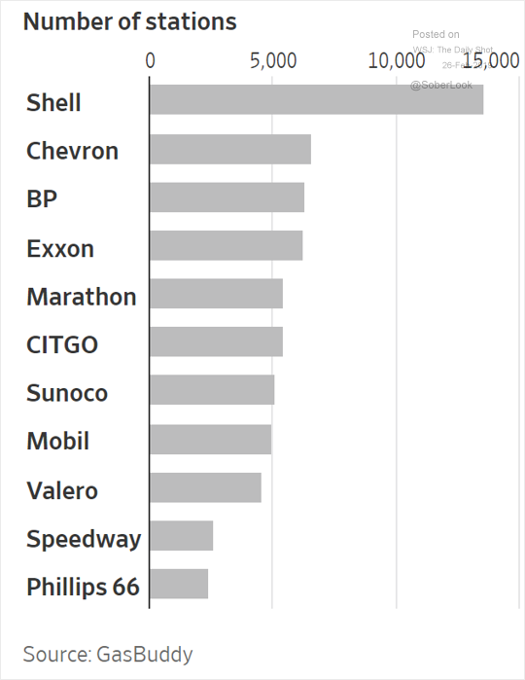
Source: GasBuddy; Dated: February 26th, 2019

Slide 26
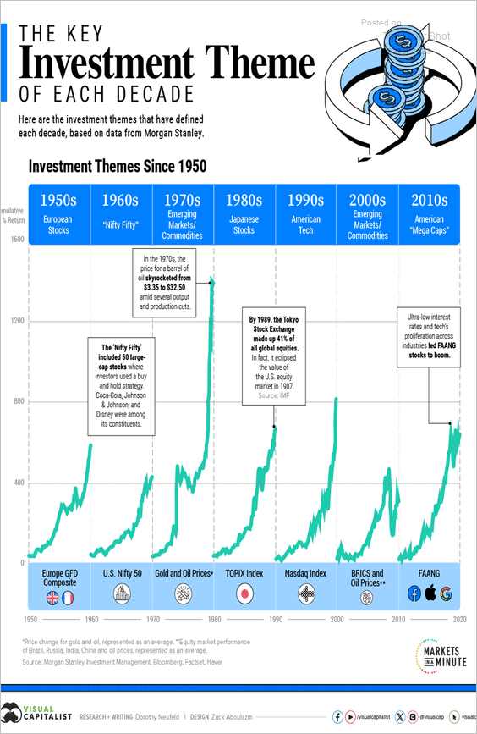
Source: Morgan Stanley Investment Management, Bloomberg, Factset, Haver; Dated: October 26, 2023

Slide 27
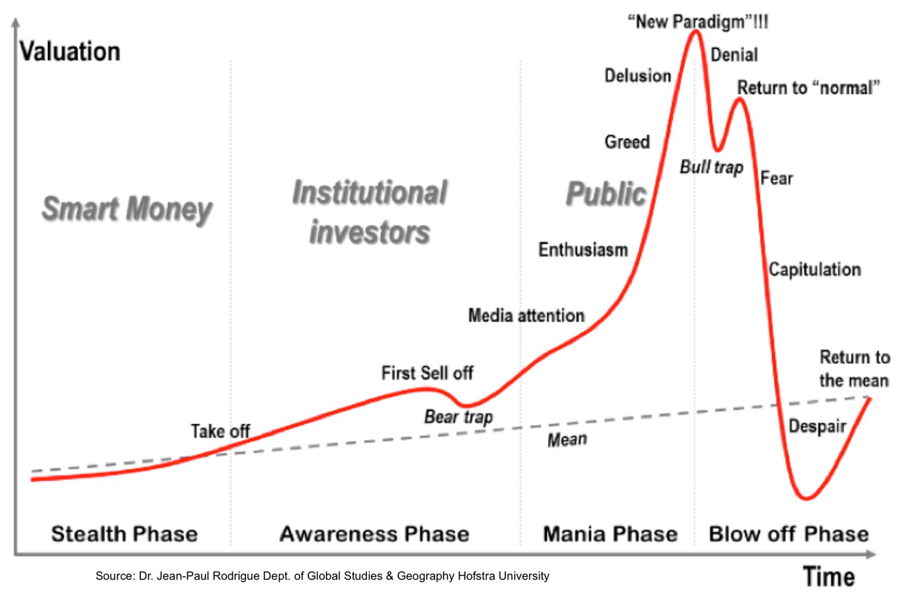
Source: Dr. Jean-Paul Rodrigue Dept. of Global Studies & Geography Hofstra University; Dated: February 6, 2015

Slide 28
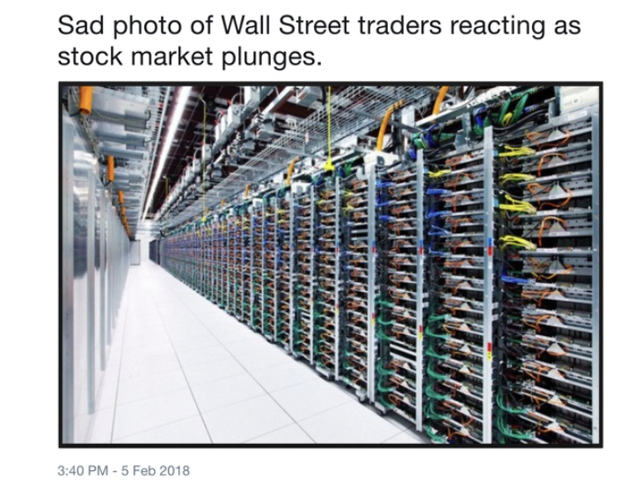
Source: Watermill Trading; Dated: February 5, 2018

Slide 29
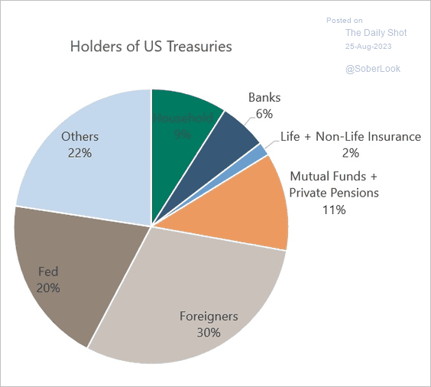
Source: Norman Mogil, Sober Look; Dated: August 25, 2013

Slide 30
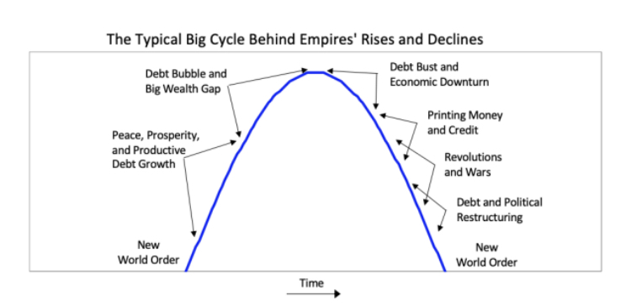
Source: The Changing World Order, by Ray Dalio, Simon, and Schuster; Dated: November 30, 2021

Slide 31
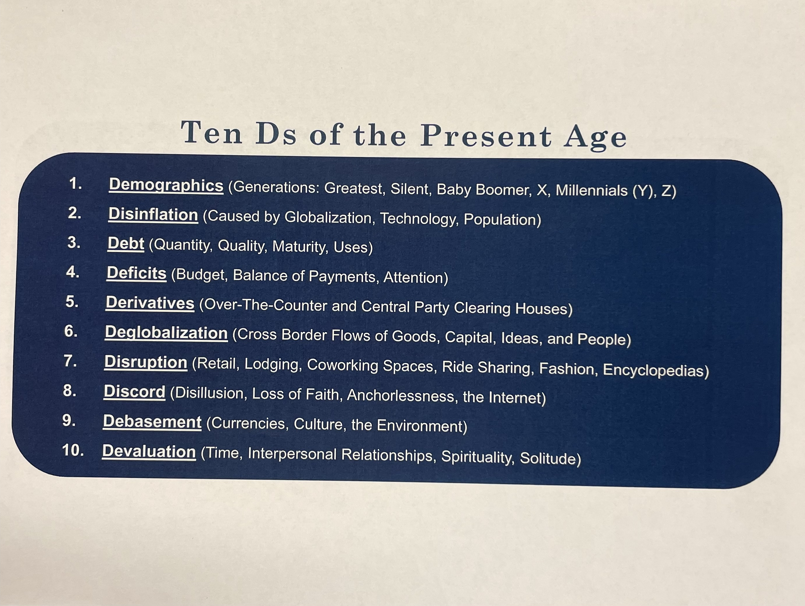
Source: David Martin Darst, CFA; Dated: March 14, 2023

Slide 32
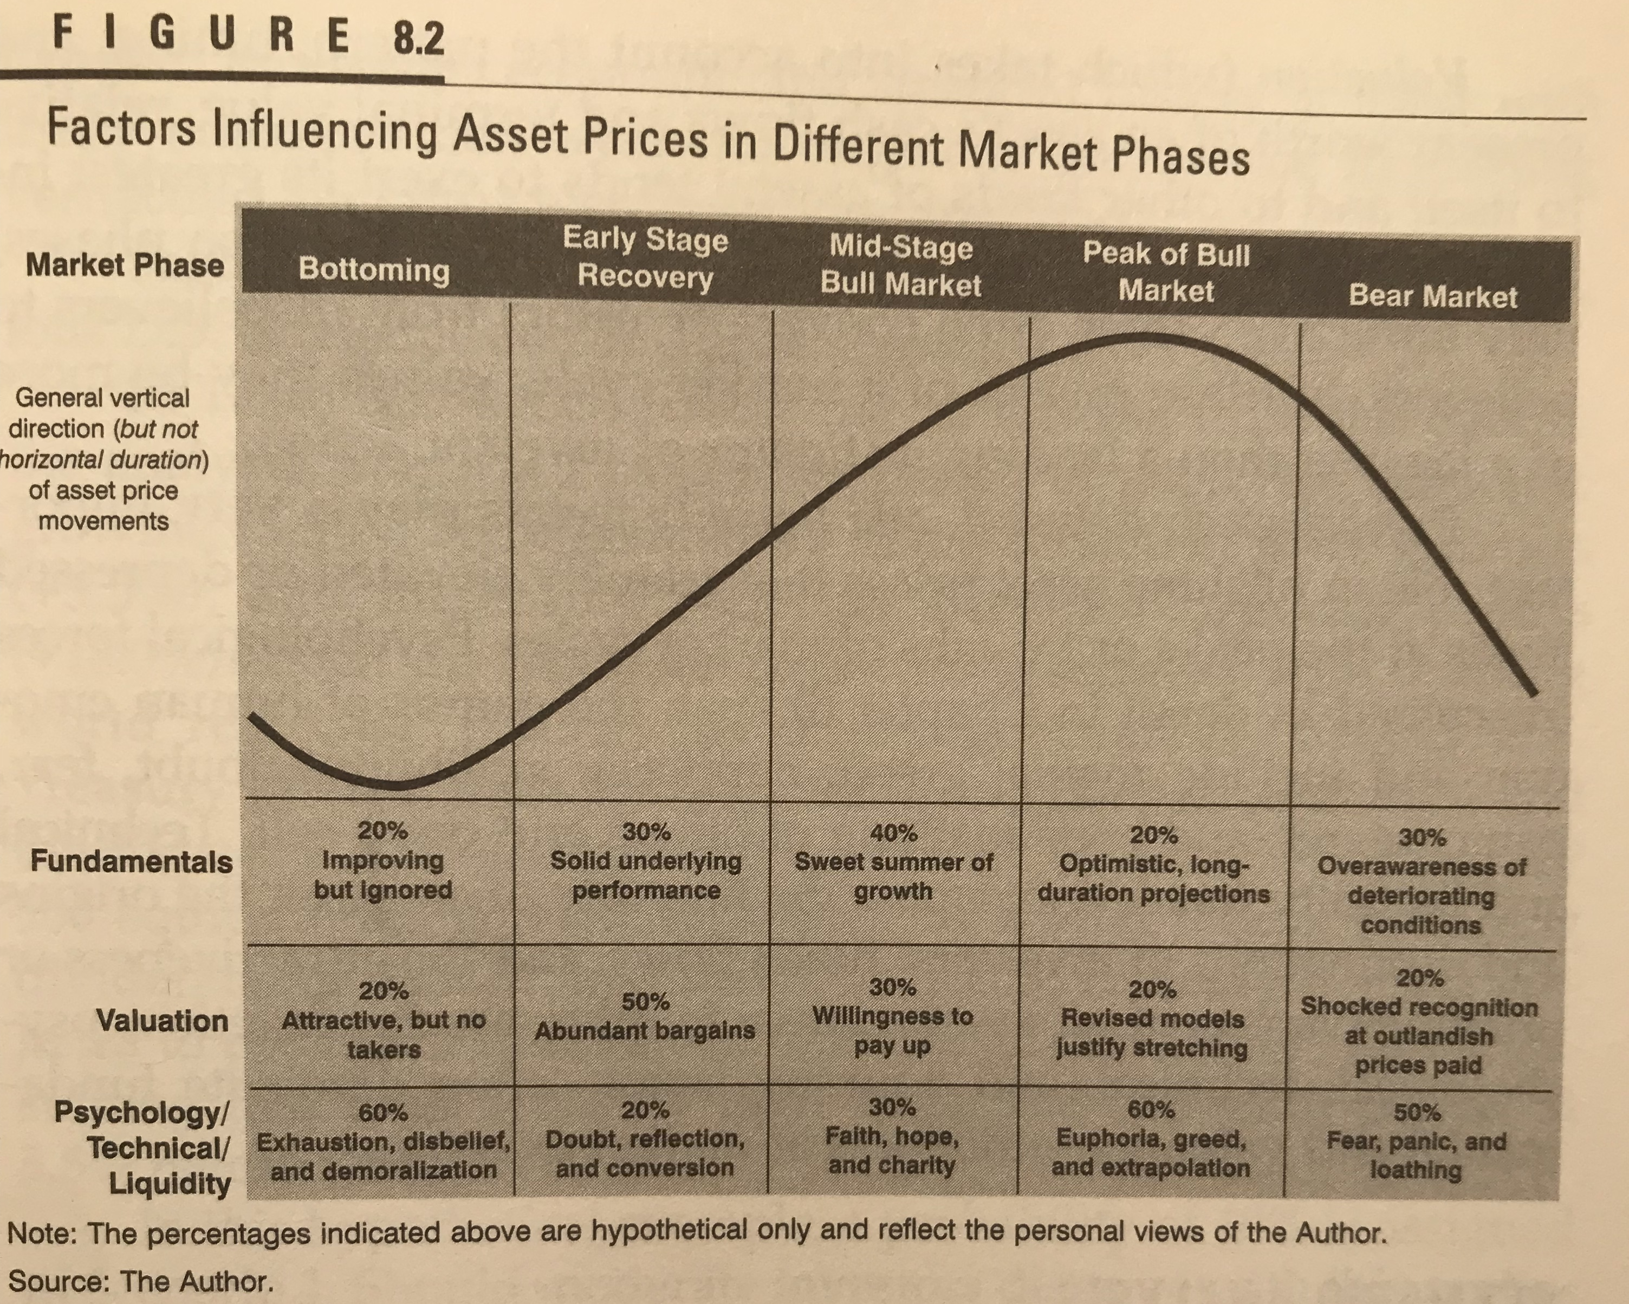
Source: The Art of Asset Allocation, Second Edition, McGraw-Hill; Dated: May 28, 2008

Slide 33
Source: Franklin Templeton Investments; Dated: October 15, 1992

Slide 34
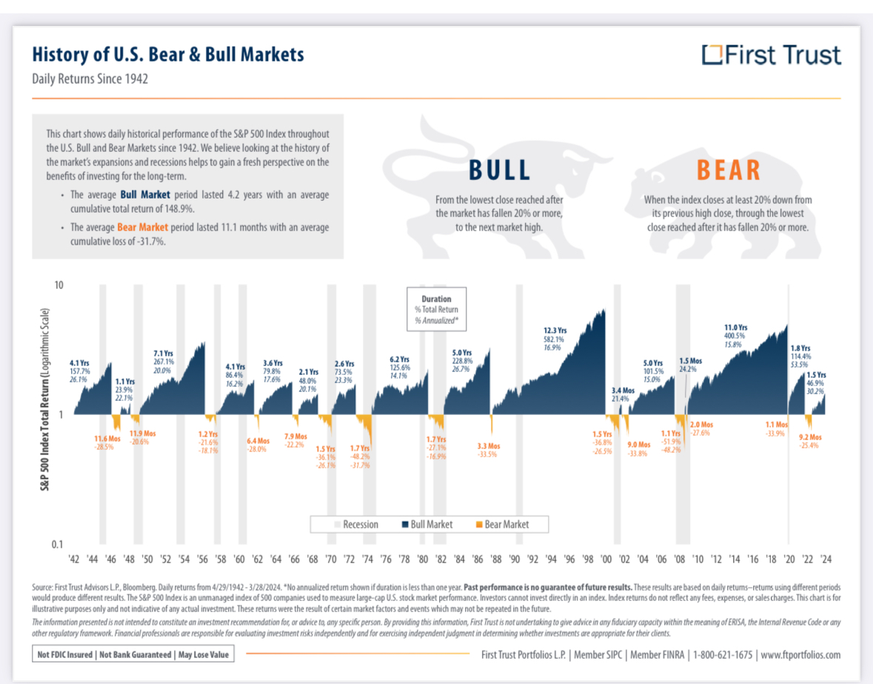
Source: First Trust; Dated: May 15, 2024

Slide 35
Source: David Martin Darst, CFA; Dated: November 14, 1997

Slide 36
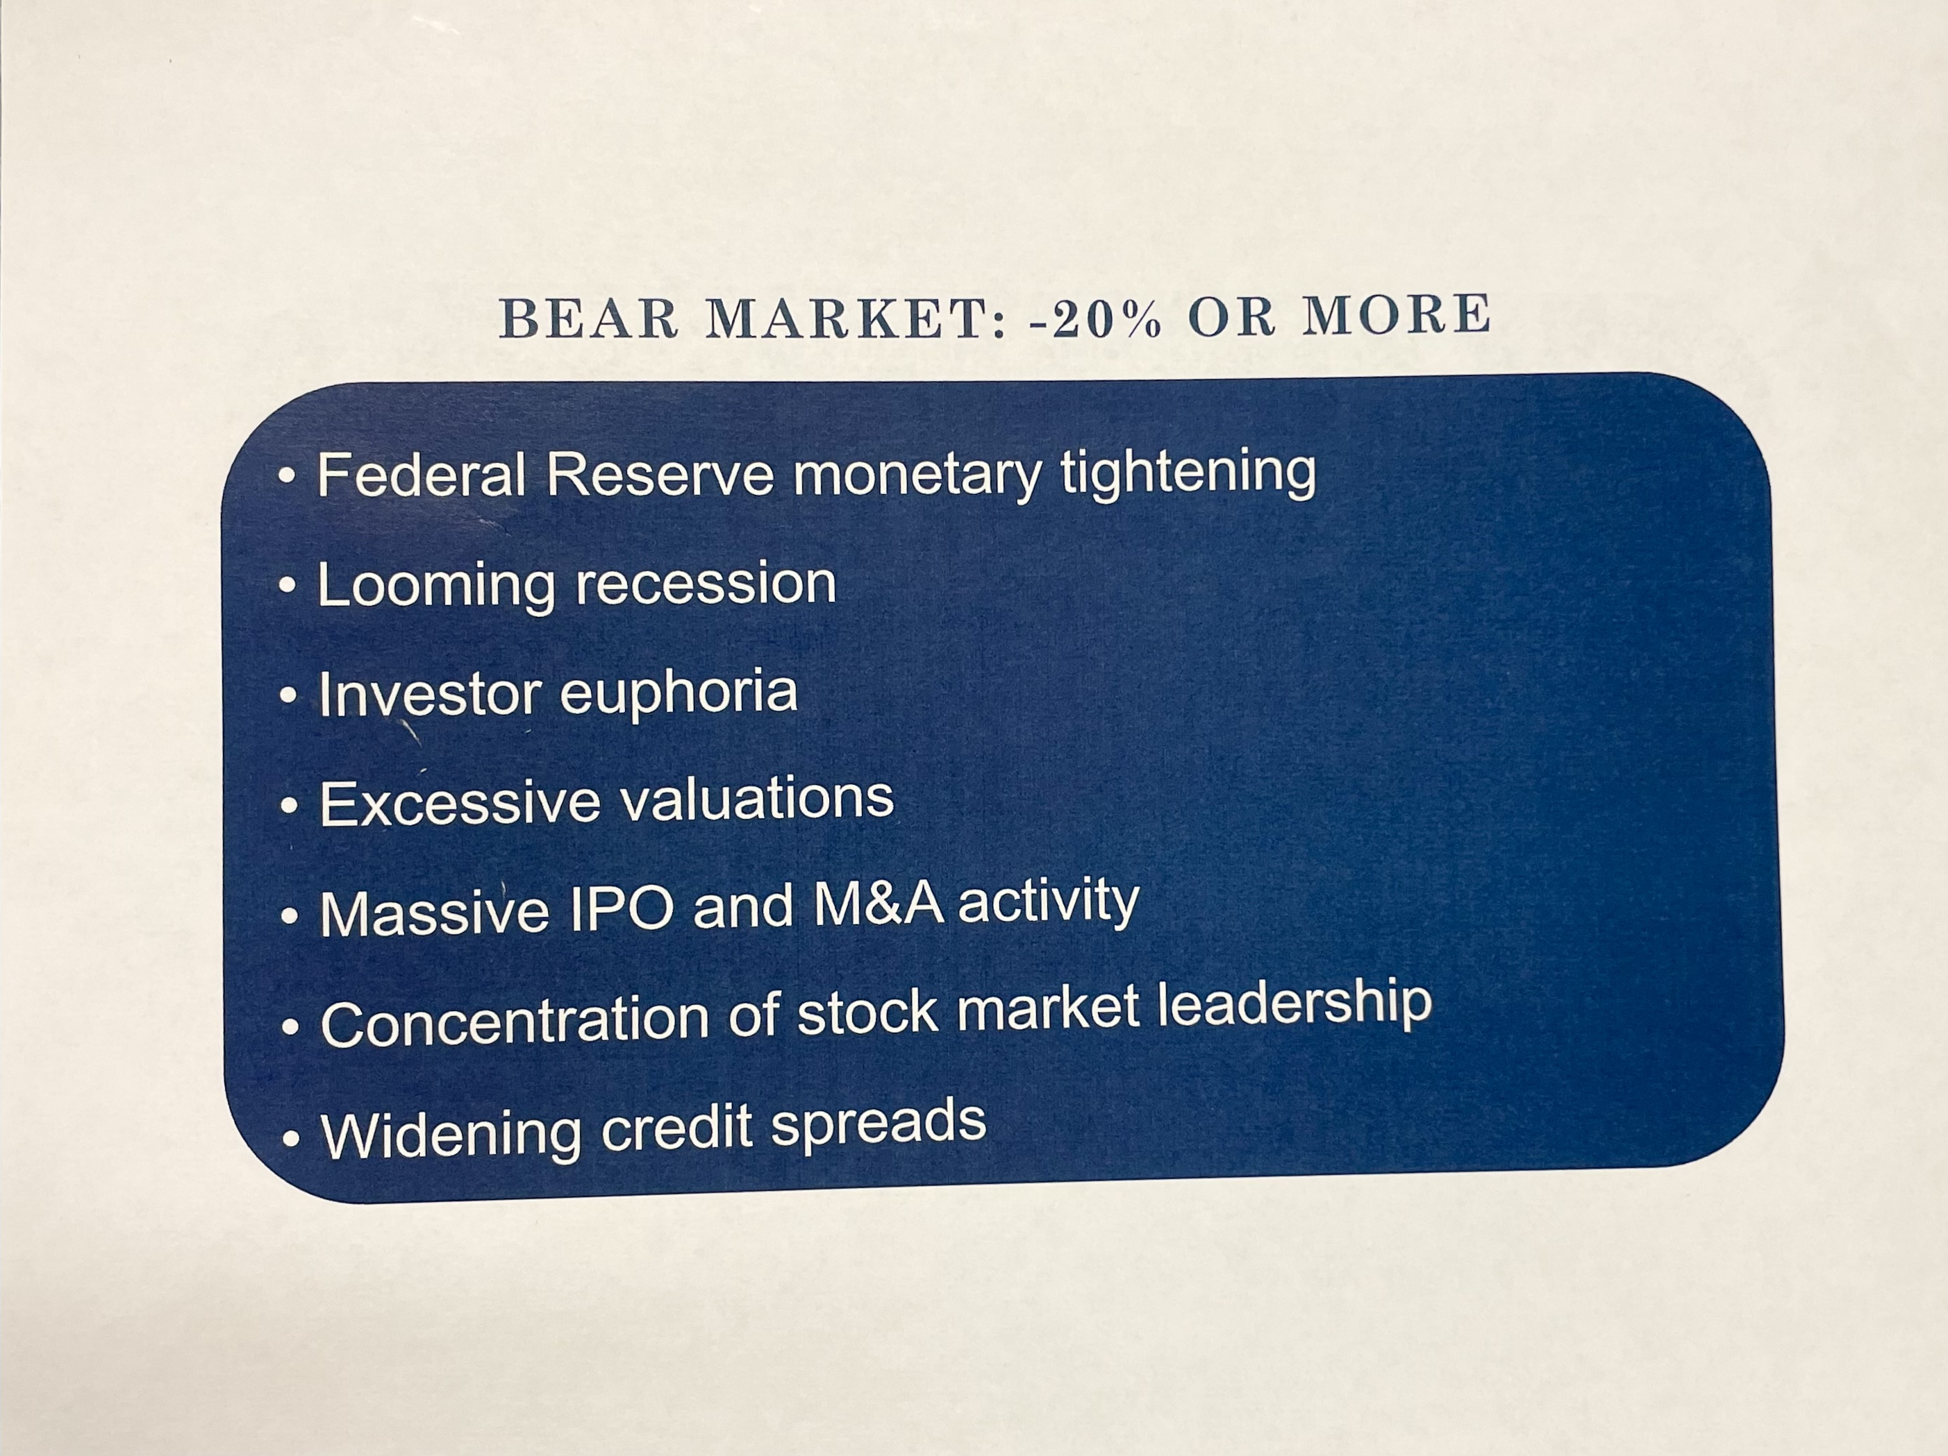
Source: David Martin Darst, CFA; Dated: November 14, 1997

Slide 37
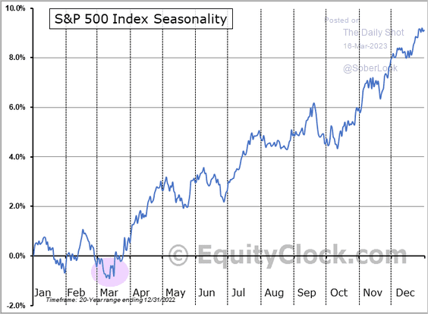
Source: EquityClock.com; Dated: March 18, 2023

Slide 38
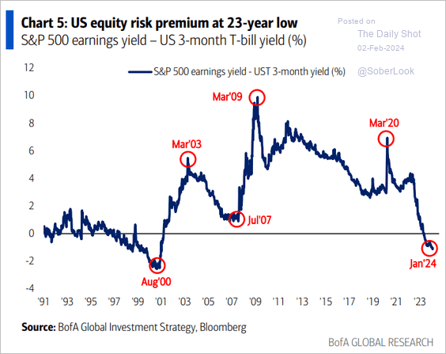
Source: BofA Global Investment Strategy, Bloomberg; Dated: February 2, 2024

Slide 39
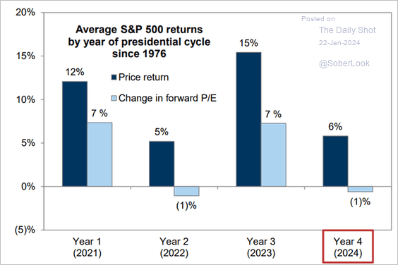
Source: Norman Mogil, Sober Look; Dated: January 22, 2024

Slide 40
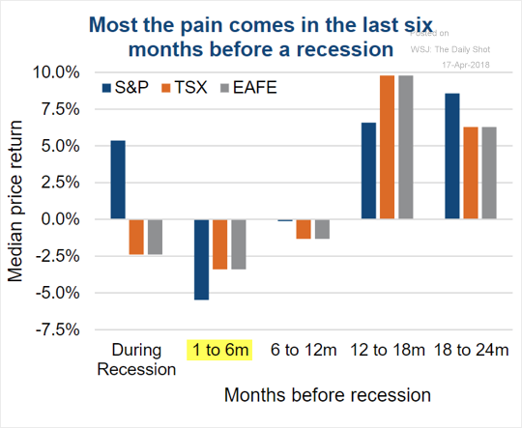
Source: The Wall Street Journal; Dated: April 17, 2018

Slide 41
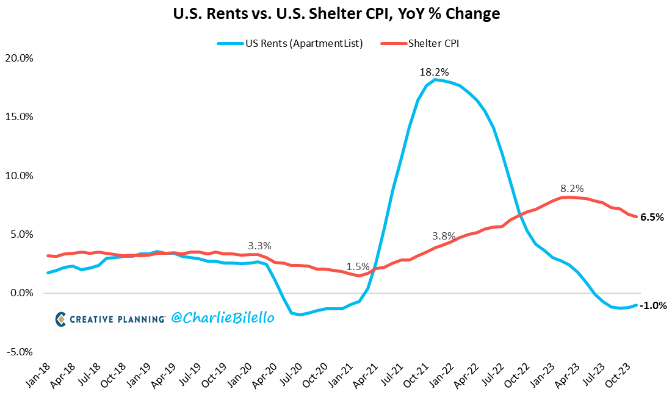
Source: Charlie Bilello; Dated: December 18, 2023

Slide 42
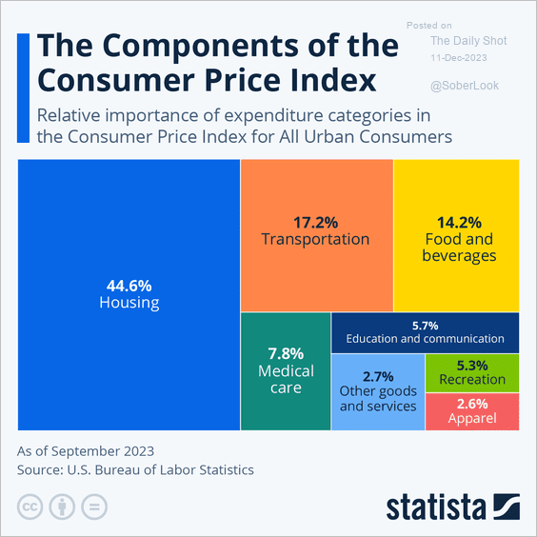
Source: U.S. Bureau of Labor Statistics; Dated: December 11, 2023

Slide 43
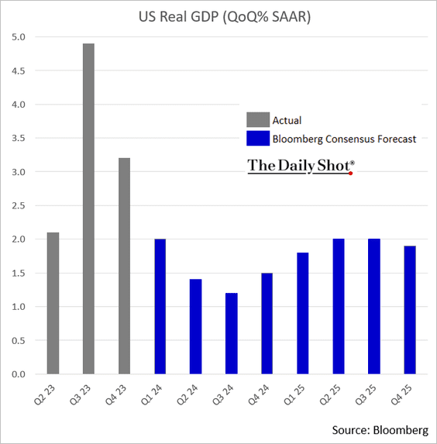
Source: Bloomberg; Dated: March 26, 2024

Slide 44
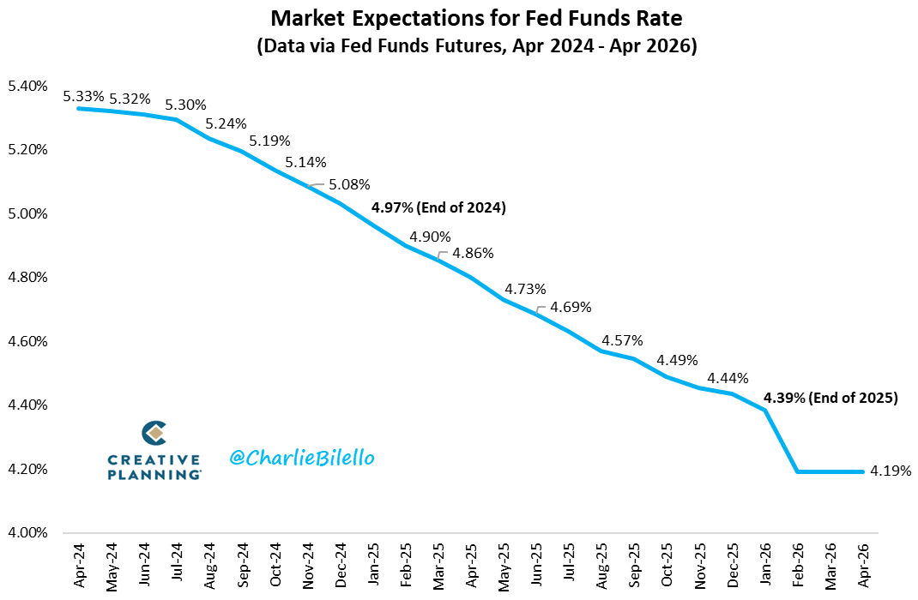
Source: Charlie Bilello; Dated: April 30, 2024

Slide 45
Source: BofA Global Investment Strategy; Dated: March 4, 2023

Slide 46
Source: Vala Afshar, Chief Digital Evangeslist, Salesforce, Inc.; Dated: September 26, 2018

Slide 47
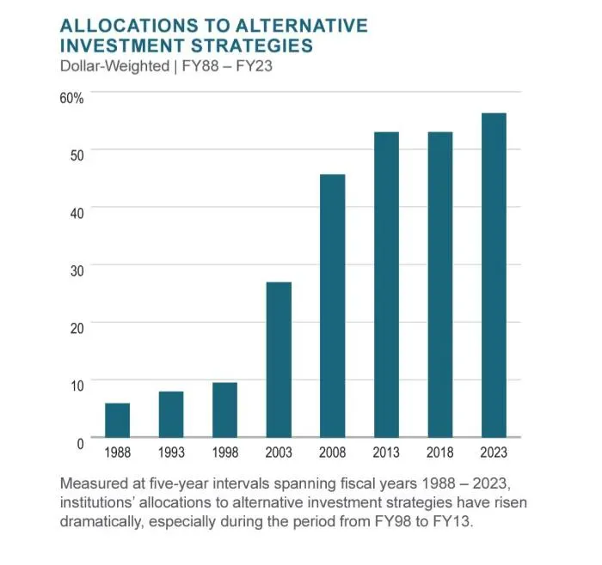
Source: The Daily Shot; Dated: May 8, 2024

Slide 48
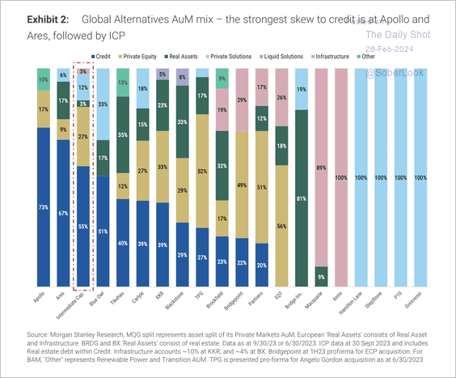
Source: Morgan Stanley Research; Dated: February 26, 2024

Slide 49
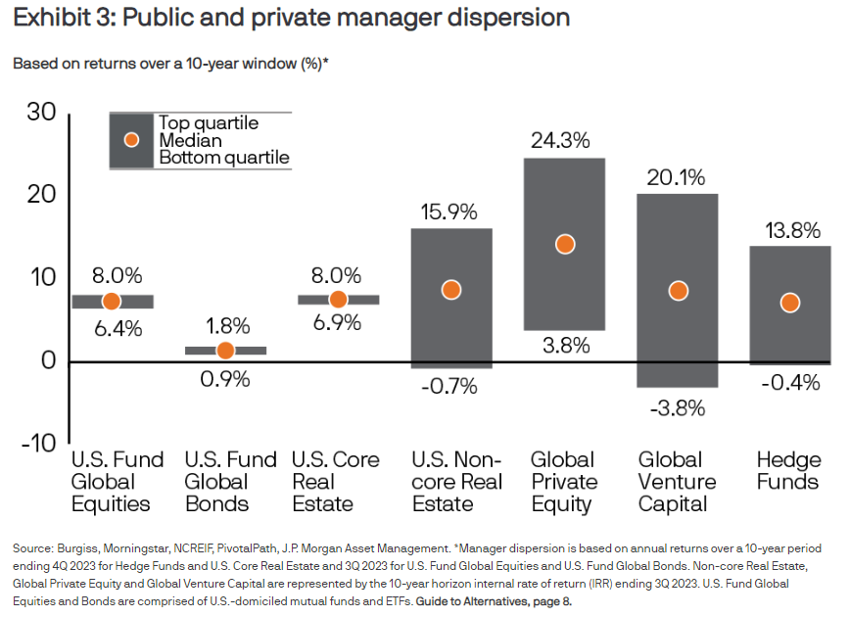
Source: Burgiss, Morningstar, NCREIF, PivotalPath, J.P. Morgan Asset Management; Dated: April 2, 2024

Slide 50
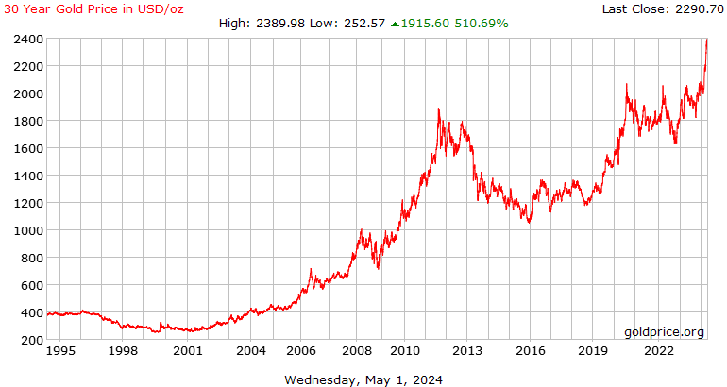
Source: Goldprice.org; Dated: May 1, 2024

Slide 51
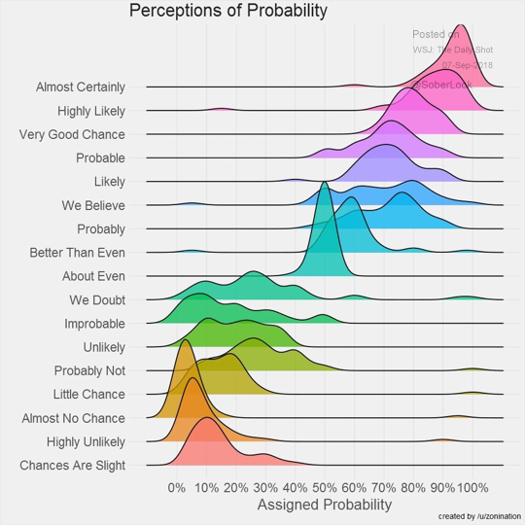
Source: /u/zonination; The Daily Shot; Dated: September 7, 2018

Slide 52
The Top Ten Secrets to Success Adapted from Investor’s Business Daily, founded in 1984
How You Think is Everything: Always be positive. Think success, not failure. Beware of a negative environment.
Decide Upon Your True Dreams and Goals: Write down your specific goals and develop a plan to reach them.
Take Action: Goals are nothing without action. Don’t be afraid to get started. Just do it.
Never Stop Learning: Go back to school or read books. Get training and acquire skills.
Be Persistent and Work Hard: Success is a marathon, not a sprint. Never give up.
Learn to Analyze Details: Get all the facts, all the input. Learn from your mistakes.
Focus Your Time and Money: Don’t let other people or things distract you.
Don’t Be Afraid to Innovate; Be Different: Following the herd is a sure way to mediocrity.
Deal and Communicate with People Effectively: No person is an island. Learn to understand and motivate others.
Be Honest and Dependable; Take Responsibility: Otherwise, Nos. 1-9 won’t matter.
Source: Investor’s Business Daily; Dated: July 2, 2019

