Slide 2
Technology, Free and Simple:
An AI Primer
Jerris Johnson, CPL
AI Strategist and Implementer | FutureProof Tech
Energy SME | Rowland.ai

Slide 3
Understanding AI
What is AI?
AI Applications
The AI Renaissance
Artificial intelligence refers to the ability of machines to perform tasks in a smart and intelligent way, mimicking the cognitive functions of the human mind. This includes natural language processing, allowing AI to understand and communicate like a human.
Cutting-edge AI tools like ChatGPT, Claude, and Copilot are revolutionizing how land professionals approach their work. These large language models can be treated like knowledgeable experts, providing invaluable insights and assistance across a wide range of land and energy-specific tasks.
The oil and gas and renewables industries are catching on to the current "AI Renaissance," with landmen poised to reap the benefits of this transformative technology. By embracing AI, landmen can enhance their efficiency, sharpen their strategic decision-making, and maintain a competitive edge in an ever-evolving industry.

Slide 4
Industry Knowledge at Your Fingertips
Regulatory Insights
Streamlining Compliance
AI can provide landmen with invaluable insights by analyzing public regulatory data, helping them stay up-to-date on the latest state oil and gas rules and procedures.
Landmen can leverage AI to quickly understand the nuances of title and drilling requirements, enabling them to navigate compliance more efficiently and with greater confidence.
Contextual Understanding
Proactive Monitoring
By tapping into AI's natural language processing capabilities, landmen can engage in more natural, context-driven conversations to uncover critical details.
AI can be leveraged to continuously monitor activities, alerting landmen of updates and ensuring they remain at the forefront of the energy industry's evolving landscape.

Slide 5
Tapping Into AI’s Creative Potential
Innovative Perspective
Ideation and Brainstorming
Scenario Planning
AI models can provide landmen with "out-of-the-box" perspectives and ideas, challenging traditional approaches and sparking new avenues for exploration.
Landmen can leverage AI as a collaborative partner in the ideation process, using the models to generate a diverse range of concepts and solutions that can then be refined and optimized for their specific needs, such as negotiations and contract drafting.
AI can help landmen anticipate and plan for a variety of potential scenarios for lease analysis, trade options, drilling and acreage retention strategies, and acquisition and divestiture strategies.

Slide 6
Elevating Leasing and Title Abilities
Lease Negotiation Strategies
Title Due Diligence
AI can provide landmen with expert-level advice on negotiating lease terms, drawing from a wealth of industry knowledge and past successful negotiations to identify optimal strategies.
Landmen can leverage AI to quickly summarize key court cases, identify potential title issues, and ensure compliance with published state title standards, enhancing the overall title review process.
Contractual Optimization
Streamlined Workflows
AI-powered contract review and drafting can help landmen identify areas for improvement in documents like JOAs, PSAs, letter agreements, and leases, ultimately strengthening their effectiveness and efficiency.
By automating repetitive tasks and providing intelligent assistance, AI can significantly boost landmen's productivity, freeing up time for more strategic and value-added activities.

Slide 7
Getting Started with AI
Exploration
Landmen should begin by experimenting with free-to-use AI models like ChatGPT, Claude, Copilot, Perplexity, Pi, and Gemini, and exploring their capabilities and understanding how these tools can be integrated into their existing workflows.
Courageous Integration
Land professionals should not be afraid to introduce AI into their day-to-day activities. They should practice integrating these tools into their existing processes and regularly re-evaluate their role as the capabilities of the technology continue to evolve.
Skill Development
To unlock the full potential of AI, landmen should seek training and practice that teach effective prompting techniques and strategies for leveraging these technologies to their advantage.

Slide 8
The AI-Augmented Landman
Automation
AI can handle routine, non-strategic tasks, freeing up landmen to focus on more complex and value-added activities.
Augmentation
By leveraging AI as a cognitive assistant, landmen can enhance their productivity, decision-making, and overall effectiveness.
Transformation
As AI capabilities continue to evolve, landmen must be prepared to adapt and redefine their roles, embracing the transformative potential of this technology.

Slide 9
Customized AI for Landmen
Proprietary Models
Tailored Capabilities
It is possible to create custom AI models trained specifically on landman-centric data, procedures, and industry knowledge. These models can dramatically reduce the need for detailed prompting, as they already possess a deep understanding of the landman's domain.
Customized AI models can be fine-tuned to address the unique challenges and requirements of individual landmen or their clients or companies, providing hyper-specialized assistance and insights that are perfectly aligned with their specific needs.
Continuous Learning
Competitive Advantage
As landmen continue to use and interact with these custom AI models, the models can learn and evolve, becoming increasingly adept at understanding the landman's preferences, workflows, and decision-making processes.
By leveraging custom AI models, landmen and their organizations can gain a significant competitive edge, accessing tailored insights and capabilities that may not be available to their industry peers.

Slide 10
Standard vs. Custom

Slide 11
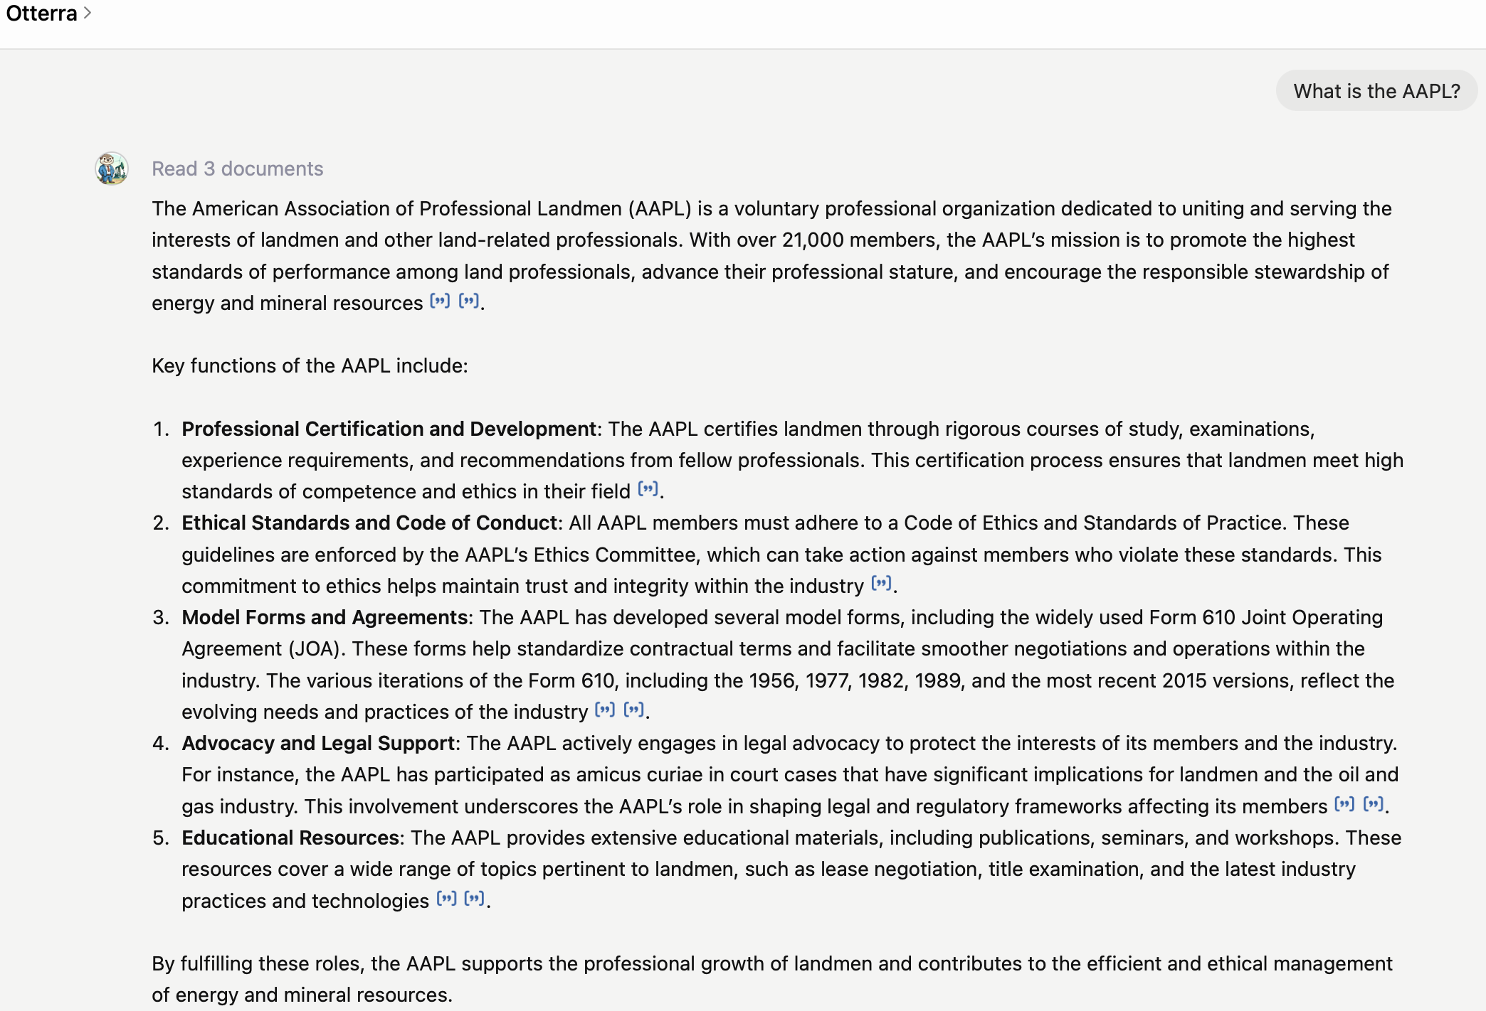
Standard vs. Custom

Slide 12
Lease Analysis with AI

Slide 13
Effective Prompt Engineering
Specificity
Consistent Phrasing
Clarifying Questions
Providing AI models with detailed, context-rich prompts is key to unlocking their full potential. Landmen should treat the AI like a seasoned expert, briefing it on the specific task at hand and offering relevant background information.
Using consistent language and phrasing when interacting with AI models can help establish a more natural and productive dialogue, as the AI learns to anticipate the landman's communication style.
Encouraging AI models to ask clarifying questions can help them better understand the landman's intent and requirements, leading to more accurate and relevant outputs.
1
2
3

Slide 14
Ethical Considerations
Unbiased AI
It is crucial to ensure that AI models used by landmen are unbiased and respect privacy, avoiding the perpetuation of harmful prejudices or the misuse of sensitive information.
Human Review
While AI can provide valuable assistance, it is essential that landmen maintain human oversight and review of critical outputs to ensure accuracy, reliability, and alignment with ethical standards.
Transparency
Landmen should consider communicating to clients and stakeholders when AI has been involved in their work, promoting transparency and building trust in the use of these technologies.

Slide 15
A Future-Ready Profession
Competitive Edge
Enhanced Productivity
Continuous Learning
Landmen who embrace the power of AI and learn to leverage these transformative technologies will gain a significant competitive advantage, positioning themselves as innovators and leaders within the industry.
By automating repetitive tasks and augmenting their strategic decision-making, AI-savvy landmen can dramatically improve their productivity and efficiency, allowing them to focus on higher-value activities.
As AI capabilities continue to evolve, landmen must be committed to ongoing learning and adaptation, ensuring they remain at the forefront of the industry's technological transformation.

Slide 16
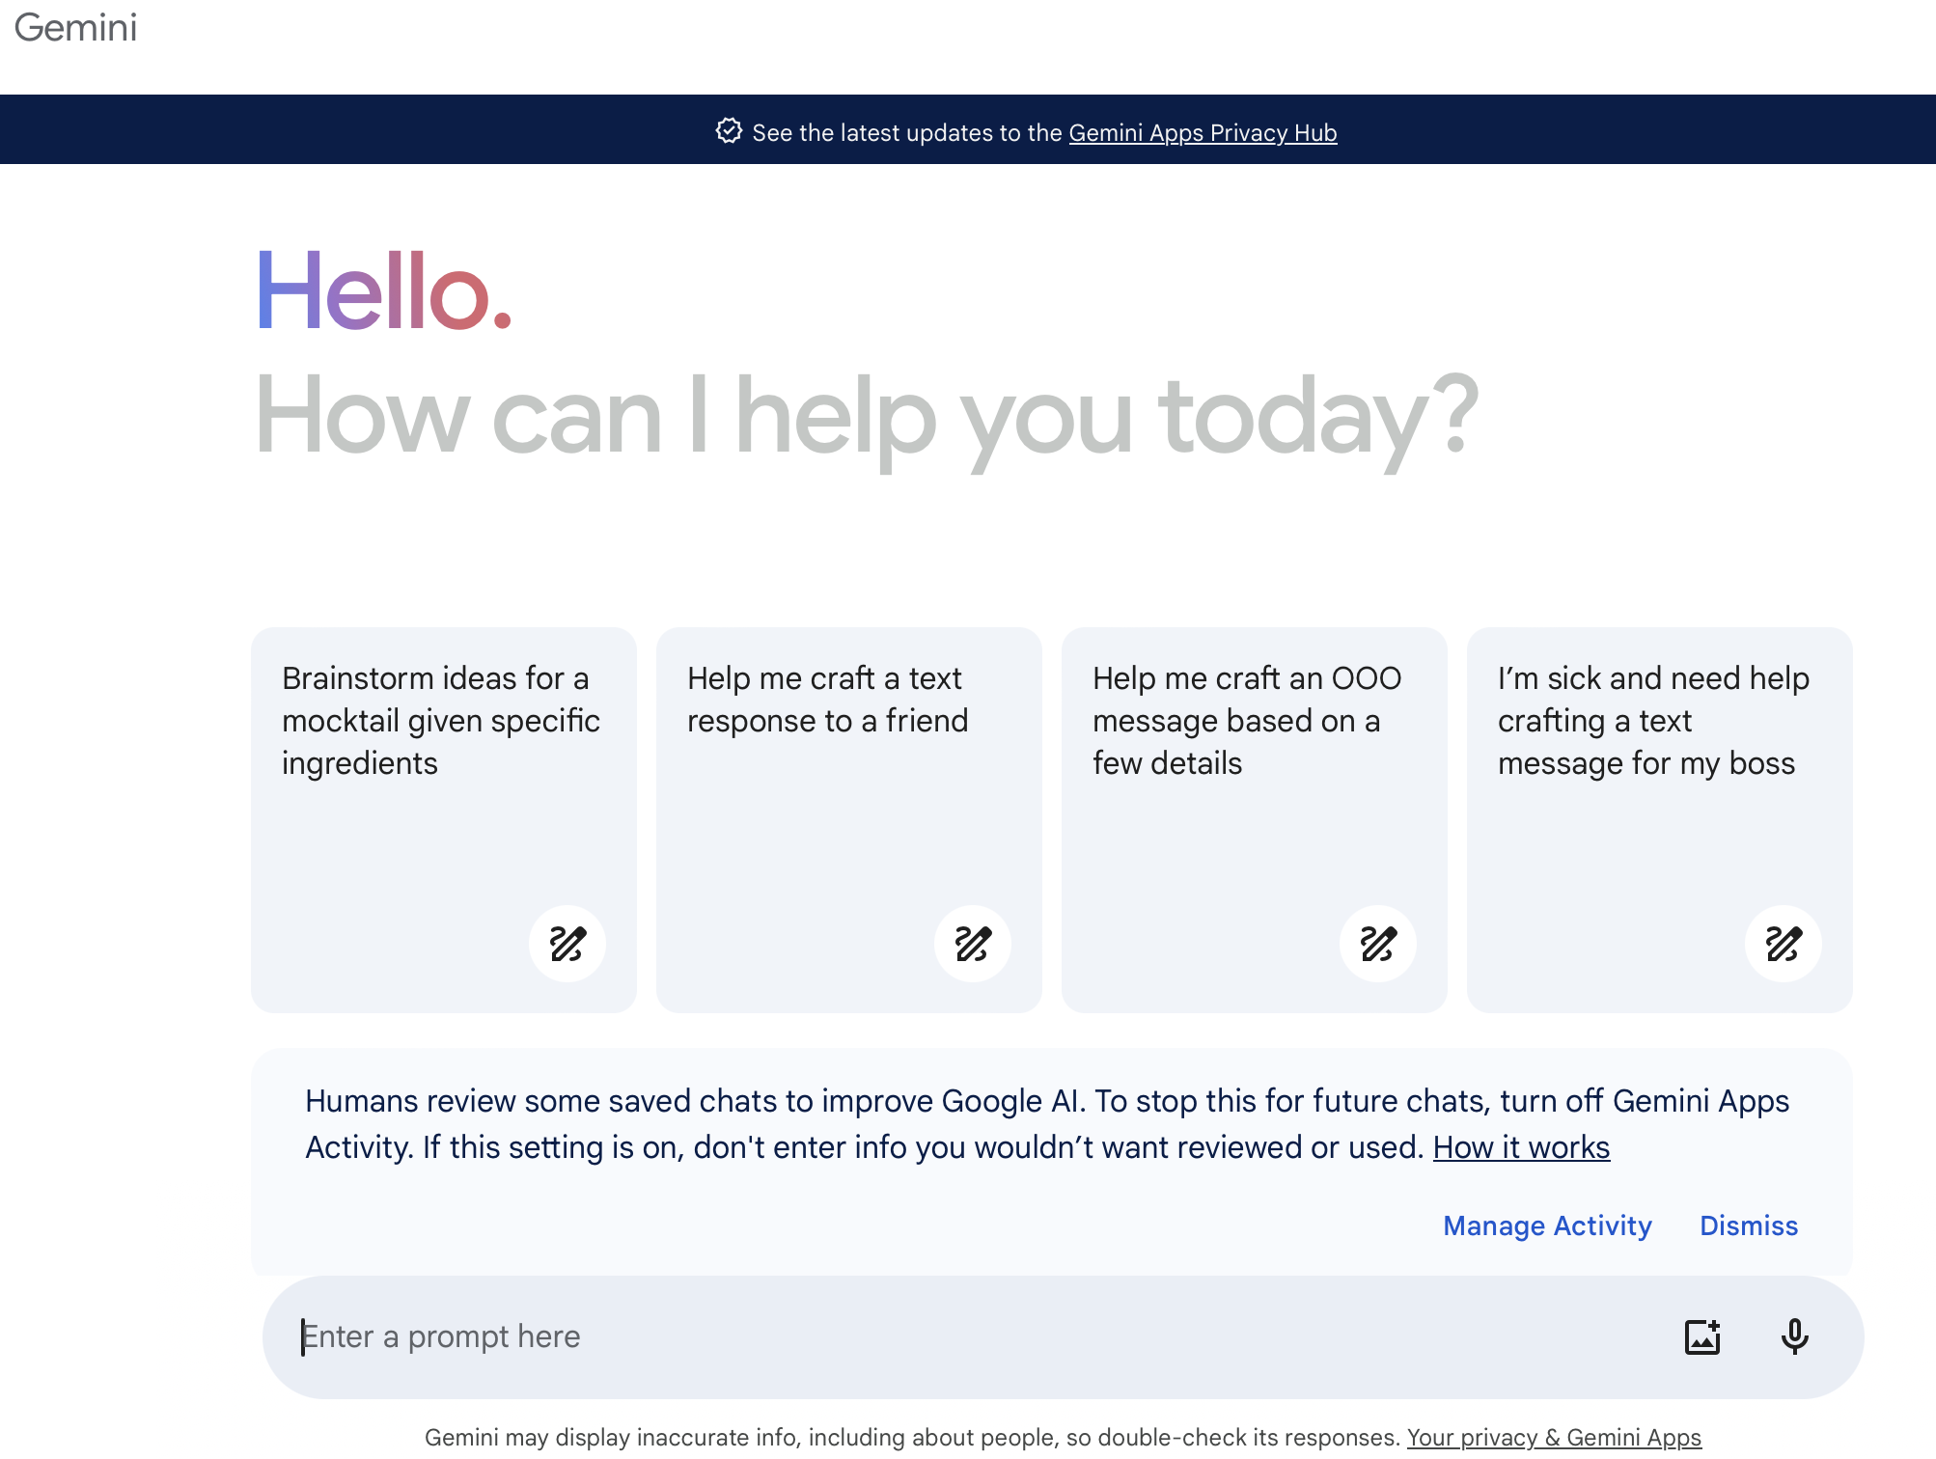
Tools to Try
Google Gemini gemini.google.com

Slide 17
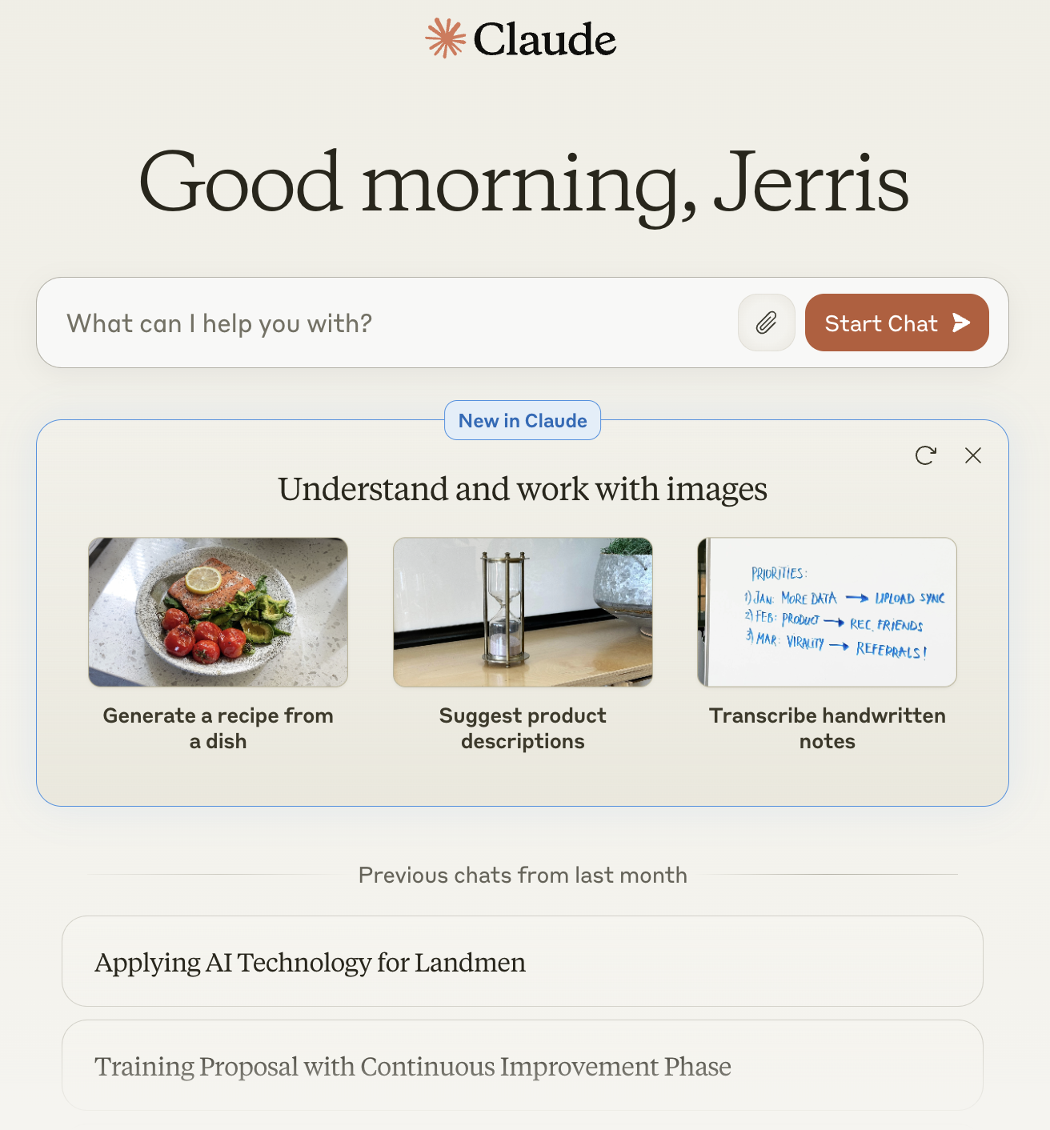
Tools to Try
Anthropic Claude Claude.ai

Slide 18
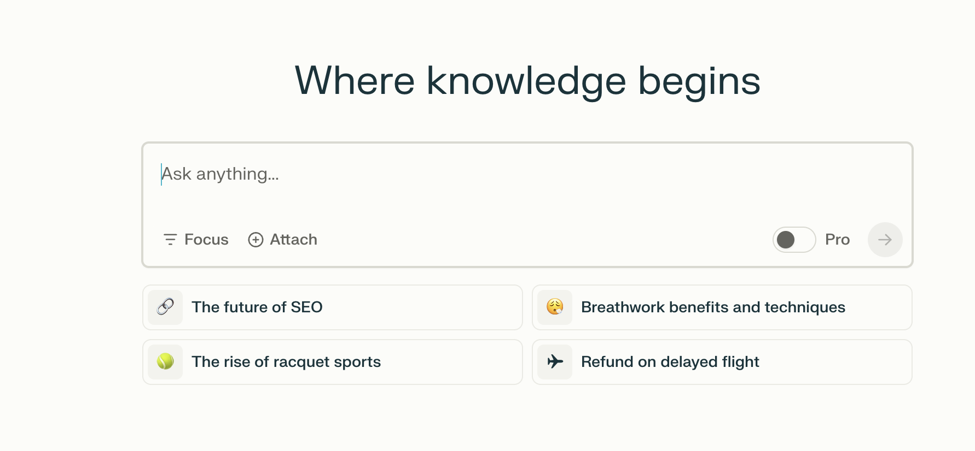
Tools to Try
Perplexity
Perplexity.ai

Slide 19
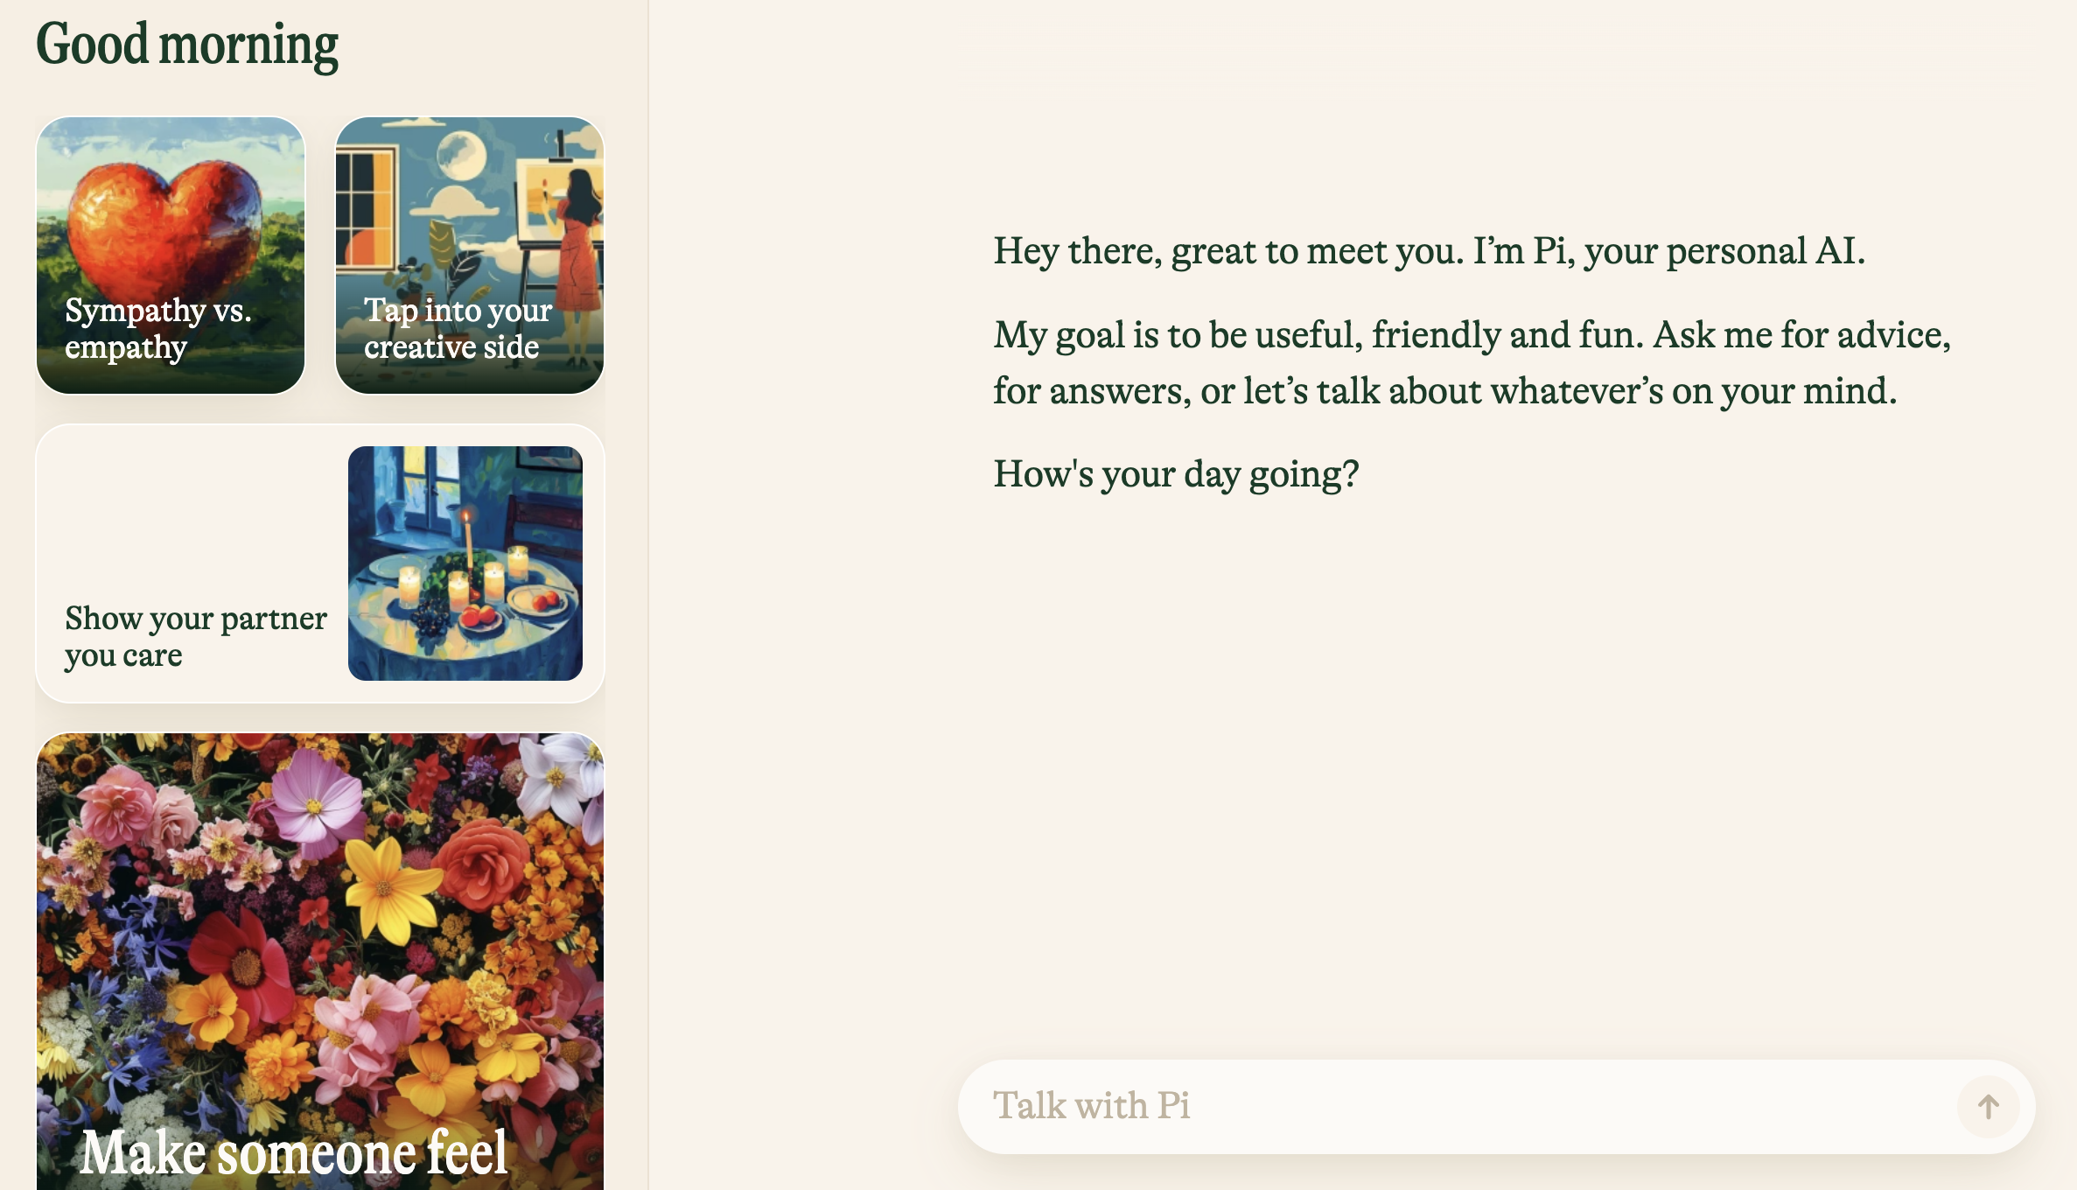
Tools to Try
Inflection Pi
Pi.ai

Slide 20
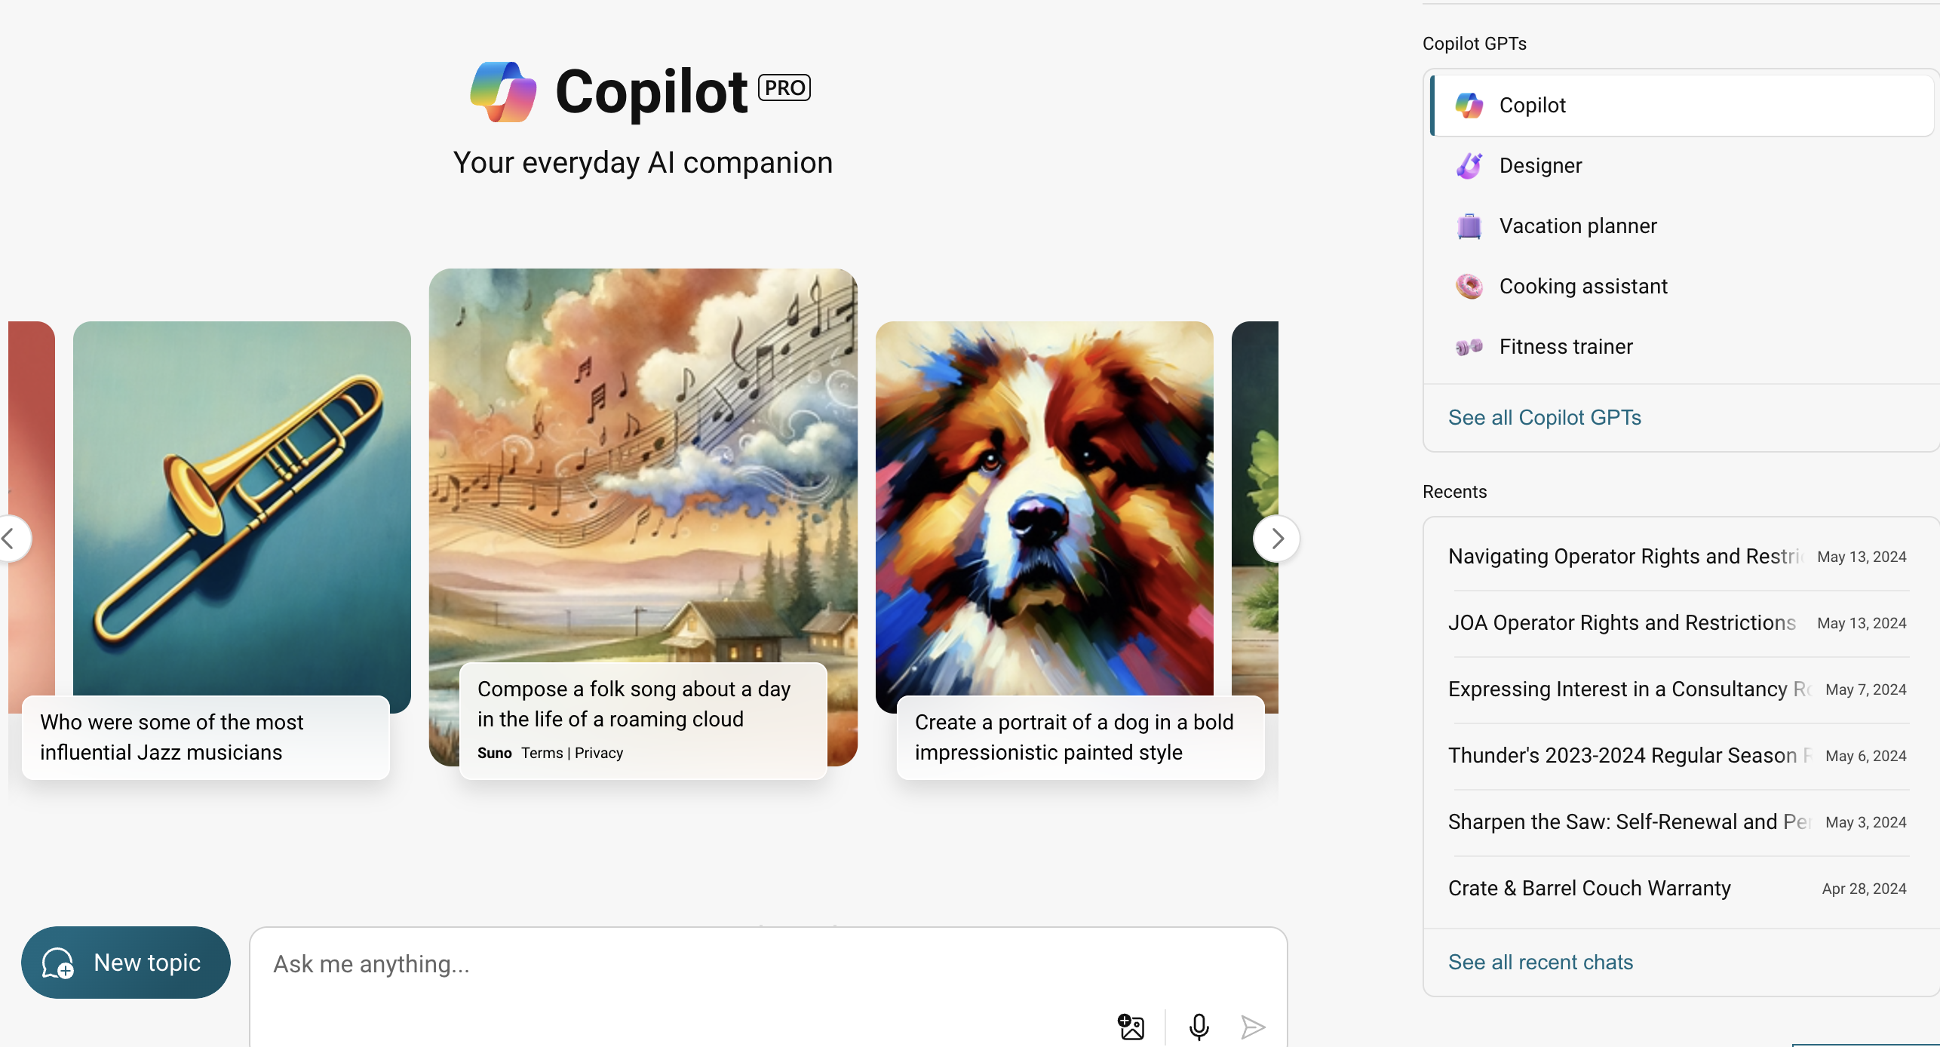
Tools to Try
Microsoft Copilot - Copilot.Microsoft.com

Slide 21
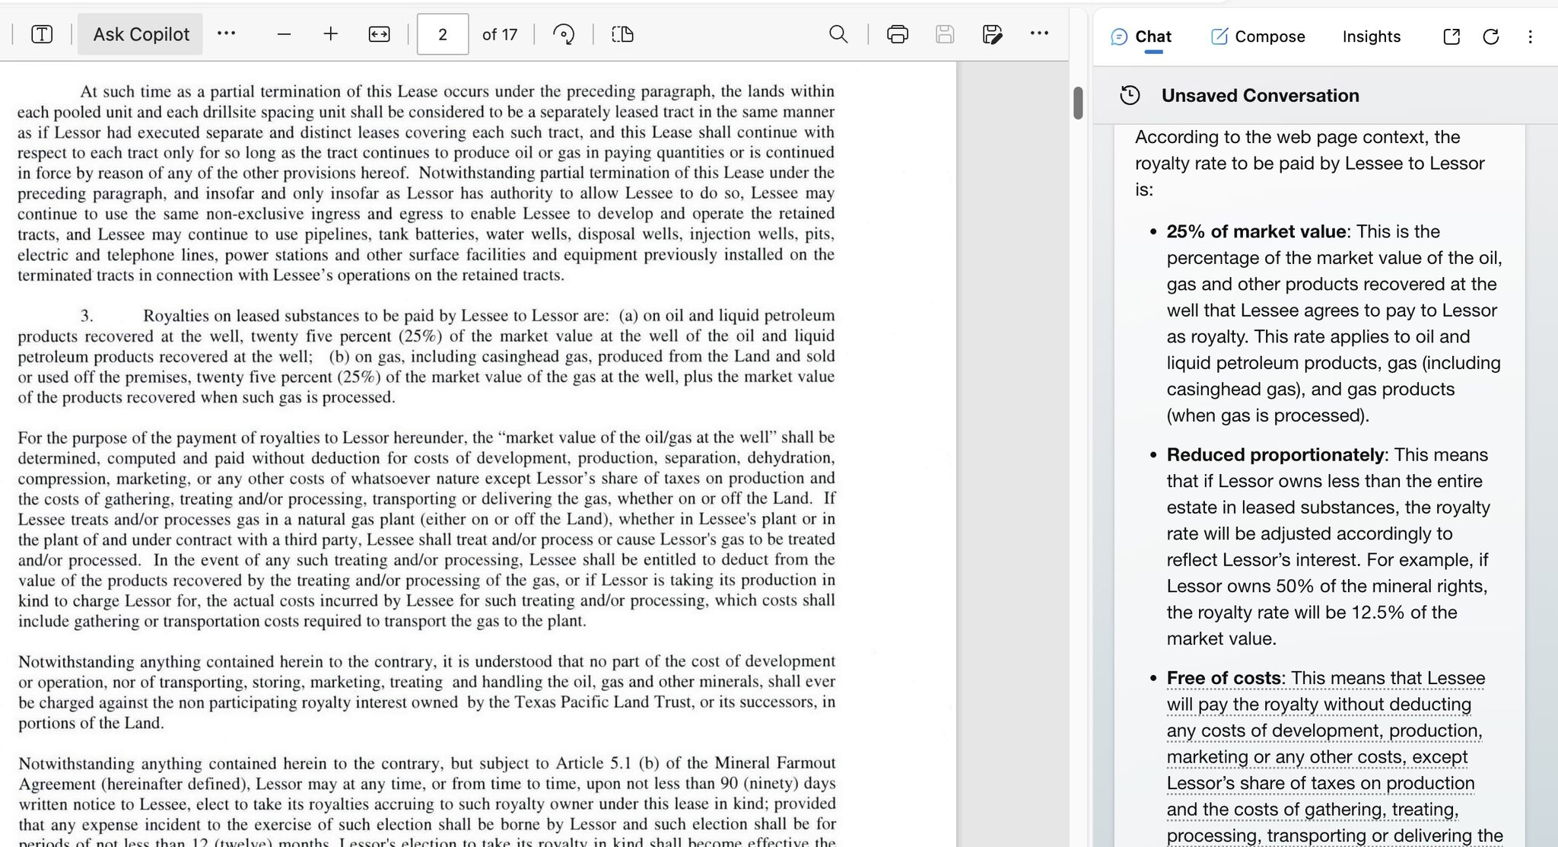
Microsoft Copilot in Edge Browser
Use the built-in PDF viewer to ask Copilot questions about your document.

Slide 22
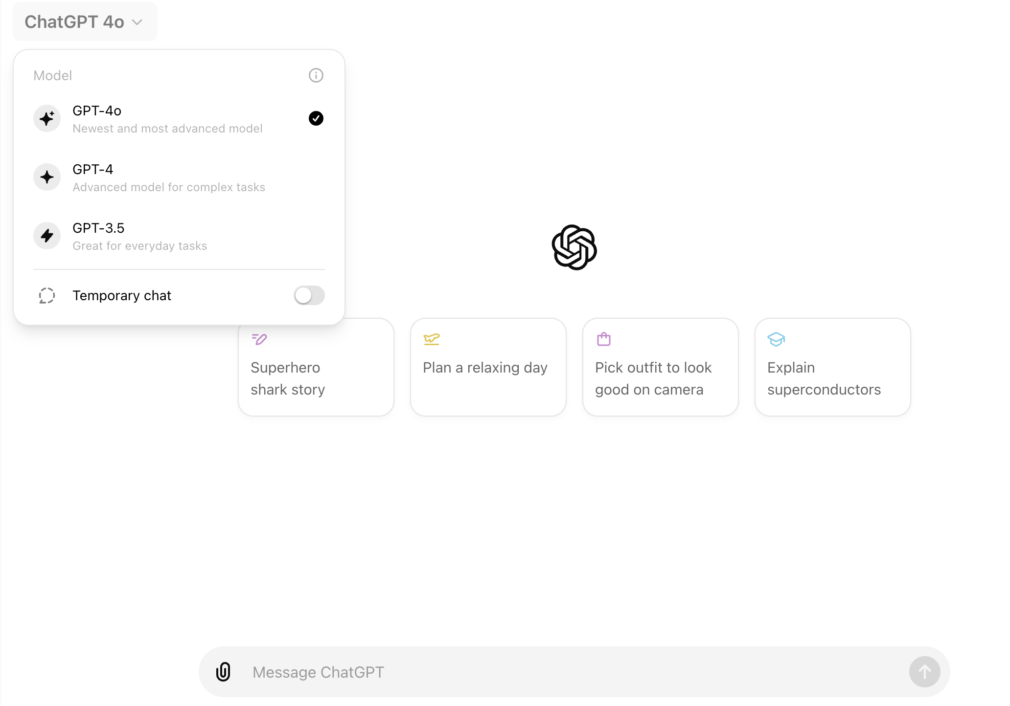
Tools to Try
OpenAI ChatGPT
Chatgpt.com

Slide 23
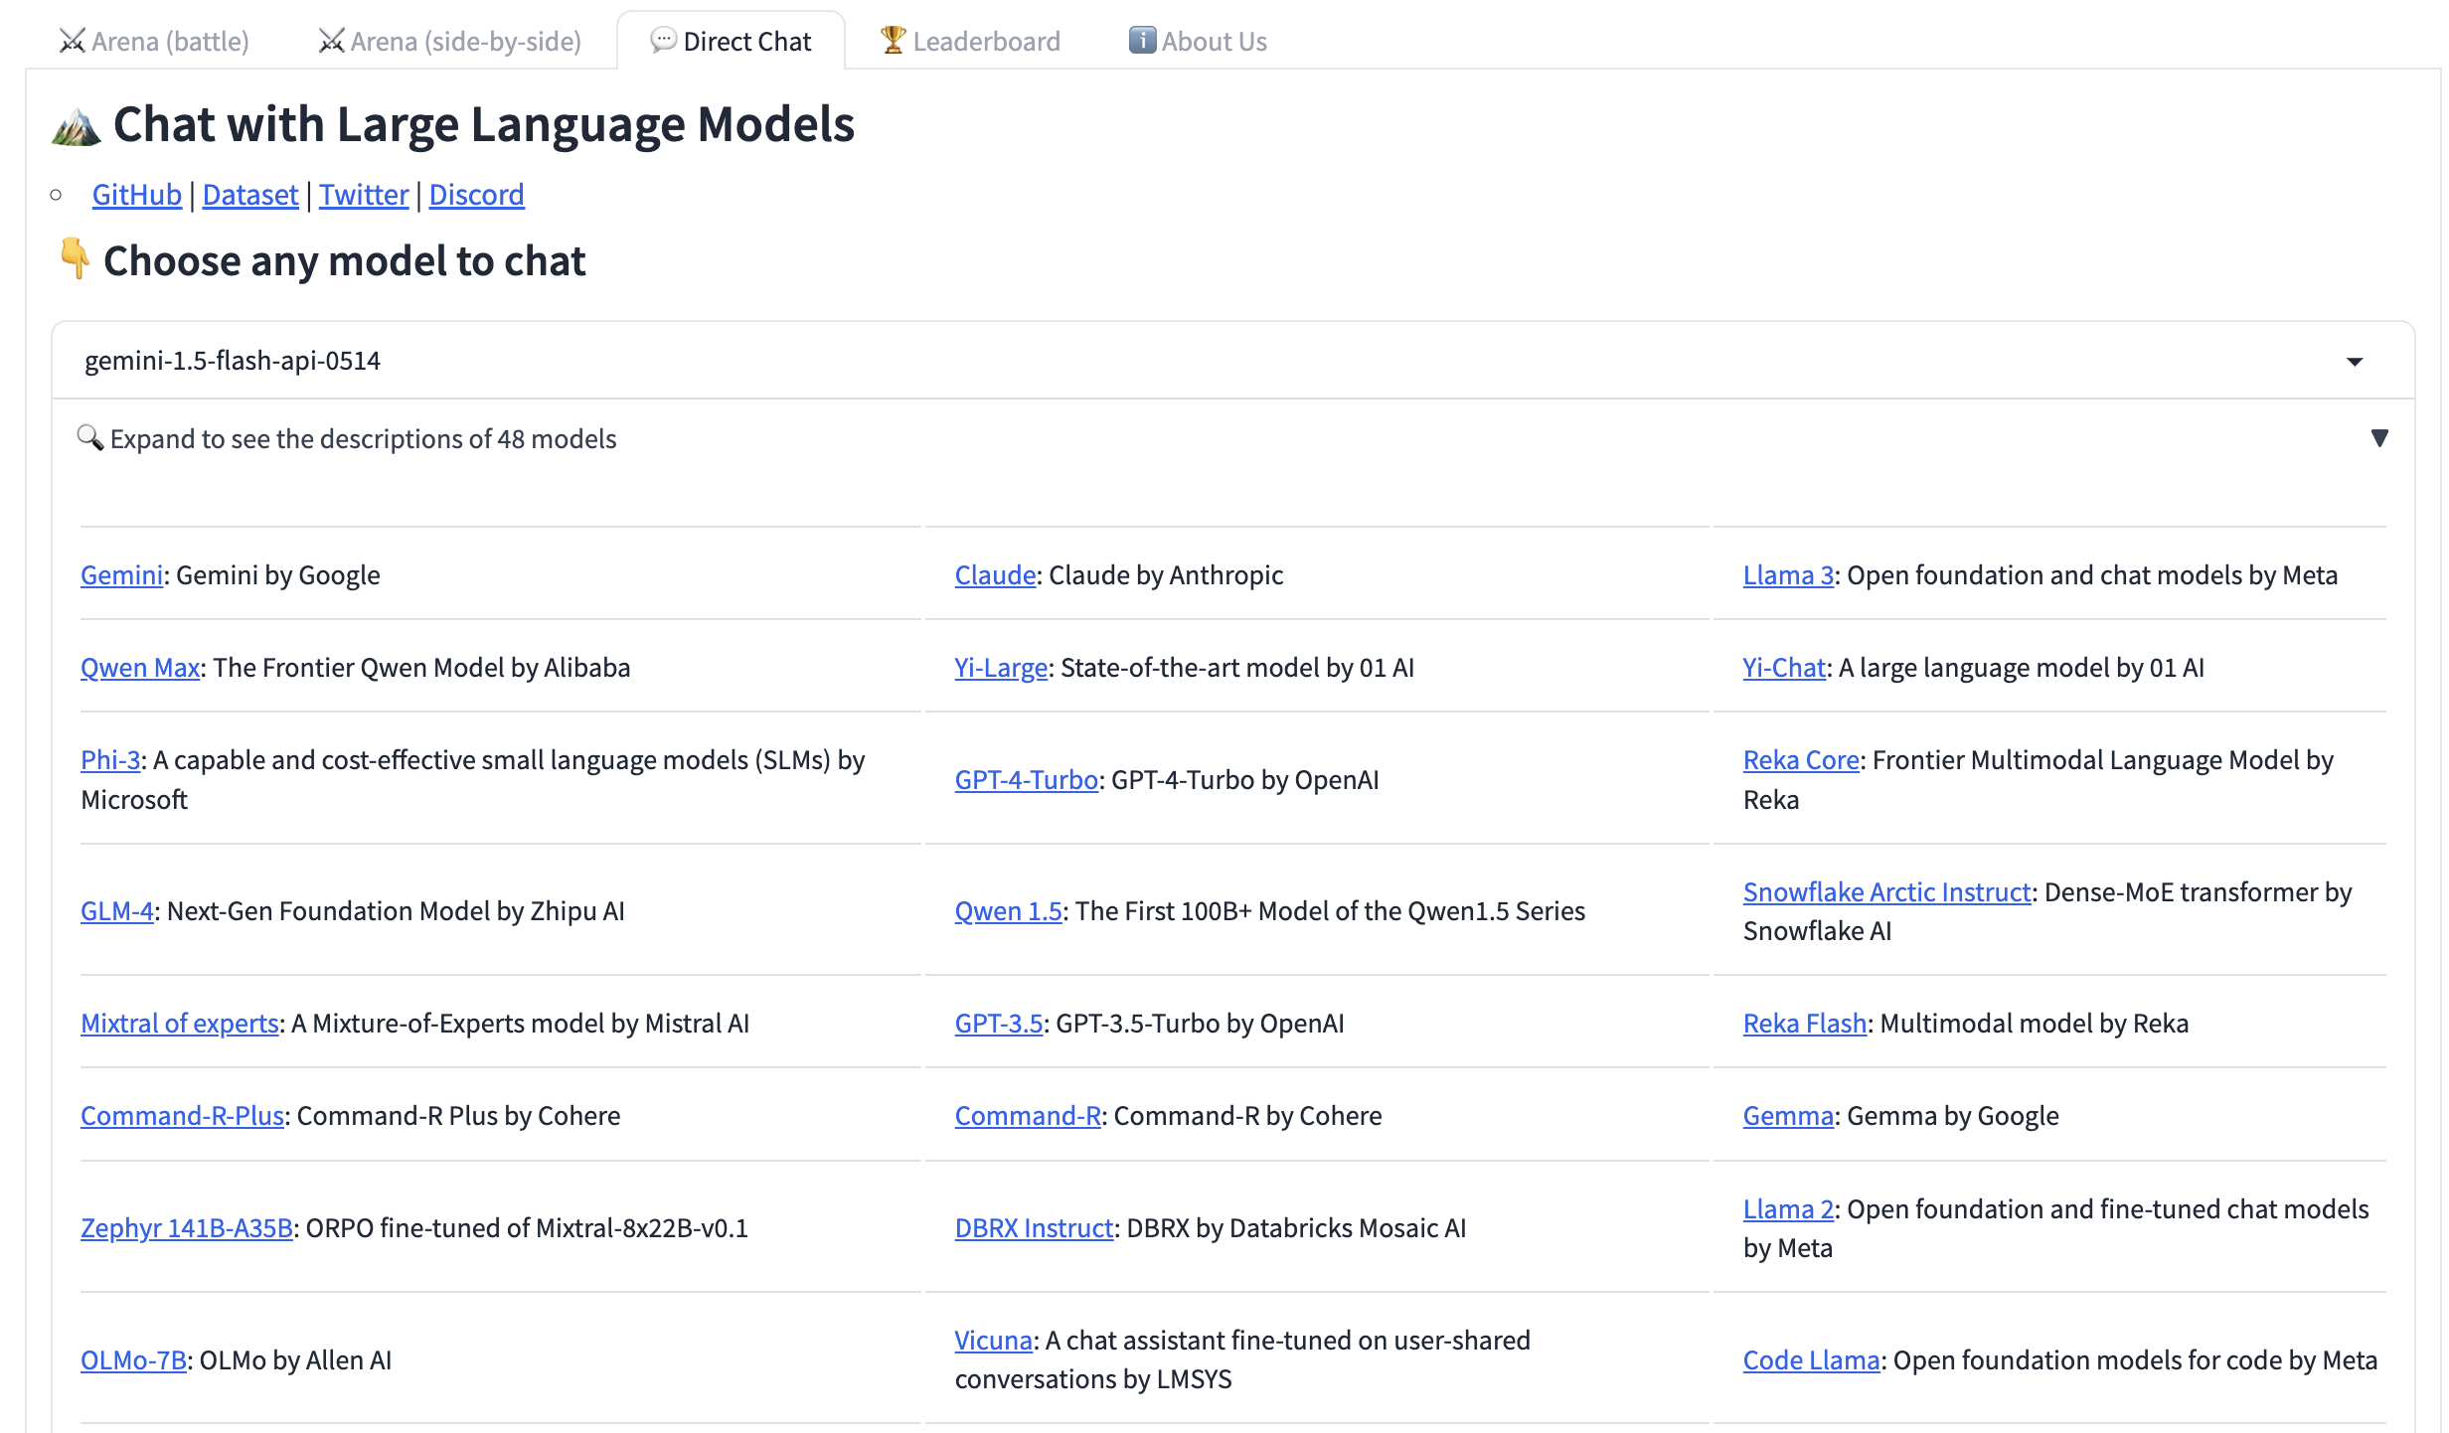
Tools to Try
LMSYS Chatbot Arena
chat.lmsys.org

Slide 24
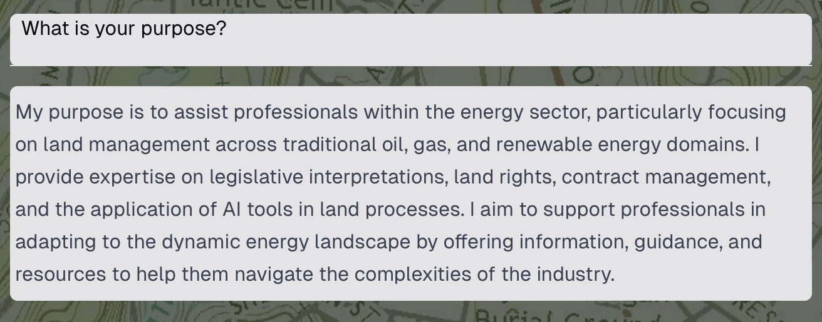
Tools to Try
Coming soon…
Rowland.ai

Slide 25
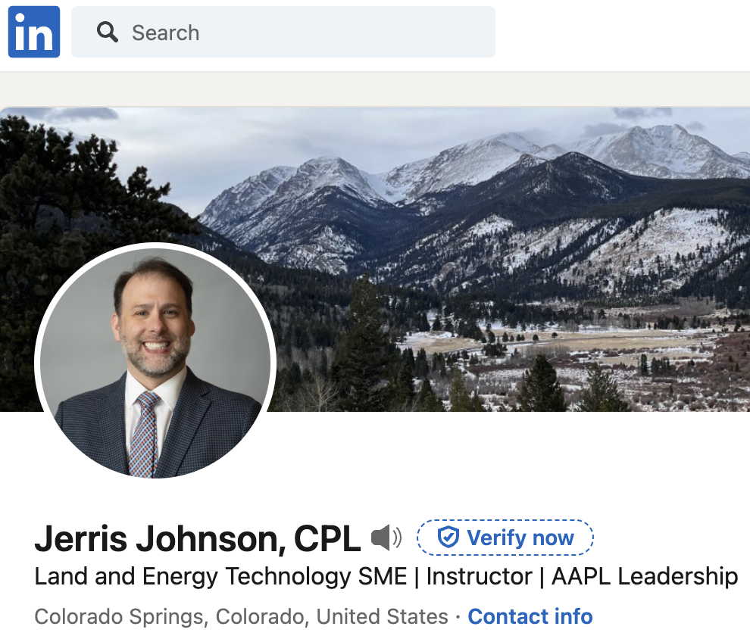
Stay in touch and be connected for more info…

